Slide 1
Profiles in Trauma Innovation:
Improving PIPS and SBIRT
Sponsored by Peregrine Health Services

Slide 2
Trauma Innovation
Housekeeping
Replay and Slides: Will arrive by email on Monday
Questions: Click the Q&A icon
Notes:
Bob does a few short previews.

Slide 3
Trauma Innovation
Angie Chisolm
Managing Partner
Peregrine Health Services
Notes:
Bob introduces the presenter.

Slide 4
Today’s Agenda
Level I-II Winner: PIPS
Level III-IV-V Winner: SBIRT
Audience Q&A
Notes:
Briefly preview the agenda.

Slide 5
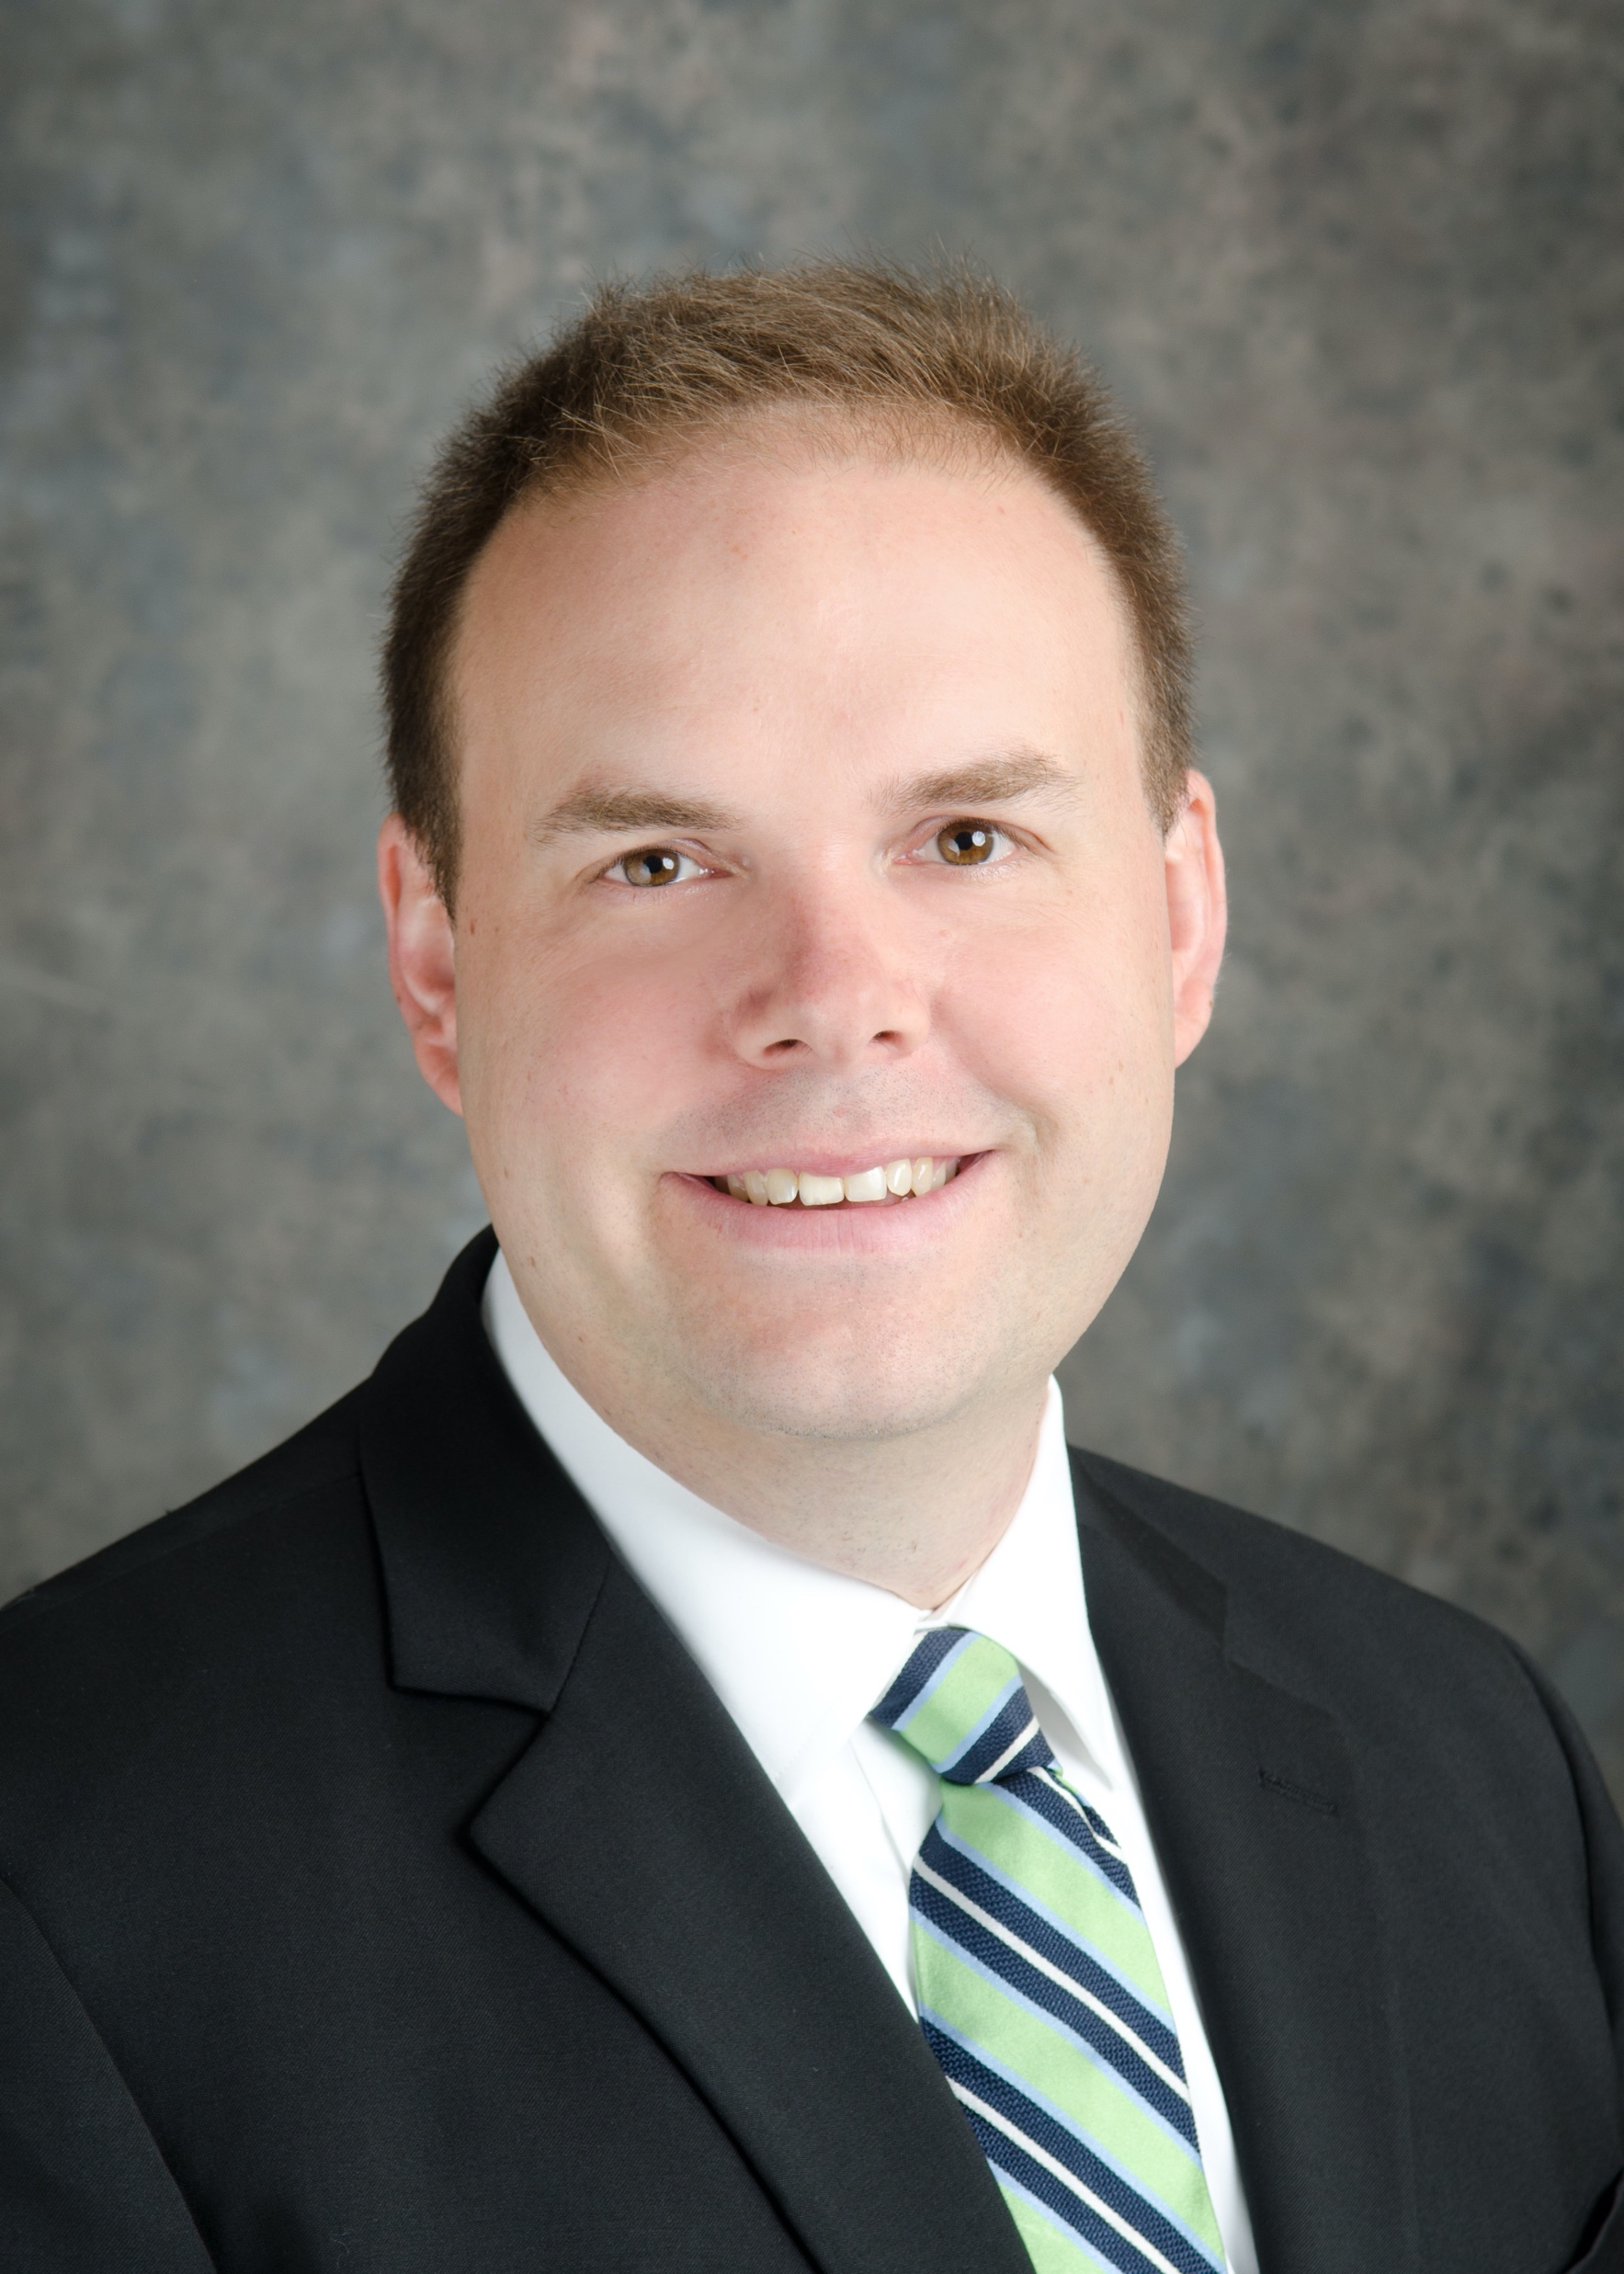
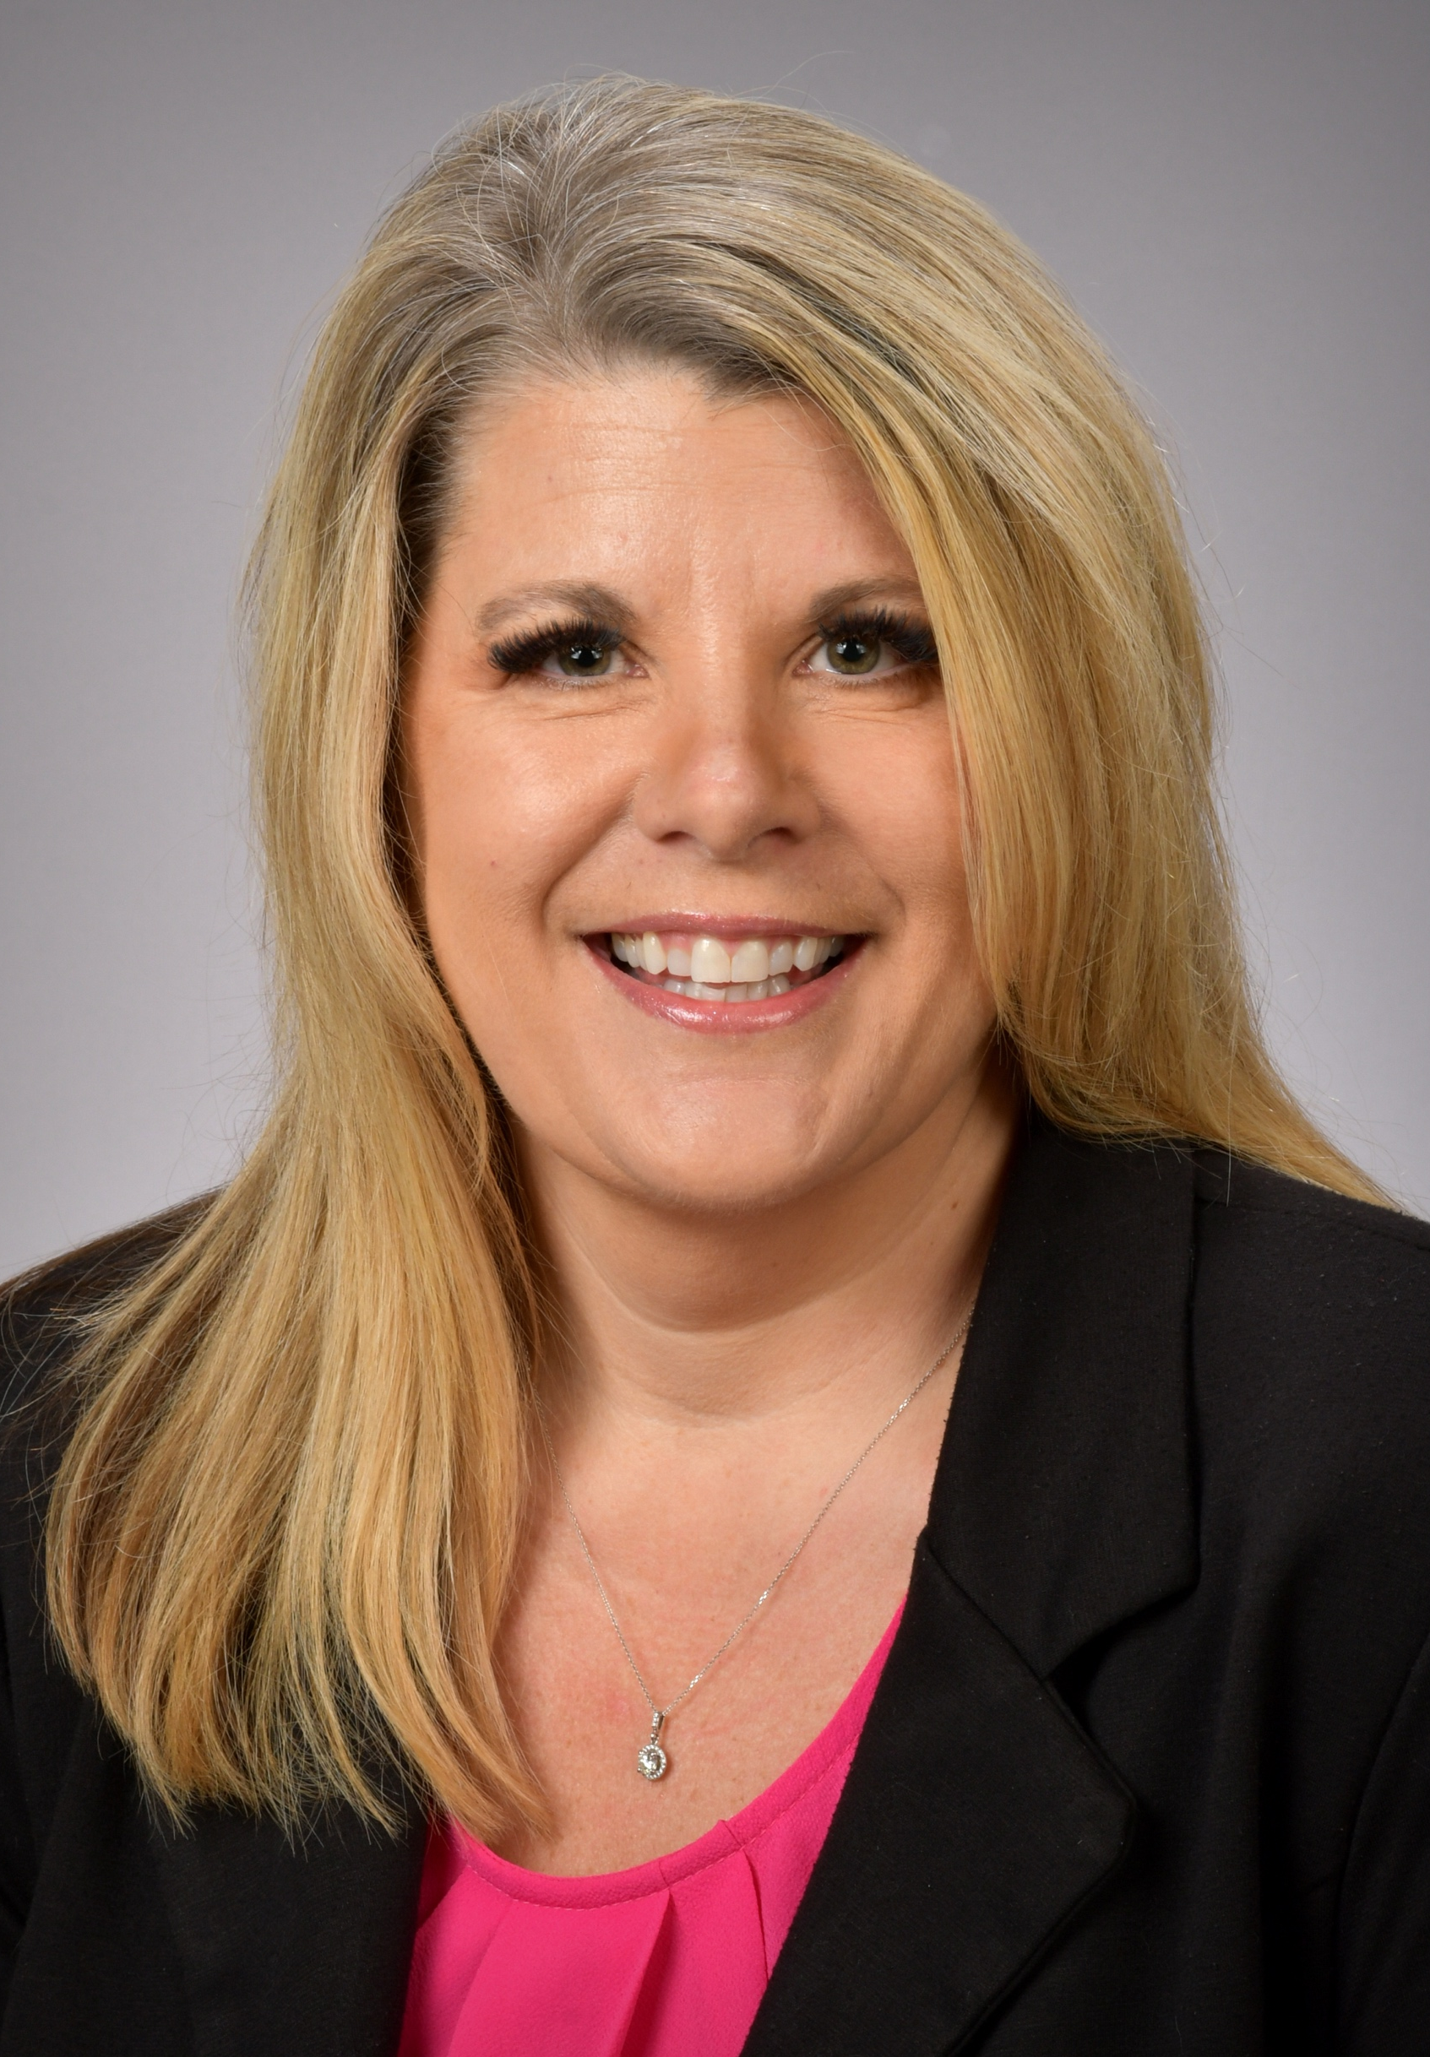
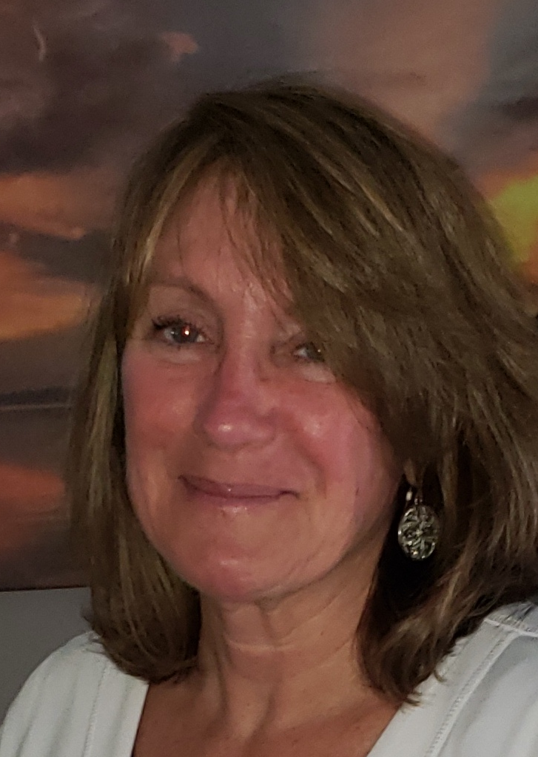
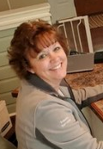
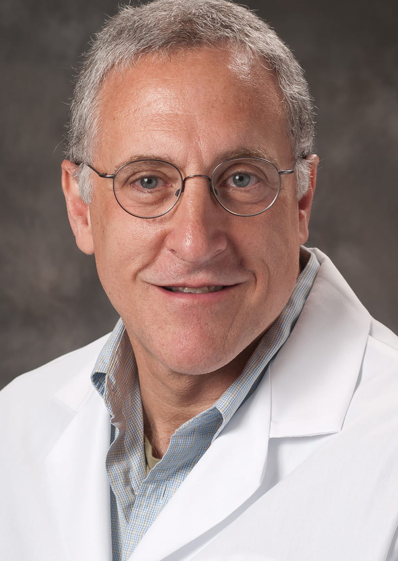
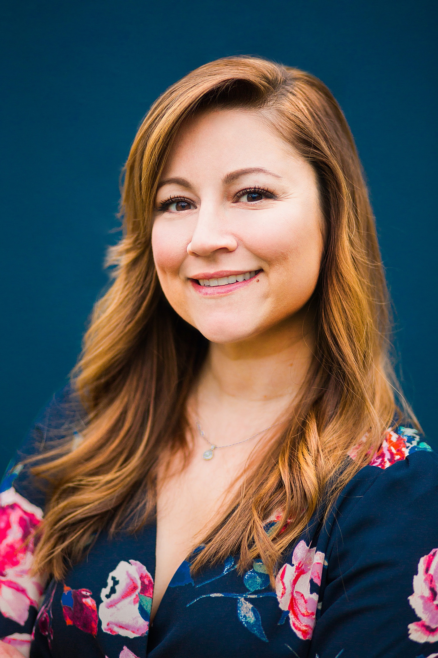
Panel of Judges
Dr. Peter Fischer
Trauma Medical Director, Regional One Health, Memphis, TN
Elizabeth Freeman Trauma Program Director, Atrium Health, Concord, NC
Debra Kitchens
Trauma Services Manager, Prisma Health, Greenville, SC
Brenda Medlin
System Database Administrator, Atrium Health
Dr. Barry Renz
Trauma Medical Director, Wellstar Cobb Hospital, Austell, GA
Stephanie Vega
Clinical Quality Specialist Lead, University of Colorado Hospital, Aurora, CO
Notes:
Introduce the webinar.

Slide 6
The Semifinalists
Advocate Aurora / “Geriatric Rib Fracture Initiative”
Dignity Health Saint Elizabeth and Mercy Redding / “Red Box Transfers”
Erlanger Health System / “Trauma Intensive Care Unit/Emergency Department RN Job Share”
HCA Florida Osceola Hospital / “Just-In-Time Training Using QR Code Technology”
Mukono Access Orthopaedic Clinic / “Extending Pre-Hospital Trauma Care to Lay Responders”
Postgraduate Institute of Medical Education & Research / “Setting Up an Early Ultrasound Guided Brachial Plexus Analgesia to Improve Value of Care in Complex Hand Injuries”
Providence St. Peter Hospital / “Breaking Through EMS Wall Times”
Stony Brook University Hospital / “Limitless Reach and Reduced Operational Burden:
Novel Approaches to Injury Prevention”
Notes:
Introduce the webinar.

Slide 7
Winner: Level I-II
UCHealth Medical Center of the Rockies
2023 Peregrine Award for Trauma Innovation
Level I or II Trauma Centers Category

Slide 8
Profiles in Trauma Innovation: Optimizing Performance Improvement through Development of a PI Dictionary
May 19, 2023
UCHealth Medical Center of the Rockies
Jamie Teasley-Bennett, BSN, RN, TCRN
Lead Trauma Nurse Clinician
Jes Cofran, MSN, RN, TCRN, CSTR, CAISS
Trauma Informatics Manager

Slide 9
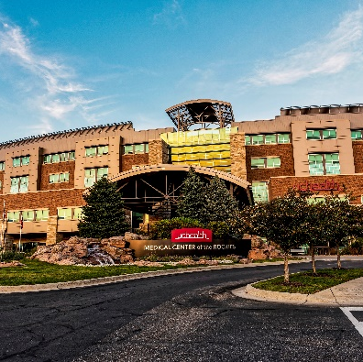
Medical Center of the Rockies
State Designated Level I
ACS Verified Level II Trauma Center
Annual inclusion volume ~1600
Large catchment area serving many urban and rural communities
Northern Colorado
Wyoming
Nebraska
Kansas
South Dakota

Slide 10
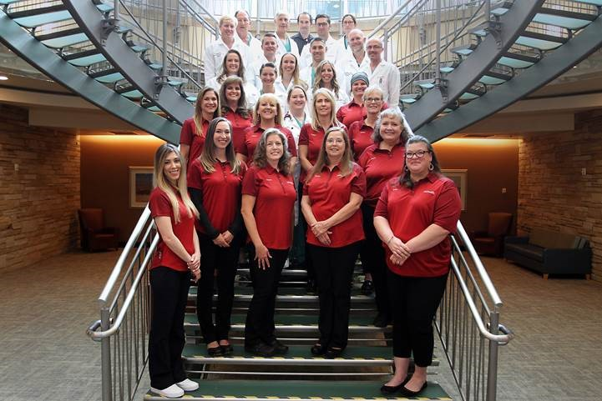

Slide 11
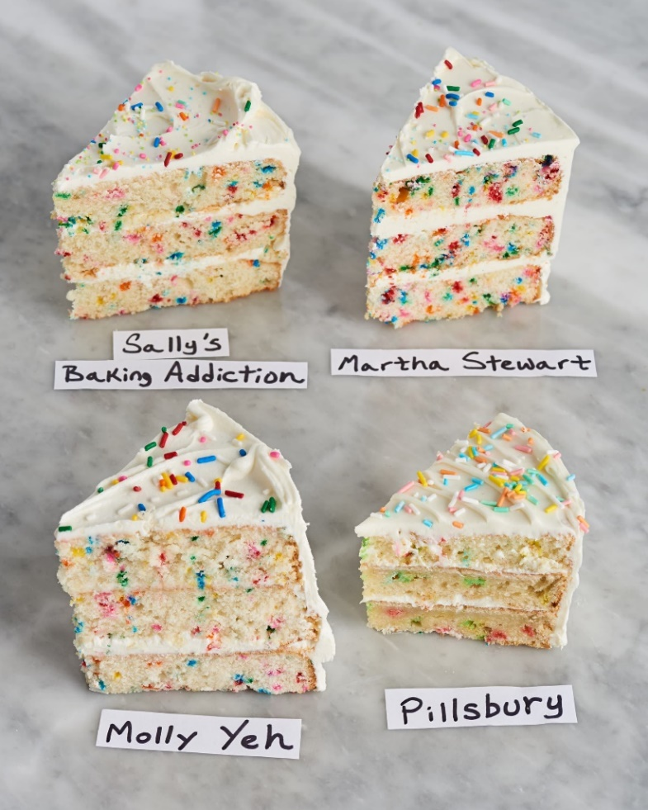
The Challenge
3 Trauma Nurse Clinicians
Recent role modification
Inconsistency in review of events
Between reviewers
Between records
Inconsistency of review documentation
Between reviewers
Between records
Notes:
I like the nailed it cakes but I’m open to the other cakes if you think the nailed it cakes will offend anyone

Slide 12
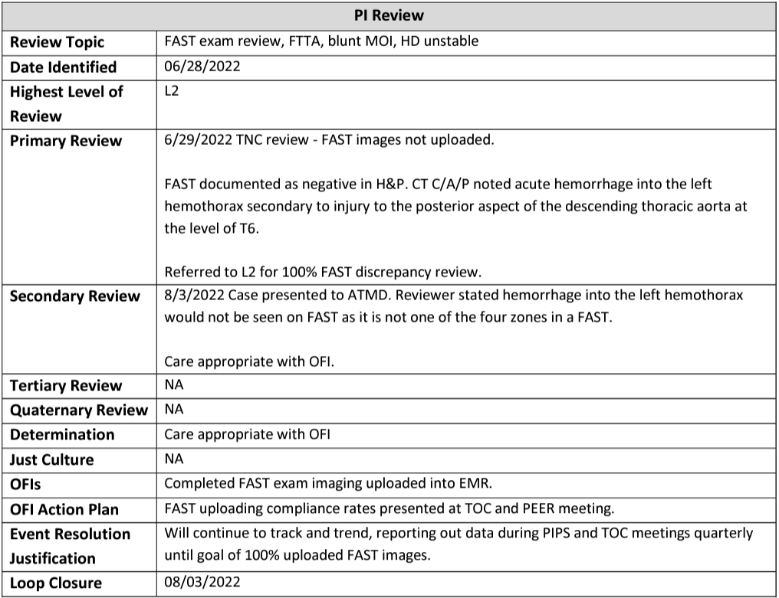
Modification of the PI screens in the Trauma Registry
Simplification of the PI screens within the trauma registry
Dedicated areas for each level of review
Reduction of redundant documentation

Slide 13
The Innovation: PI Dictionary
Comprehensive document
Framework for the review process
Defines audit filters
Guides appropriate documentation
Supports the PIPS process through loop closure
Notes:
A PI Dictionary may be a new concept to you but just like the NTDS Data Dictionary is the bible for the Trauma Registry, the PI dictionary should be the bible of your PI Plan.
The PI Dictionary provides a framework for the review process for each audit filter and defines the key components of the review that need to be addressed. The PI Dictionary provides standardized verbiage so that everyone on the PI team is consistent in their process and documentation for each audit filter.

Slide 14
Creating a PI Dictionary
Components
Benchmark Goal and Reporting Timeline
Audit Filter Name/Title
Level of Review
Standard Verbiage for PIPS Documentation
Considerations
Documentation of Opportunity for Improvement (OFI) and Event Resolution (Loop Closure)
Notes:
Any level trauma center can create a PI dictionary. Here are the components of our PI Dictionary:
Benchmark Goal (if applicable) is determined and cadence of reporting
AUDIT FILTER – Includes the Definition and Criteria for the audit filter. In our PI Dictionary, we have added Hyperlinked resources to some of our audit filters
Level of review - Who can close the issue?
Considerations - Standard verbiage to include HD#
- Appropriate per policy/guideline/SOP
- Inappropriate/OFI/review details
OFI/ OFI action items/Event Resolution Justification
Include timeframe in OFI action plan i.e., will review data in 3 months or 6 months, determined as appropriate for this fallout.
Future similar patients are less likely to experience this event because....
I.e., education was given to the provider and no further fallouts have been identified with this provider for the last 90 days.
Link to Just Culture algorithm*
*tertiary level of review ONLY

Slide 15
PI Dictionary Example
Benchmark Goal % (If applicable) Report out forum & cadence | CODE/AUDIT FILTER NAME Definition Hyperlinked resources | Level of review required Who can close the event? | Essential information (include in discussion) Hospital day number format: HD # MM/DD/YYYY | Standard verbiage or Considerations Appropriate per policy/guideline/SOP Inappropriate/OFI/review details | OFI & Event Resolution Action Plan: Include timeframe Event Resolution (Use only if OFI identified with OFI action plan) Future similar patients are less likely to experience this event because....
Goal: 85% CPG Compliance Trauma Operation Meeting Quarterly | OPEN_FX CPG Open Fracture (Antibiotics & Tetanus Administered) | L1 - Compliant TNC, TPM L2 - Deviation TPM, TMD | Open fx CPG followed? Injury details Treatment course and dispo Abx within 1 hour of arrival? Tetanus admin if appropriate? OR for I/D within 24 hours? | Standard L1 CPG compliance responses: (date) Care consistent with current Open Fracture Guideline. Care appropriate. (date) Care inconsistent with current Open Fracture Guideline. Referred to L2 for further review. Cases Referred to L2 review: [date] Care appropriate with acceptable deviation from current Open Fracture Guideline per provider clinical judgement. [date] TMD and TPM review -Case details reviewed. *Details* OFIs – Closed/Referred to L3 for further review. | OFI’s Action Plan: Specific to case OFI i.e. Education of ED staff regarding Antibiotic administration Event Resolution Justification: Increased compliance to Open Fx CPG through monitoring and reporting at PIPS meetings
Notes:
This first example is an audit filter for Clinical Practice Guideline (CPG) compliance of Open Fractures. This is taken directly from one of our PI Dictionaries in the region.
The first column is WHERE we report this audit filter and HOW OFTEN
The second column is the Audit Filter title, and we have a hyperlink to our Open Fracture CPG
The next column is the Level of Review. For this audit filter, if the CPG was followed then it can be closed at Level I or the Primary Level of Review by the Trauma Program Manager or the Trauma Nurse Clinician. If there is a deviation, the event is taken to Level 2 review with the Trauma Medical Director.
The next column is important because it defines WHAT we are looking for to determine compliance. For this audit filter, we will document the injury details, treatment and disposition. We are looking to see if antibiotics were given within 1 hour of arrival and if a tetanus was given if applicable. We also track to see if the patient had an I&D within the first 24 hours.
Our standard verbiage that we use is listed in the next column. Documentation will include the date and if care was consistent with the CPG. If not, it is referred to Level 2 for review. If the TMD determines the event to be an acceptable deviation, the case is closed at Level 2. If there are Opportunities for Improvement, then the case will be referred for Level 3 or tertiary level of review.
The last column is the action plan which will be specific to each case as well as how and where event resolution will be documented and reported out. For this example, we would track CPG compliance and expect an increasing compliance rate.

Slide 16
The Innovation in Action
Notes:
So let’s dig a bit deeper into how we use the PI dictionary in our normal workflow. How does it work in action?

Slide 17
“Drinking from the firehose” -is a metaphor explaining the experience of being presented with an overwhelming amount of new information while simultaneously attempting to understand, remember, and apply it.
Notes:
I know in trauma program we live by the .........drinking from a firehouse philosophy. If you do not know that term, it is defined as ( read above.) How many of you feel that is how you learned how to PI? How to do IP? Run a program, etc?
However, consider there might be a less painful way! Not that we have it mastered in any way, it’s a continuous journey of growth, re evaluation and so on and so on. To be completely transparent we just completed our ACS Level 1 Trauma Survey yesterday...yep yesterday literally and there were a lot of takeaways for we can hone in our PI and our constant survey readiness more successfully. However, I would love to offer you a walk through of the PI Dictionary .

Slide 18
Benchmarking
Event Identification
PIPS Process
Monitoring
Levels of Review
Compliance
Action Plans
Event Resolution
Notes:
Jes went through the vision of the tool. The PI Dictionary was thoughtfully created to take all of the pieces of a successful PIPS ( Performance Improvement Patient Safety) program into account, all of the requirements that are the expectation of our PIPS process. Each column is designed to cover all the bases.
Speak briefly on each.

Slide 19
NTDS Data
Dictionary
Clinical Practice Guidelines
PI Resources
Hospital Event Resource
Trauma Liaisons Letter Templates
Notes:
and then combines that with all of the necessary PI resources in one place. Speak to each in more depth.

Slide 20
Benchmarking
Event Identification
NTDS Data
Dictionary
Clinical Practice Guidelines
PI Dictionary
Monitoring
Levels of Review
Hospital Event Resource
Trauma Liaison Letter Templates
Compliance
Action Plans
Event Resolution
Notes:
And when you put it all together it = PI Dictionary.
Let’s quickly walk through a Hospital event

Slide 21
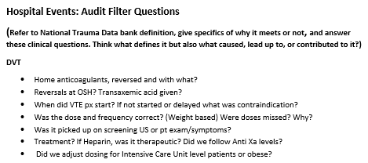
Hospital Event
Benchmark Goal % (If applicable) Report out forum & cadence | CODE/AUDIT FILTER NAME Definition Hyperlinked resources | Level of review required Who can close the event? | Essential information (include in discussion) Hospital day number format: HD # MM/DD/YYYY | Standard verbiage or Considerations Appropriate per policy/guideline/SOP Inappropriate/OFI/review details | OFI & Event Resolution Action Plan: Include timeframe Event Resolution (Use only if OFI identified with OFI action plan) Future similar patients are less likely to experience this event because....
TQIP Odds Ratio <1 Trauma Operation Meeting Quarterly | COMP_REV 100% Hospital Event Review using: 2023 NTDB Definitions | L1 - When treated appropriately per guidelines TNC, TPM L2 TPM, TMD | Refer to Hospital Event PI audit filter/critiques resource | L1 Review: [date] NTDB *Hospital Event* hospital event criteria reviewed. Appropriate interventions per standard of care. Does not Meet/Meets NTDB reporting criteria. [date] NTDB *Hospital Event* hospital event criteria reviewed. *Details* Referred to L2 for further discussion of hospital event. Cases Referred to L2 Review: [date] TMD and TPM discussed NTDB *Hospital Event* hospital event criteria. *Details* *Does not meet/Meets NTDB reporting criteria* Appropriate *Hospital Event* management. OR (date) TMD and TPM discussed NTDB *Hospital Event* hospital event criteria. *Details* *Does not meet/Meets NTDB reporting criteria* *Hospital Event* management. Referred to L3 for further discussion. | OFIs Action Plan Specific to the event Event Resolution Justification: Will continue to trend all NTDB hospital events for future reporting per PI plan and TQIP reporting cycle.
Notes:
Let’s take DVT for example. So, we have been monitoring and patient develops DVT lower extremity. How do we approach reviewing this? We need our PI resources. So, I am going to grab my NTDB data dictionary for starters so I can validate that this DVT truly meets the NTDB definition. Refer to dictionary.

Slide 22
PI Review
Review Topic | Complication Review- Deep Venous Thrombosis
Date Identified | 5/3/23
Highest Level of Review | L2
Primary Review | 5/3/2023 TNC review – NTDB DVT hospital event criteria reviewed. HD4 5/1/2023 -Trauma Surgeon notes RLE swelling, VTE prophylaxis held per Neurosurgery due to Spinal Cord Injury needing operative repair. -Bilateral upper and lower extremity duplexes revealed extensive DVT of L axillary artery, and right superficial thrombosis. -Neurosurgery okay w/heparin gtt, no bolus, and goal PTT 40-60 to start 8 hours after spinal drains are discontinued. -Drains removed 0930 5/2. VTE px planned to start at 1730 pm (8 hours post drain removal) -Family elected to transition to comfort care, therefore heparin gtt was not initiated. 5/9/2023 TNC presented case to TPM- Neurosurgery recommended no anticoagulant, antiplatelet or VTE chemo px on HD0. TS identified DVT by US and treatment recommended prior to decision to transition to comfort care. Referred to L2 for discussion of hospital event.
Secondary Review | 5/10/2023 Case reviewed by TMD and ATMD. Case presented by TNC. Reviewed US findings. Referred to NTDB data dictionary. - Reviewers feel the event does not meet NTDB defined criteria, due to DVT not being treated in light of family electing to transition to comfort care. NTDB definition includes identification and treatment of the DVT for the event to meet.
Tertiary Review | NA
Quaternary Review | NA
Determination | Care appropriate without OFI
Just Culture | NA
OFIs | NONE
OFI Action Plan | NA
Event Resolution Justification | Will continue to trend all NTDB hospital events for future reporting per PI plan and TQIP reporting cycle.
Loop Closure | 05/10/2023
Notes:
And here’s a look at how the Final output document looks.

Slide 23
Innovation Impact
Local
National
Streamlined Trauma PIPS processes
Ensured that we have standardized performance improvement processes and documentation
Improvement in trauma members’ understanding of PI action plans and loop closure
Team member satisfaction has improved
Provided regionalized approach to PI
Presented at 2022 TQIP Annual Conference
Template shared with over 30 Trauma Centers across the United States
Presented at Colorado Trauma Network 2022 Fall Meeting
Colorado Department of Public Health and Environment is sharing this across the state as best practice
Adopted into the American Trauma Society Trauma Program Management Course Curriculum
Incorporated into Society of Trauma Nurses TOPIC Curriculum

Slide 24
Thank you for the honor of this award

Slide 25
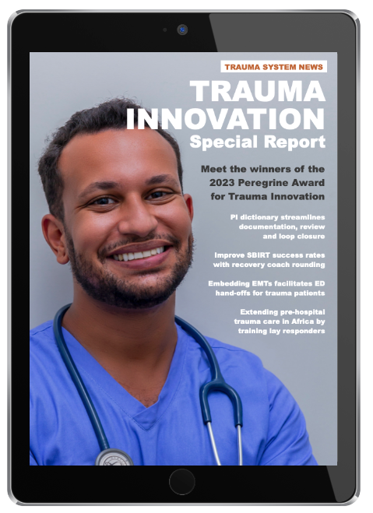
Trauma Innovation
Special Issue:
Trauma Innovation Special Report
Delivered by email to all subscribers on June 5
Notes:
Bob will do this part.

Slide 26
Winner: Level I-II
Franciscan Health Crown Point
2023 Peregrine Award for Trauma Innovation
Level III, IV or V Trauma Centers Category

Slide 27
Improving SBIRT Process with Recovery Coach Rounding
Continuing Christ’s Ministry in Our Franciscan Tradition

Slide 28
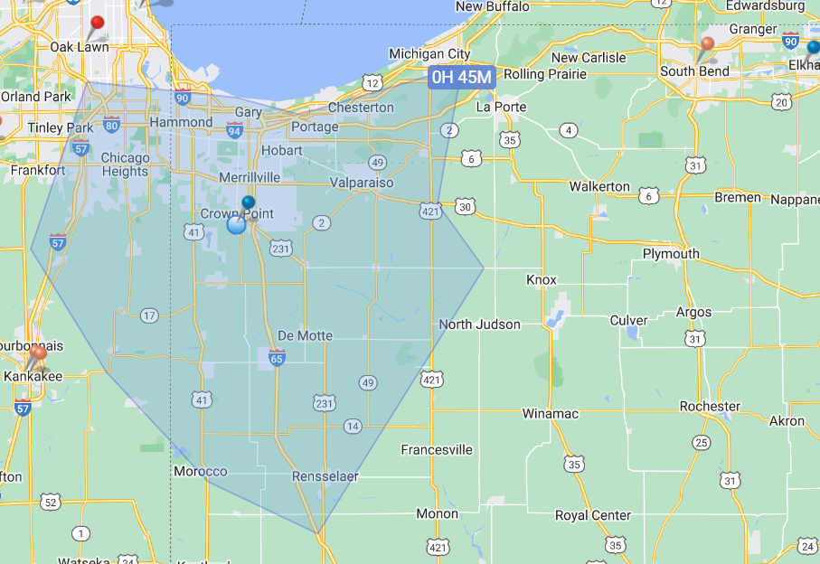
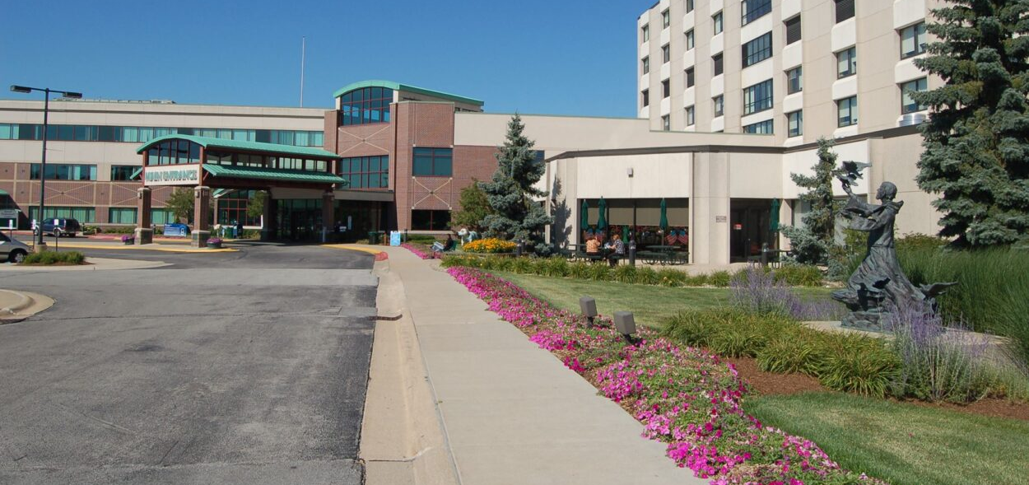
About Us
Level 3 ACS-verified trauma center
Located in Crown Point, Indiana
Known as “The region”
Annual registry volume approximately 1,000 patients
ER volume approximately 34,000 annually
98% blunt trauma

Slide 29
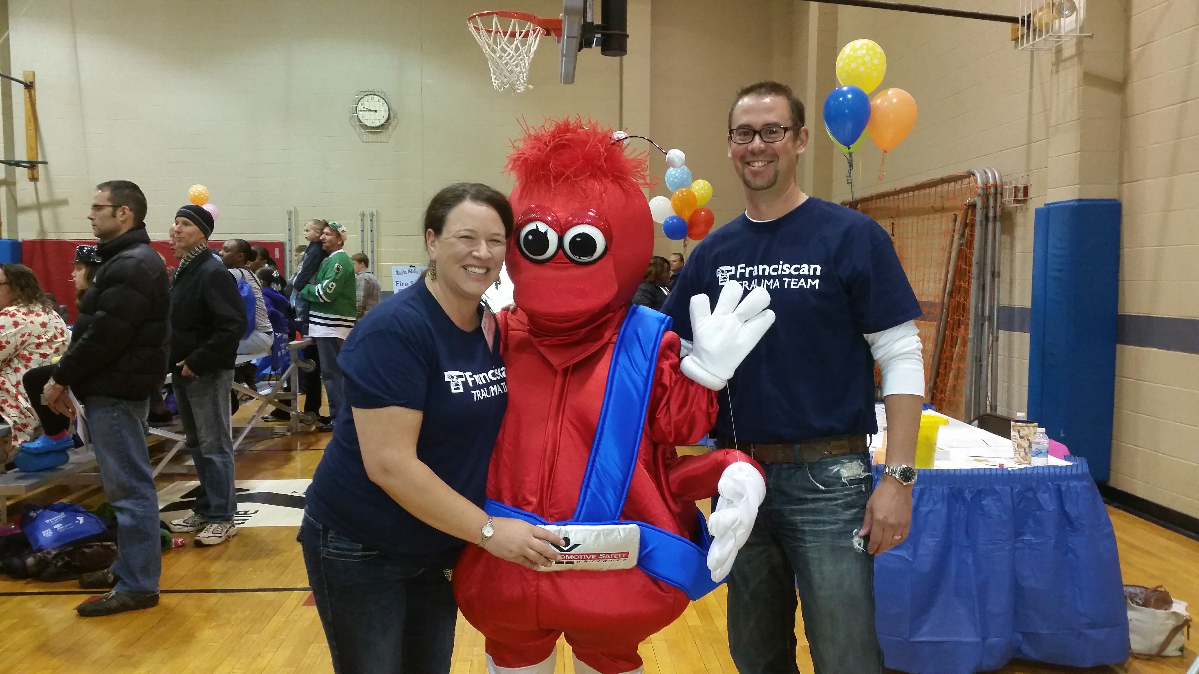
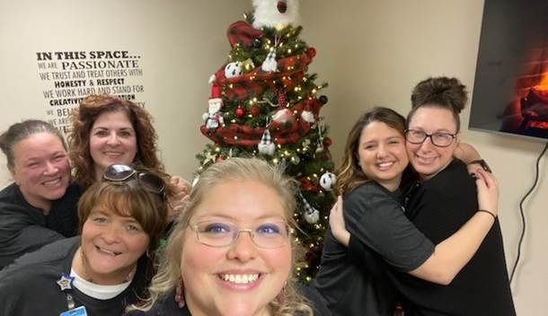
Our Team
Trauma Medical Director $
Trauma Program Manager $
PI Coordinator $
2.6 registry FTE $
1.0 Injury Prevention Coordinator
1.0 Licensed Social Worker
0.7 Peer recovery

Slide 30
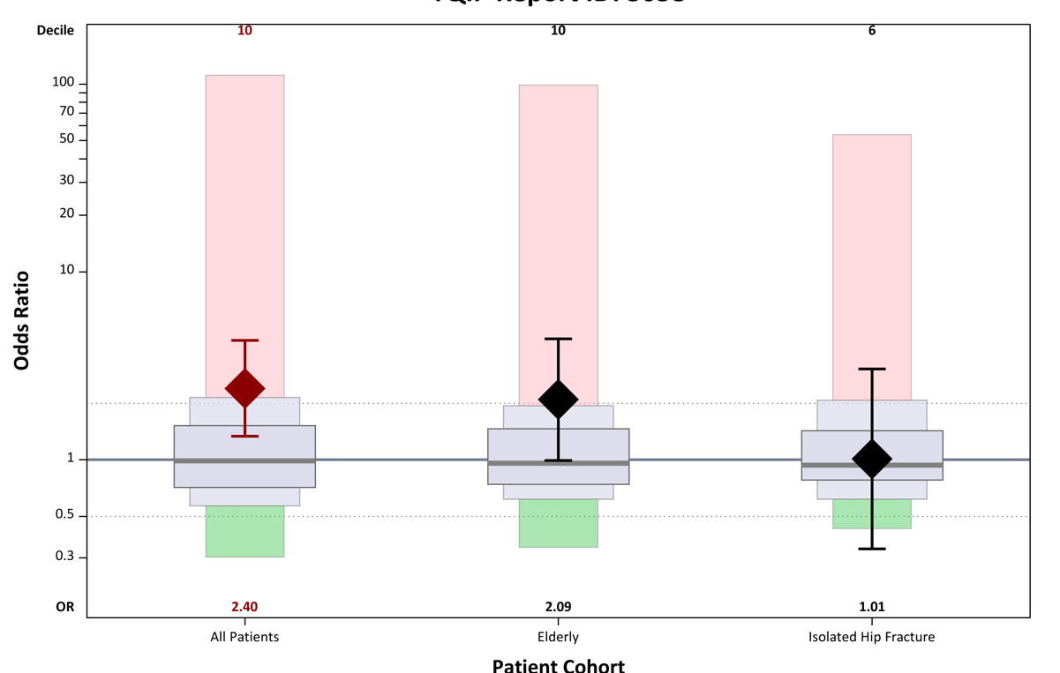
Opportunity

Slide 31
Opportunity
Improve SBIRT Process:
Optimize electronic medical record
Ensure the right person is doing the SBIRT
Increase referrals for treatment
Ensure referral arrangements are completed for patient
Identify baseline knowledge of healthcare staff related to substance use disorders

Slide 32
New Process
Identify patients that have substance use disorders in the ED or inpatient units
Social worker/peer recovery coach complete the Screening Brief Intervention and Referral for Treatment process.
Round on inpatients with substance use disorders daily
Implement Peer support
Meet patients where they are in terms of readiness for recovery
Journaling
Harm Reduction
Arrange treatments after discharge
Provide education on harm reduction to patients and families
Provide healthcare and community education about substance use disorder

Slide 33
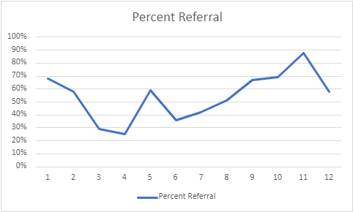
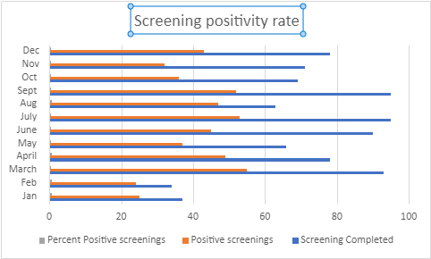
Results

Slide 34
Next Steps
Medication assisted treatment
SMART recovery groups
Follow-up care
Repeat screening (PTSD, depression)

Slide 35
Grants
A great source of funding for your department
Multiple little grants can equal significant funding
Look for opportunities:
National/state
Community foundations
Local business partners
Create a goal and plan
Notes:
Our trauma service has received approx. $200,000 in funding every year for the last several years. We develop stronger funding bases annually and gain new strategic partners in the community.
The partnerships help to maintain the Injury Prevention program. That aspect of the program is fully funded by 2.7 FTE which include the Peer coach, social worker and the injury prevention coordinator..

Slide 36
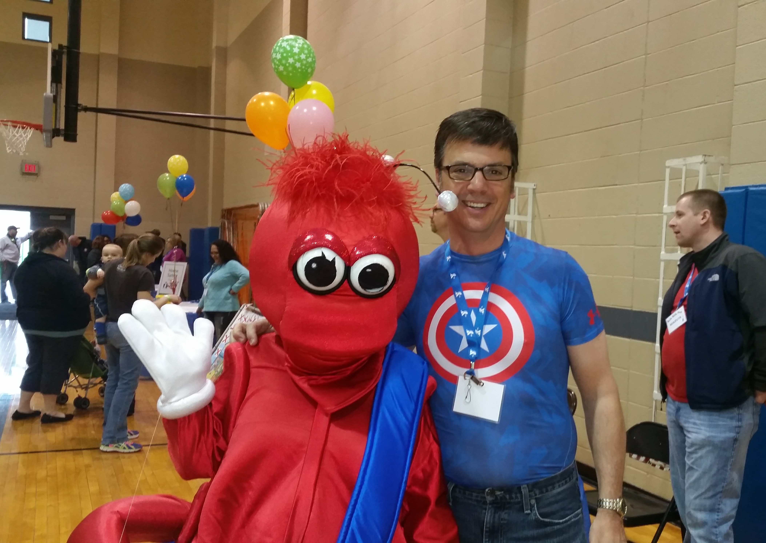
Funding
Understand your mission, vision, and values
Know your leadership team
Establish meeting with your foundation
How can we help YOU?
Notes:
We report our injury prevention initiatives to the hospital Community benefit program for any parts of the program that come from our budget. This helps to quantify and maintain the not for profit requirements

Slide 37
Trauma Innovation
Questions
Click the Q&A icon

Slide 38
Trauma Innovation
Do you have more questions
for the award winners?
You may contact them directly at:
Jessica Cofran / jessica.cofran@uchealth.org
Jamie Teasley / jamie.teasley@uchealth.org
Jennifer Homan / jennifer.homan@franciscanalliance.org

Slide 39
Trauma Innovation
Nominate Your Team:
The 2024 Peregrine Award
for Trauma Innovation
Watch for Information Later This Year

Slide 40
Trauma Innovation
Thank You
Monday: Replay and slides
Right now: Exit survey

