Slide 1
TSN Webinars
Emergency Department Leadership:
Breaking Out of
The New Vicious Cycle

Slide 2
TSN Webinars
Housekeeping
Replay: Link will arrive by email tomorrow
Notes:
Bob does a few short previews.

Slide 3
Expert Panel
Beth Fuller
Managing Partner
Peregrine Health Services
Dan Collard
Co-Founder and Partner
HealthCare Plus Solutions Group
Mark Feinberg
Managing Partner
Peregrine Health Services
Notes:
Bob introduces the presenter.

Slide 4
Survey Results
May 2023 Survey:
ED Management Challenges
Notes:
Introduce the webinar.

Slide 5
Survey Results
Which of the following ED management challenges are a significant concern in your hospital?
Notes:
Introduce the webinar.

Slide 6
Survey Results
Could you explain your answer?
“Our biggest challenge is nurse turnover, and we have a lot of difficulty hiring staff.
All staff are being asked to do more with less. This makes it difficult to work on
any improvement initiative and it impacts morale.”
“There are not enough experienced preceptors to go around.
We have inexperienced nurses at triage and trauma who are making mistakes,
but they were pushed into these roles because experienced nurses have left.”
“ED burnout is the number one reason RNs change jobs,
and onboarding a new RN to the ED take so much time (6 months or more).
The amount of management work required to keep staff in the ED is tremendous.”
“Everything adds to and compounds the problems. Experienced staff leave,
which puts more stress on the newer nurses.
Those stressed nurses burn out and eventually leave.”
Notes:
Introduce the webinar.

Slide 7
The Vicious Cycle
High percentage of new leaders (lack experience)
Low support of staff
Unreal expectations of staff
Work-life balance / burnout
Staff turnover / vacancy

Slide 8
ED Leadership
Precision Leadership Development

Slide 9
ED Leadership
What We Know
30% to 40% of healthcare leaders are new to their current leadership role
Those who became leaders during the pandemic were not onboarded in a traditional manner — and they typically did not receive mentorship as they would have previously
Many had to “staff in” to augment their teams’ schedules

Slide 10
ED Leadership

Slide 11
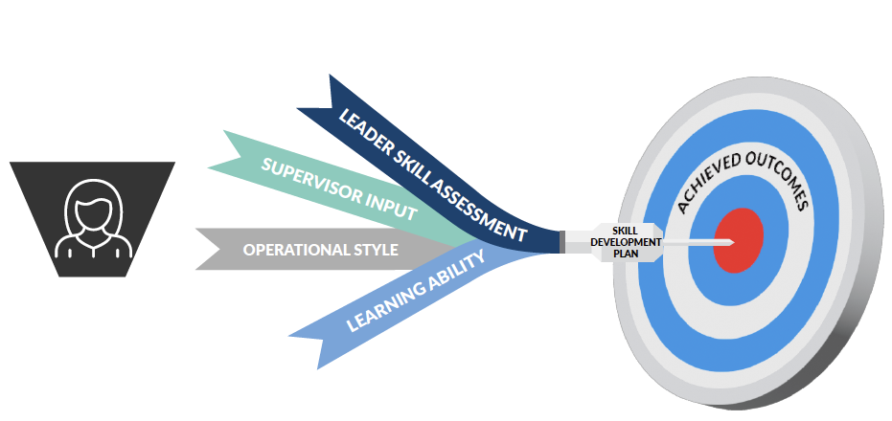
ED Leadership

Slide 12
ED Leadership
OSAR™
Name: |  |  | Date: 6.28.23
OUTCOME | SKILL(S) | ACTIONS | RESOURCES
What is the outcome you want to achieve? | What skill(s) do you want to master? | What actions will you take to achieve this outcome? | What resources will be used to build these skills?

Slide 13
ED Leadership
Coaching and Mentoring

Slide 14

Positive psychology
Empathy
Kindness
Gratitude
Mindfulness
Social events

Slide 15
TSN Webinars
Break
Notes:
Bob will do this part.

Slide 16

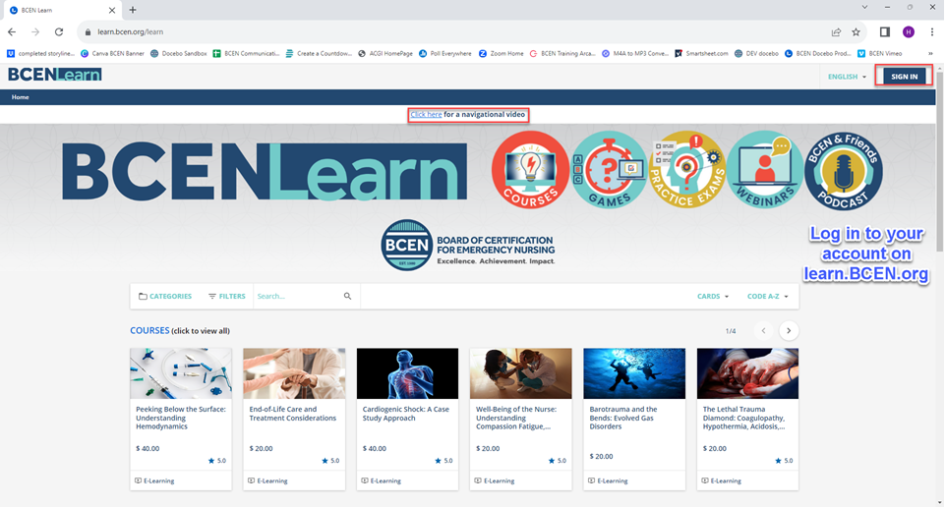






Flexible, Convenient and Respected Continuing Education for Nurses
Courses | Practice Exams | Free Webinars | And More!

Slide 17
ED Leadership
Building Leader-Staff Relationships
Replenishment vs. Resilience

Slide 18
ED Leadership
Replenishment Exercises
Share why you chose to work in healthcare.
Share why you chose to stay in healthcare.
You could work anywhere.
Why do you continue to stay at ______ Hospital/Health System?
Share with the team a time when you felt like you belonged.

Slide 19
ED Leadership
Bringing Value to Huddles
1x week, ask everyone to share a specific win from the last week
1x week, ask everyone to share a specific one thing for which they are grateful

Slide 20
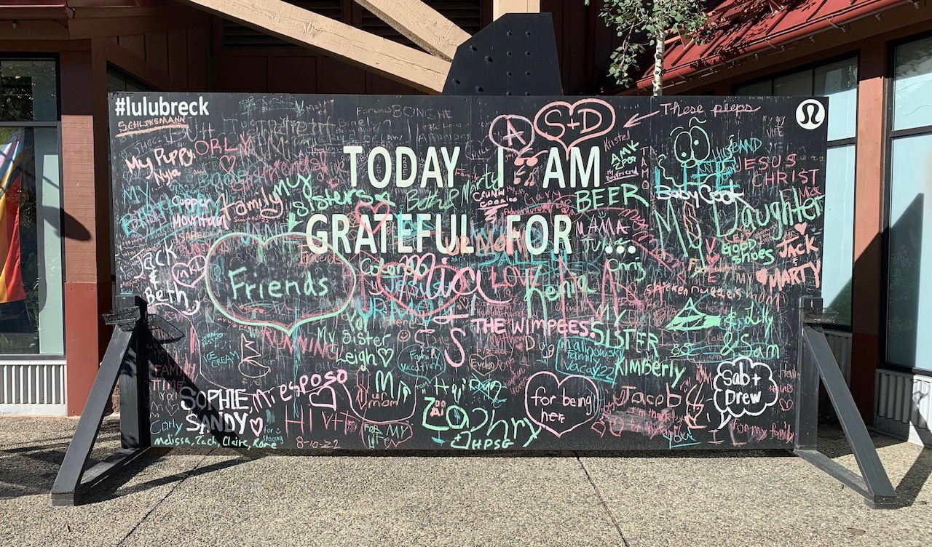
ED Leadership

Slide 21
ED Leadership
Leveraging Interim Leadership

Slide 22

Leadership void

Slide 23

Interim Leader
Benefits
  Fresh set of eyes
  Opportunity for change
  Time to hire
  Handover time
  Novice leader coaching

Slide 24
ED Leadership
Building Relationships with Support Services
What’s It Look Like Today?
Which Support Services Department Is the Very Best?
Which One Lags?

Slide 25

ED Leadership
The “Open-Book Test”

Slide 26
ED Leadership
Pick a person, group of people or department: ____________
If I considered this person/group/department to be one of my most important customers, I would do the following differently in order to better serve them and our mission:
__________________________________________________
__________________________________________________
__________________________________________________
If this person/group/department considered me to be one of their most important customers, I would ask them to do the following in order to better serve me/our mission:
__________________________________________________
__________________________________________________
__________________________________________________

Slide 27
TSN Webinars
Your Questions
Click the Q&A icon

Slide 28
TSN Webinars
Thank You
Replay and presentation
Exit survey

Slide 29
TSN Webinars
Contact Information
Beth Fuller: beth.fuller@peregrinehs.com
Dan Collard: dan@HealthcarePlusSG.com
Mark Feinberg: mark.feinberg@peregrinehs.com

