Slide 1
TSN Webinars
Case Study:
How a Level I Trauma Center Got
IR Response Times Under 60 Minutes

Slide 2
TSN Webinars
Housekeeping
Replay: Link will arrive by email tomorrow
Notes:
Bob does a few short previews.

Slide 3
SPEAKERS
Ann Quinlan, RN, MSN, TCRN
Director of Trauma, Burn and EGS
Texas Health Harris Methodist Hospital Fort Worth
Jennifer Grant, MD, FACS
Trauma and Critical Care Surgeon
Texas Health Harris Methodist Hospital Fort Worth
Notes:
Bob introduces the presenter.

Slide 4
TSN Webinars
Poll
What is your center’s average “decision to needle”
time for IR hemorrhage control?
Notes:
Bob does a few short previews.

Slide 5
DISCLOSURES
Texas Health Harris Methodist
No conflict of interest
No financial conflicts

Slide 6
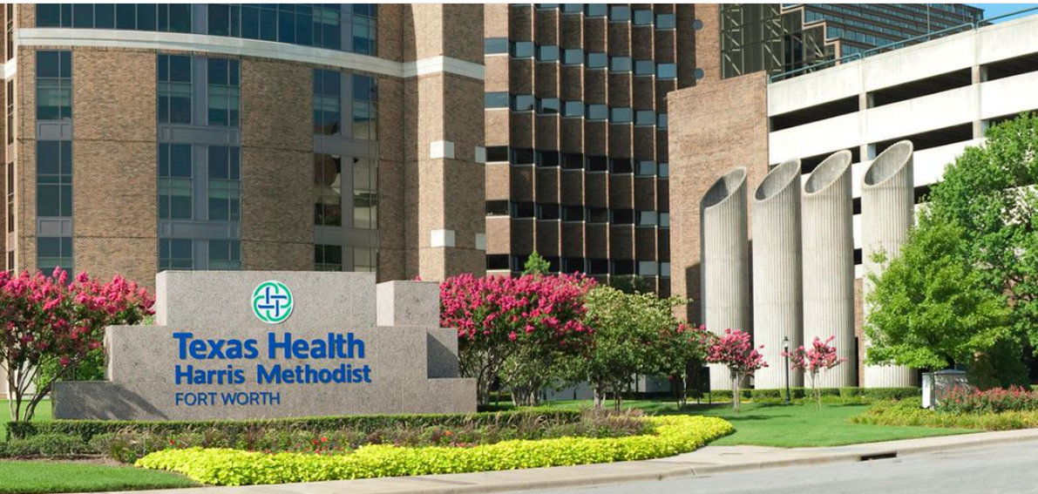
Texas Health Fort Worth
743-bed tertiary care center
Verified Level I in January 2023
ED annual census over 130,000
6,280 trauma registries in 2022

Slide 7
CASE STUDY
Issue
Standard 4.15: IR decision to needle within 60 minutes
Unable to meet unless staff in house

Slide 8
CASE STUDY
Process Review
Root cause analysis to identify issues in process completed in September 2021
Delay in communication found to be the predominant challenge
All portions of process reviewed:
Notification of radiologist
Notification of IR staff
Arrival times of staff and physician
ED packaging to leave room
Transport times
Room set up
Notification of anesthesia

Slide 9
CASE STUDY
Definition of Consensus
Consensus is…
Finding a solution acceptable enough that all team members can support it — no team members oppose it
Consensus is not…
a unanimous vote — consensus may not represent everyone’s first priorities
a majority vote — in a majority vote, only the majority gets something they are happy with; people in the minority get something they don’t want at all, which is not what consensus is about
everyone is totally satisfied
Scholtes, Peter R. The Team Handbook.
Madison, WI, Joiner Associates, Inc., 1989.

Slide 10
An Opportunity for Everyone to Speak Up

Slide 11
CASE STUDY
Process Change: September 2021
IR staff call the Trauma Nurse Clinician when they are en route after activation
Patient is packaged and taken to IR so the patient is present when IR staff arrive

Slide 12
CASE STUDY
Issues
Communication: no program found to solve time issues in process
ED team waiting in hallway with critical patient and no access to IR room
ED/trauma team not familiar with location of supplies
IR staff arrive at various times, so ED staff had to stay until full IR team arrival to care for patient, no anesthesia in the room

Slide 13
CASE STUDY
Process Change: December 2021
Multidisciplinary meetings and staff input
ED/trauma team leaves room 15 minutes after IR notification, notifies anesthesia
Team goes to IR designated room
Anesthesia is present on arrival
ED team stays until an IR staff arrives

Slide 14
Process Change: December 2021
Decision for IR identified
ED secretary calls Radiology answering service
Answering service calls radiologist
Radiologist calls trauma surgeon back
Discuss case
Radiologist has to log into computer at home to review films
Agreement reached, IR staff called in, Anesthesia notified through OR desk
Staff leaves with patient for IR suite

Slide 15
CASE STUDY
Success: Ask the Right Question
October 2021:
Viz.ai process for stroke identified as successful model
Company contacted for trauma application
July 2022:
Completed process for trauma IR cases and implemented at THR Ft. Worth
Education on process delivered to trauma surgeons/team
Results:
Improved time documentation with texted chat
Consistently under 60 minutes when Viz used (except 1 late staff arrival)

Slide 16
Viz Trauma Suite Process
Decision IR needed
Push button on smartphone app, connects directly to on-call radiologist
Films available in app on smartphone (high-quality CT, CTA, MRI, etc.)
Radiologist pushes button, IR staff notified via app
Staff leaves 15 minutes after agreement and takes patient to IR
HIPAA-
compliant platform

Slide 17
TSN Webinars
Break
Would you like to be contacted by someone from Viz.ai
to learn more about Viz Trauma Suite?
Notes:
Bob does a few short previews.

Slide 18
TSN Webinars
Trauma Surgeon Perspective
Using Viz Trauma Suite to review imaging, activate IR
and communicate in real time with the entire team
Notes:
Bob does a few short previews.

Slide 19
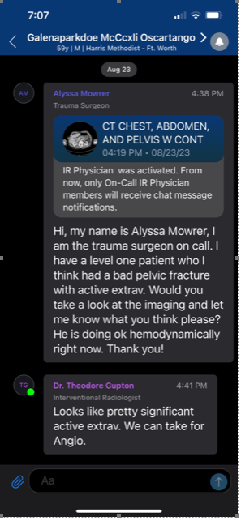

Slide 20
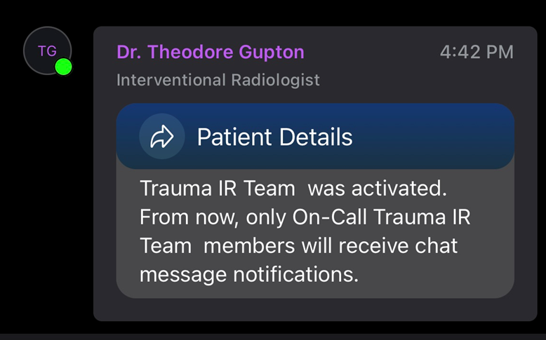

Slide 21
CASE STUDY
Physician Benefits
Easy to use
Excellent images on phone
Only need cell service to get images (on-call physicians not tied down)
One-button activation, physician contact
No waiting on call-backs
HIPAA-compliant program
Ability to review conversations and plan of care
All team members in the same text group

Slide 22
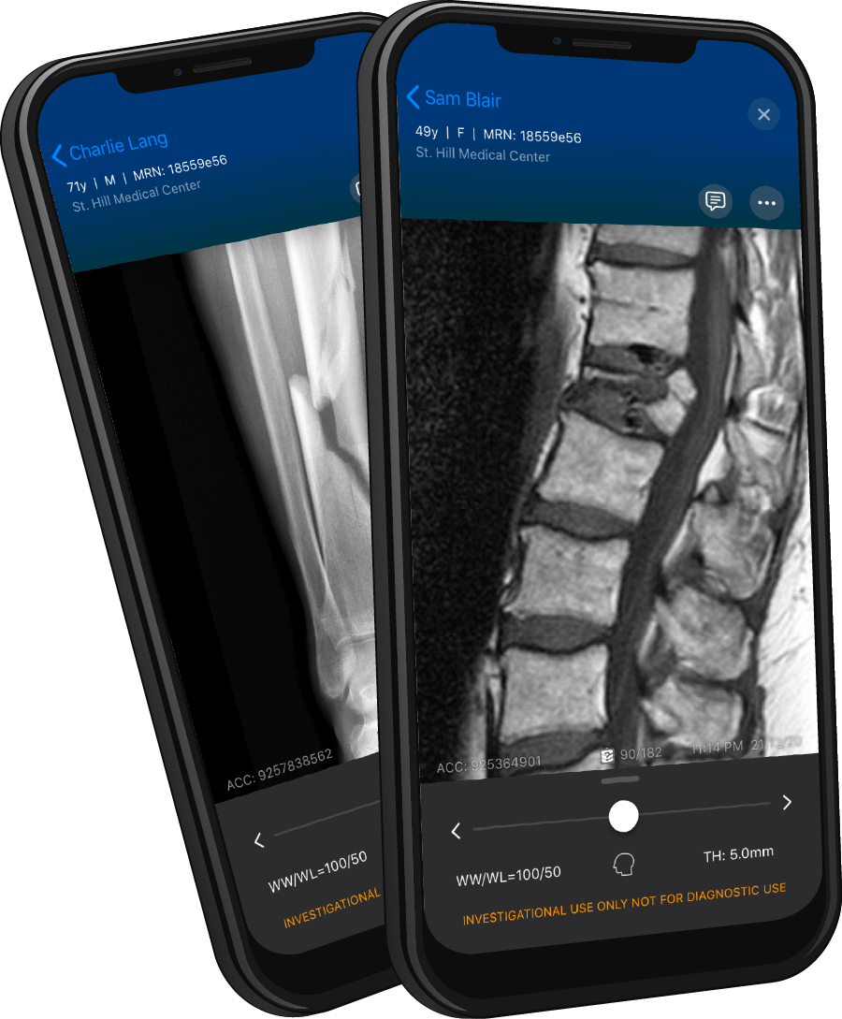
High Fidelity Image Viewing On-the-Go
Viz’s mobile image viewer offers dynamic manipulation of DICOM imaging on-the-go. Viz uses proprietary compression algorithms to ensure that imaging can be fully analyzed even when only minimal cellular service is available.
CT, CTA, MRI, X-Ray, EKG, Ultrasound, etc.
Proprietary compression enables review even with low cellular service
3D manipulation and customizable window and level
Notes:
Once an alert is received. Immediately review imaging. Our-proprietary high-fidelity image viewing technology enables full manipulation on-the-go just as you would have at your PACS workstation.The platform is compatible with any imaging modality and images can be viewed even with limited service.

Slide 23
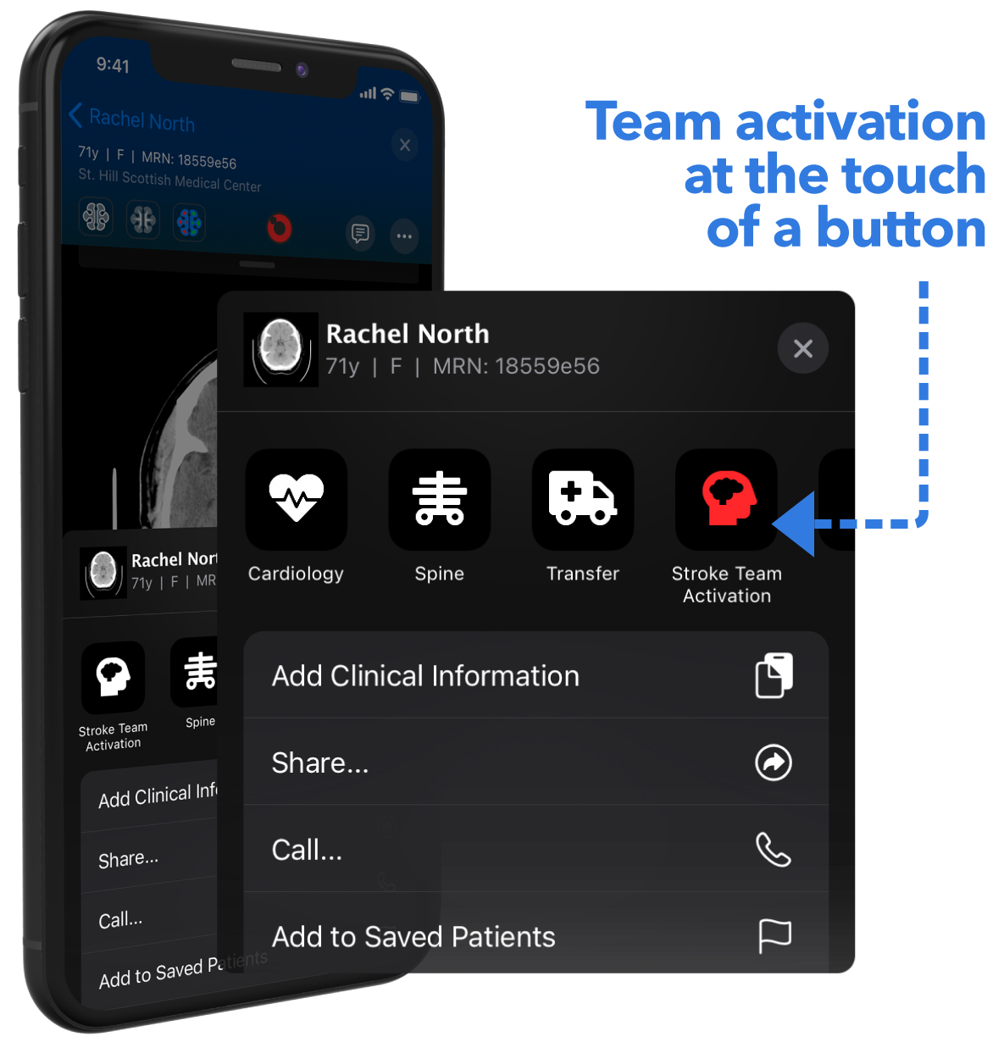
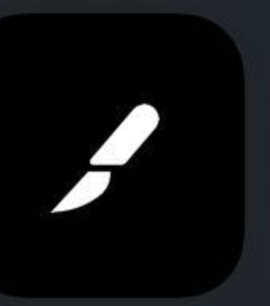
Immediate Treatment
Decisions and Consultations
When the decision is made to treat the patient, consult a specialty provider or activate your entire care team in just one click — saving time for the patient. When immediate care is not required, schedule the patient to your clinic, ensuring the patient receives the follow-up they need.
Configuration of activation buttons for specialty consultation, team activation, or referral to outpatient clinic follow-up allows providers at the point of care to immediately begin care coordination for each patient.
Cardiothoracic Referral
Ortho Referral
Activate Trauma
NeuroSurgery Referral
Notes:
Consultations beyond dedicated care teams are easily made with one touch to anyone on the Viz app within your institution. Simply select the on call specialty group to share the case. Surgical teams can also be activated in app with a touch of a button.

Slide 24
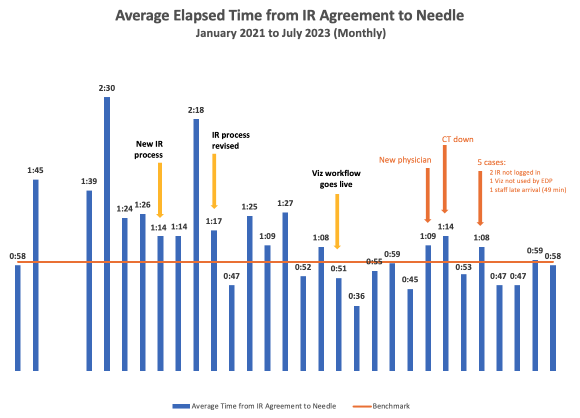

Slide 25
CASE STUDY
Questions?
Click the Q&A icon

Slide 26
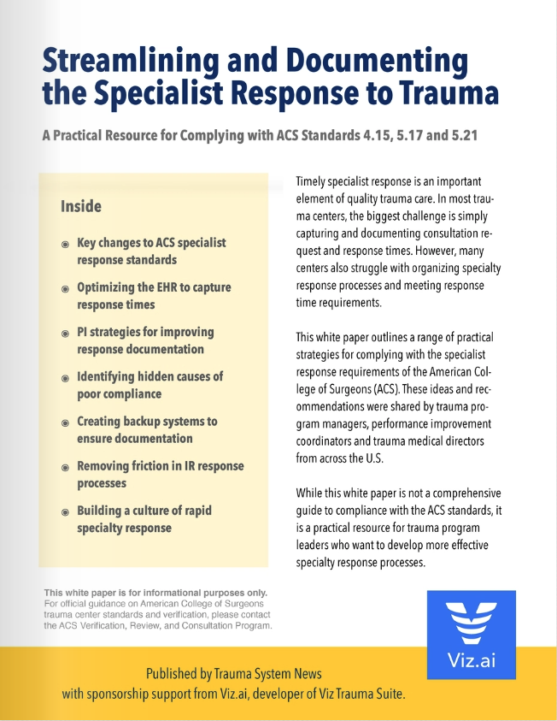
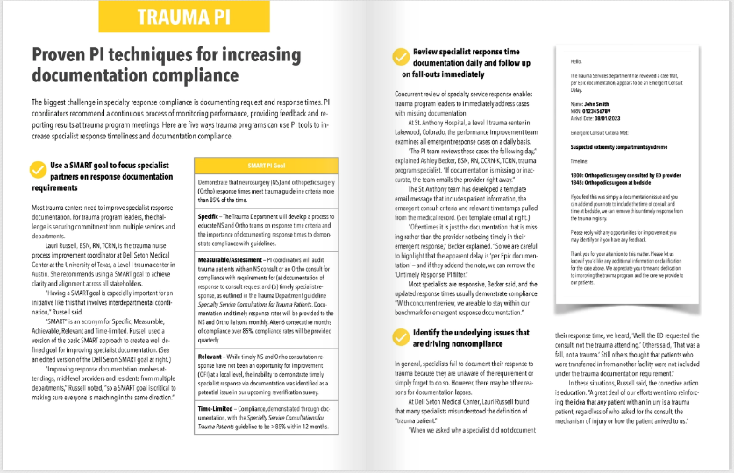
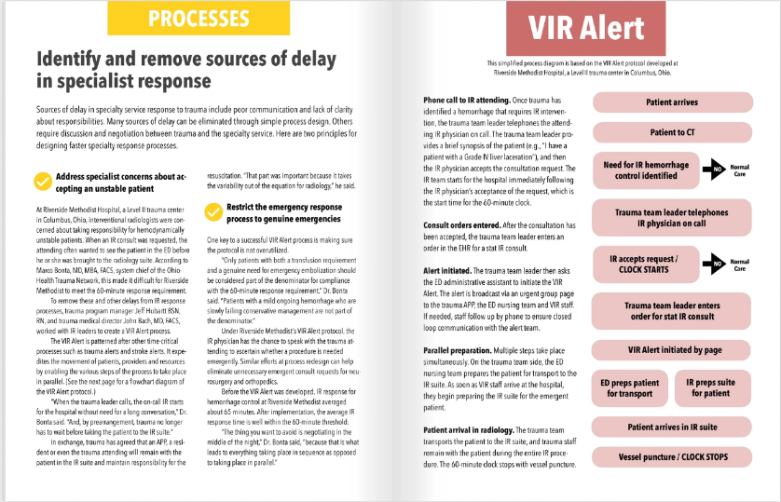
WHITE PAPER
More answers
Click link in tomorrow’s email
Email editor@trauma-news.com

Slide 27
TSN Webinars
Thank You
Watch email tomorrow
Take exit survey

