Slide 1
TSN Webinars
Strategies for Closing
The New “Skills Gap”
In ED and Trauma Nursing

Slide 2
TSN Webinars
Webinar replay
Links will arrive by email tomorrow

Slide 3
TSN Webinars
Kristine Powell, MSN, RN, AGACNP-BC, CEN, NEA-BC, FAEN
Director of Emergency Services
Baylor Scott & White Health
Regina Nuseibeh, MSN, RN, AGCNS-BC, TCRN
Manager of Emergency and Trauma Services, and Center of Hope
Franciscan Health Lafayette
JoAnn Lazarus, MSN, RN, CEN, FAEN
Managing Partner
Peregrine Health Services

Slide 4
TSN Webinars
More new nurses, less mentoring, higher stress
“Our ED has an ‘experience/complexity’ gap as we see
increasing numbers of novice and beginner nurses.”
“We need ideas for onboarding new staff when there are limited nurses
with experience for mentoring the new grads.”
“How can we create quality nurses with less orientation time availability?”
“How do we develop skill confidence in new nurses?”
“Are others seeing an increasing rate of anxiety in incoming graduate nurses?”

Slide 5
TSN Webinars
Poll
What percentage of your ED nursing workforce
has less than 1 year of experience?

Slide 6
Team Care Model
Renewed Interest in
the Team Care Model

Slide 7
Team Care Model
Academy of Emergency Nursing
Trailblazer Team
“With the assumption that this nursing shortage will continue for the foreseeable future, how should emergency care be delivered?”
White paper:
Model of Care / Technology / Alternate Care for Non-Emergent Patients

Slide 8
Team Care Model
The team care staffing model
ED experienced RN
Additional nurses
Assistive personnel
ED providers
Scribes
Ancillary services

Slide 9
Team Care Model
Team care model:
Proven principles and new insights
Buy-in
Defined roles
Teamwork
Communication
Back-up plans
Flexibility
Learning needs addressed
Leadership visibility & support
Written plan

Slide 10
Team Care Model
Implementing a Team Care Model to Ensure Quality While Supporting Less Experienced Nurses

Slide 11
Team Care Model
Team care model at Baylor Scott & White
When unit volumes dropped in some areas, RNs and other staff were trained and deployed to areas that were experiencing a COVID surge.
The deployed staff teamed up with experienced RNs on the unit to assist with patient care.
Planning started in ICU and then was spread to the ED, dialysis and other acute care areas.
Emphasis was placed on helping the deployed staff feel like a welcome and needed part of the team.

Slide 12
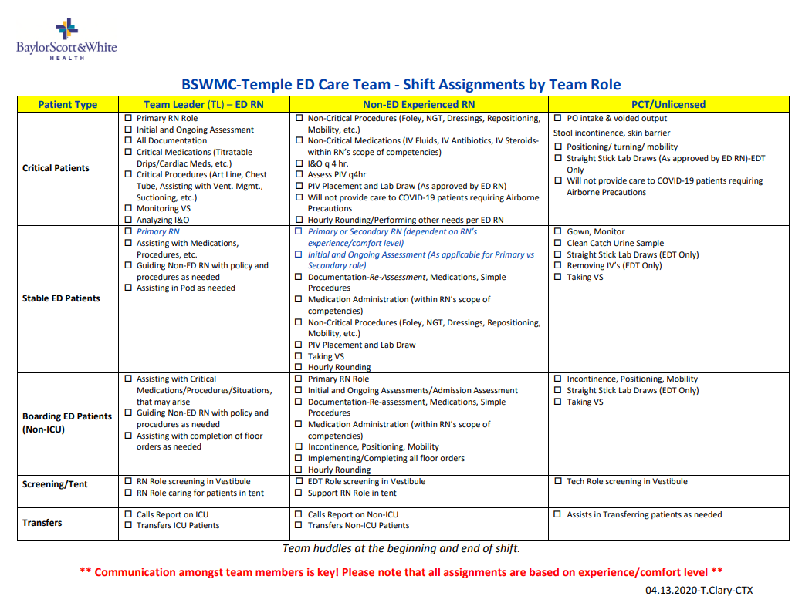

Slide 13
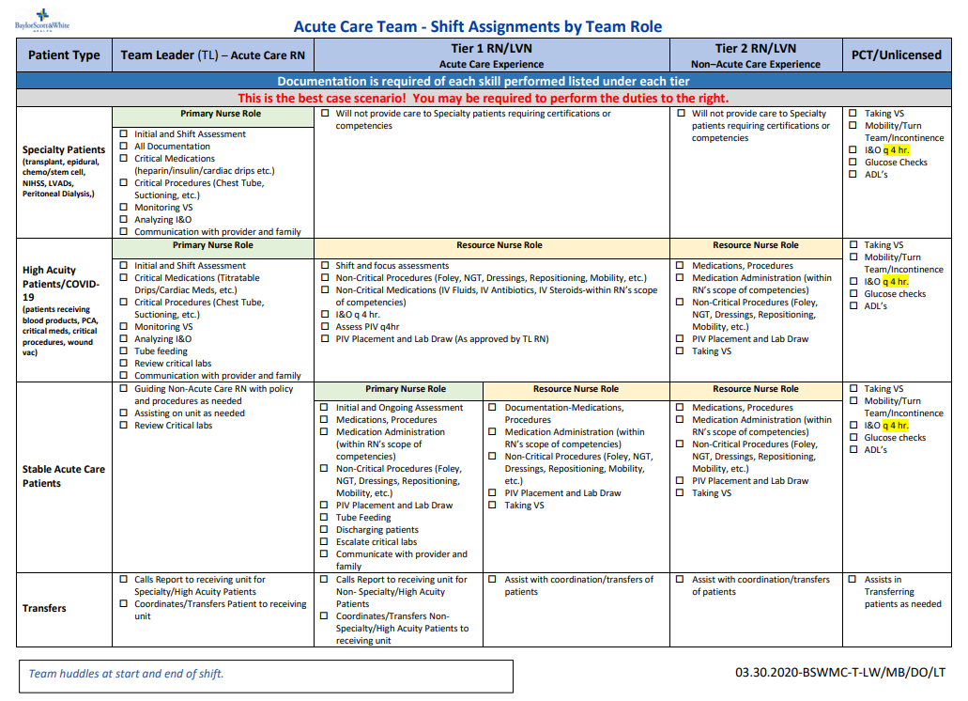

Slide 14
Team Care Model
Key insights
Understanding of team-based care model
Assess and address learning needs
Scope of practice
Orientation to unit layout, equipment and operations
Consistent unit and mentor/preceptor

Slide 15
TSN Webinars
2024 Peregrine Award
for Trauma Innovation
TRAUMA INNOVATION: Any creative solution to a problem
in trauma patient care or trauma program management

Slide 16
Virtual Mentors
Creating a Virtual Mentor Program To Transmit Key Skills and Instill Confidence in Novice Nurses

Slide 17
Virtual Mentors
Virtual Mentor Program
Overview of the state of healthcare
Review the Virtual ED Mentor Program
Methods used to incorporate a virtual mentor model
Results
Conclusions

Slide 18
Virtual Mentors
The Problem
AACN survey: 66% of nurses considering leaving nursing
Franciscan Health:
High Turnover Rates: up to 46%
Loss of >200 years RN experience
Gap in experience at the bedside
Severe short staffing requiring >50% agency staff each shift
Lack of resources/support to novice nurses

Slide 19
Virtual Mentors

Slide 20
Virtual Mentors

Slide 21
Virtual Mentors
Nurses wanted
Flexibility
Work-family life balance
Increased pay

Slide 22
Virtual Mentors
Objectives
Decrease ED RN Turnover
Decrease incident reports for care concerns
Decrease agency nurses
Improve documentation compliance to capture trauma charges
Improve RN support and satisfaction

Slide 23
Virtual Mentors
Timeline
Initiation
Core Group
Establish A3, Begin Change Plan
Recruit team, finalize statement, brainstorm, process map, develop change plan
Do
Implement
Plan
Study
Adjust
Review process
Observations
Identify opportunities for change

Slide 24
Virtual Mentors
Methods
Quality improvement initiative using quantitative data to evaluate the effectiveness of a 6-month virtual nurse mentor pilot program

Slide 25
Virtual Mentors
Proactive approach
Clear roles and responsibilities
Job descriptions
Standard work documents​
Workflow map
Observe, improve​
Solicit feedback ​
Monitor metrics
Nursing recruiter involvement
Test workflow

Slide 26
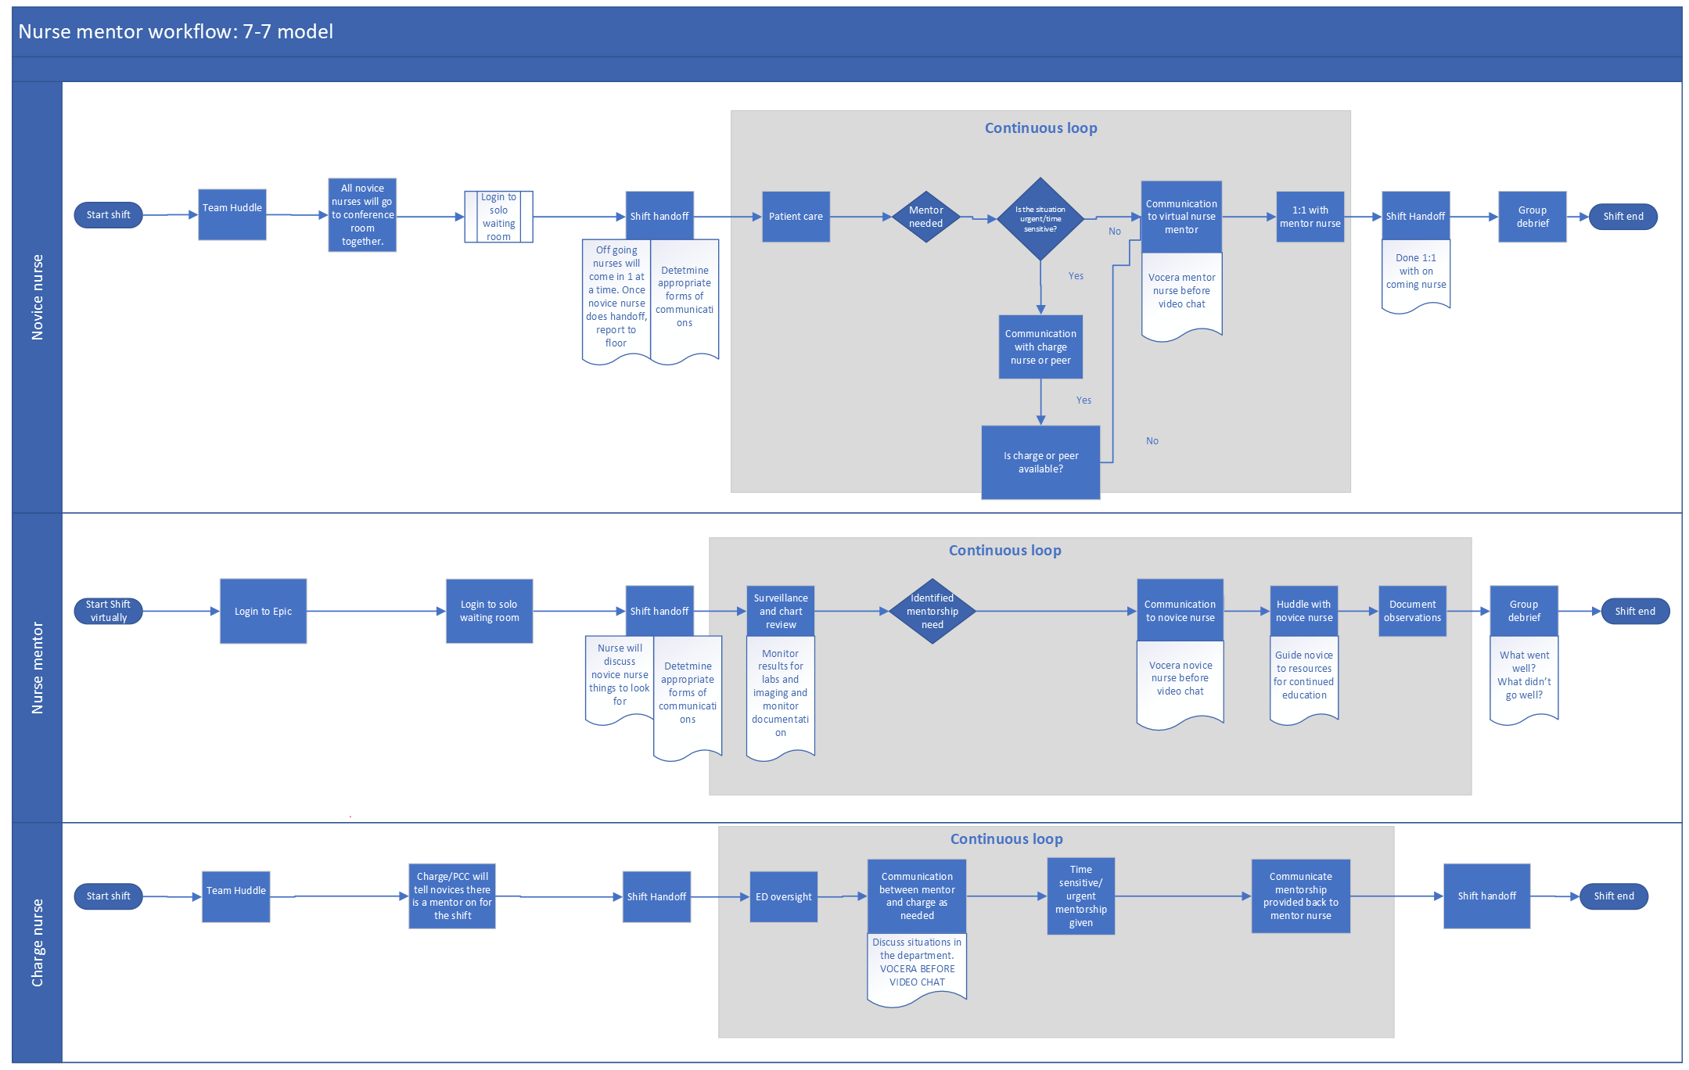

Slide 27
Virtual Mentors
Process
Start-of-shift handoff
During shift
Debriefing
Documentation review

Slide 28
Virtual Mentors
Mentors
Evaluation tools
Communication between mentors
Touchpoint meetings

Slide 29
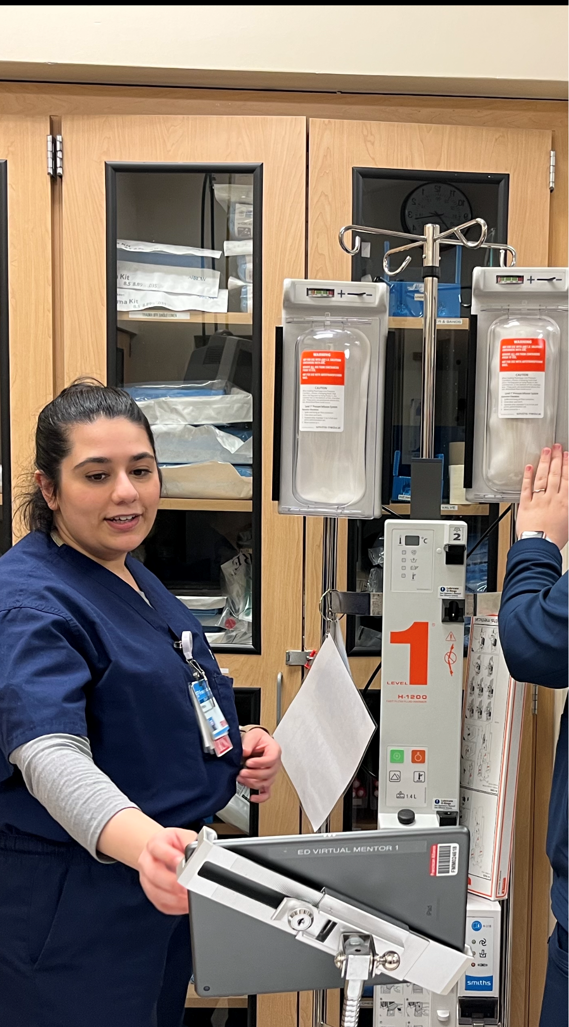
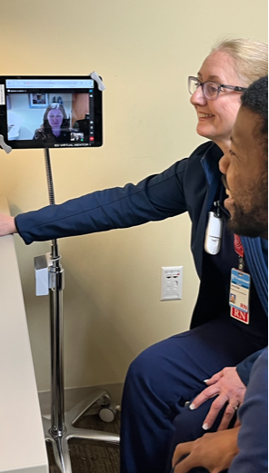
Virtual mentoring
in action

Slide 30
Virtual Mentors
Results
Decreased turnover rates — 2022 baseline: 39% / current: 9.8%
Decreased incident reports for care concern — baseline: 46 / 2023 Q1: 2
Decrease agency nurse — 2022: 12.9 / on track for 0 by December 2023
Improved trauma documentation compliance — improved but have room
Recruiting — nursing students: 5/5

Slide 31
Virtual Mentors
Survey results
Goal | Objective | 2021 Baseline | 2022 Baseline | 2023 Target |  | Pre-interaction | Mid- Month 1 | Mid- Month 2
 |  |  |  |  |  | % of responses Strongly Agree and Agree
Establish a support program for novice nurses to facilitate critical thinking skills that will enable them to care for complex patients while advancing their knowledge and feeling valued/supported. | Pre-interaction with Virtual Mentor "I feel prepared to independently care for ED patients" |  |  |  | % of responses | 64%
 |  |  |  |  | Number of responses | 11
 | "Lack of clinical support would cause me to separate from my department." |  |  |  | % of responses | 55%
 |  |  |  |  | Number of responses | 11
 | Mid Points (1-5 mo) "The clinical support of the Virtual ED Mentor decreases the time it takes for me to access nursing protocols." |  |  |  | % of responses |  | 40% | 50%
 |  |  |  |  | Number of responses |  | 10 | 2
 | "The clinical support of the Virtual ED Mentor has improved the quality of my documentation." |  |  |  | % of responses |  | 70% | 50%
 |  |  |  |  | Number of responses |  | 10 | 2
 | "The clinical support of the Virtual ED Mentor has supported my clinical growth." |  |  |  | % of responses |  | 60% | 50%
 |  |  |  |  | Number of responses |  | 10 | 2
 | End of pilot (6 mo) "I feel prepared to independently care for ED patients" |  |  |  | % of responses
 |  |  |  |  | Number of responses
 | "The availability of a Virtual ED Mentor would increase the likelihood I would stay in this department." |  |  |  | % of responses

Slide 32
Virtual Mentors
“Incredibly valuable asset that has allowed not only me to improve my workflow but has offered me to care for critical patients requiring procedures or care like giving blood when all other staff is busy. Strongly would suggest.”
— Franciscan Health Lafayette Novice Nurse

Slide 33
Virtual Mentors
“At that moment is when I realized that this program was so worth it. The mentor was able to stay on the iPad the whole time … I truly don’t think I could have done my first intubated patient and code like that if I didn’t have an ED Mentor.”
— Franciscan Health Lafayette Novice Nurse

Slide 34
Virtual Mentors
“The ED mentor program allows new grads and nursing staff in general to know that there is always someone in your corner. Even if we have very simple questions that can easily be answered by asking someone else on the floor, having a nurse mentor allows us to know that there is one singular person dedicated to ensuring our success, while others may be prioritizing patient care. There's an extreme amount of comfort, knowing that if we have critical patients in the department, there is going to be a specific individual there that can help us ensure the safety of our patients. Having that knowledge allows us to become more confident in our own practices without compromising patient care. I think it is a great way to deal with the shortage of seasoned nurses helping novices. It's innovative and a necessity in our current climate. The ED mentor program is an invaluable resource”.
— Franciscan Health Lafayette Novice Nurse

Slide 35
Virtual Mentors
“Discussions of the virtual mentor program began, and many thought the idea was crazy. Novice nurses were hesitant and unsure if the program would provide the support they needed. They thought they needed an extra set of hands. As the educator, I was unsure how to incorporate the program into my role. This program provided me with a link to staff. I could support them by providing them with the guidance they needed and at the same time, I could analyze opportunities for the department’s educational needs. I have heavily incorporated the mentor program into my role as the clinical resource nurse by working with staff directly to identify their needs, formulate educational plans and ideas based upon my assessments, and assess their progress over time.”
— Nurse Educator

Slide 36
Virtual Mentors
Conclusion
A virtual nurse mentor program played a vital role in addressing the needs of this emergency department by decreasing nurse turnover, providing support to novice nurses, and allowing flexibility of nursing staff. It has opened opportunities for future advancement of virtual mentorship at an organizational level.

Slide 37
TSN Webinars
Sources & Resources
Academy of Emergency Nursing 2022 Trailblazer Program White Paper. Access
“How Baylor Scott & White Health restructured its care team model to prepare for the Covid-19 surge.”
The Advisory Board. Read
AACN Nursing Shortage Fact Sheet. American Association of Colleges of Nursing. Visit
State of Nursing Survey. Nurse.org. Visit
“How to Support Nurses and Raise Nurse Retention Rates.” Nurse Journal. Read
2023 Peregrine Award Winners and Semifinalists: Trauma Innovation Special Report. Read

Slide 38
TSN Webinars
Your Questions
Click the Q&A icon

Slide 39
TSN Webinars
Thank You
Watch email tomorrow
Take exit survey

