Slide 1
TSN Webinars
OIG Trauma Payment Audits:
What to Know and How to Prepare

Slide 2
TSN Webinars
Webinar slides and replay
Links will arrive by email tomorrow

Slide 3
TSN Webinars
Angie Chisolm
President & Managing Partner
Optimal Healthcare Advisors

Slide 4
OIG Review of Trauma Claims

Slide 5
What is the OIG?
Established in 1976
1,570 auditors, investigators and evaluators
Experts in law, technology, cybersecurity, data analytics, statistics, medicine, economics, health policy, and management and administration
Focus is fighting waste, fraud and abuse
Majority of resources go towards the oversight of Medicare and Medicaid

Slide 6
OIG Review of Medicare Payments for Trauma Claims
“There have been concerns about trauma centers improperly billing for trauma team activation that is not medically necessary. In addition, we found some providers have received trauma team activation payments without proper designation or verification. Currently, CMS does not track which providers are designated or verified as trauma centers. We will determine the amount of Medicare overpayments and Medicare charges that affect future hospital payments, and we will identify providers that are not trauma centers or that billed for medically unnecessary trauma team activations.”
Source: Review of Medicare Payments for Trauma Claims
The expected date of the OIG report is 2024

Slide 7
Trauma Billing Basics

Slide 8
4 key issues for OIG investigation
Non designated/verified trauma centers using UB 68x revenue code
Trauma team upgrades and downgrades
How the OIG audit could affect trauma center payments
Using UB 68x correctly

Slide 9
History of trauma center billing
In 2002, TCAA (Trauma Center Association of America) successfully lobbied the National Uniform Billing Committee (NUBC) to approve trauma response fees and critical care revenue code
Only verified or designated trauma centers can use these revenue codes
Effective coding, billing and collection practices add revenue for the trauma center; however, trauma centers should base their activation fees on the costs associated with maintaining the trauma center status

Slide 10
Trauma center revenue and billing codes
FL 14, Type 5 – admit type or source
UB 68x – trauma team activation fee
UB 450 – Emergency Room general fee classification
UB 208 – trauma critical care daily accommodation fee

Slide 11
Designated or verified trauma centers
Revenue Code UB 68x – Trauma Team Response
“x” indicates trauma center level, not the activation level
681 = Level I
682 = Level II
683 = Level III
684 = Level IV
689 = Other
To be used by trauma center/hospitals as licensed or designated by the State or local government authority authorized to do so, or as verified by the American College of Surgeons and involving a trauma activation. (Source: CMS Manual System Pub. 100-04)

Slide 12
FL 14, Type 5 – Trauma Patient Registration
Form/Field Locator 14, Type 5 = Trauma Center
Used in the registration process to identify the type of patient admission:
1 Emergency
2 Urgent
3 Elective
4 Newborn
5 Trauma
Must be used to identify trauma patients for subsequent coding of UB 68x

Slide 13
Trauma Team
Upgrades & Downgrades

Slide 14
Upgrades and downgrades
Trauma team activations are intended to be medically necessary to meet the needs of the injured patient who would otherwise have a life- or limb-threatening result if left untreated.
Downgrade – after the trauma team is activated (notified), the patient does not meet the criteria for the level of response.
Examples:
EMS notifies ED of patient with GSW to head. Patient arrives, sitting up on the stretcher with a graze wound to the scalp – appropriate downgrade
EMS notifies ED of patient with MVC, rollover, entrapment. After full work up, found to have no injuries and downgraded – inappropriate downgrade
Upgrade – after the trauma team is activated (notified), the patient’s condition warrants the need for additional resources. Criteria must be met for the higher level of response.
Examples:
EMS notifies ED of elderly patient fall from standing with leg shortening. After arrival, identified altered mental status from baseline and fractured forearm, in addition to hip fracture – appropriate upgrade
EMS notifies ED of patient “found down”. After arrival, patient found to be intoxicated with no injuries but requires admission – inappropriate upgrade

Slide 15
Downgrades
Benefit:
Patient is not billed for trauma team response
Lowers over-triage rates
Risk:
Overburdening the trauma team with unnecessary notifications
OIG is evaluating the practice of charging patients for trauma team activations in the setting of downgrades
Having effective, regularly reviewed trauma triage criteria can mitigate the risk of over-triage and the need for downgrading

Slide 16
Upgrades
Benefit:
Patients receive the level of care necessary to treat the injury
Lowers under-triage rates
Risk:
Delaying care for patients in need of rapid evaluation
Activating a team response when a simple surgical consult is needed
OIG is evaluating the practice of upgrading patients to trauma team activations after workup is complete, which is essentially a surgical consult
Having effective, regularly reviewed trauma triage criteria can mitigate the risk of under-triage and the need for upgrading

Slide 17
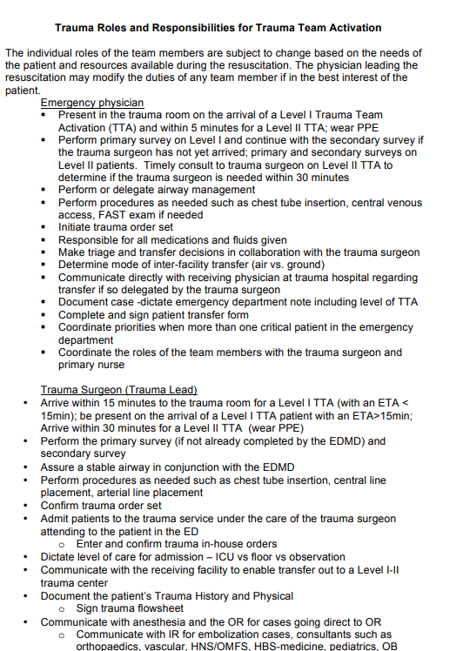
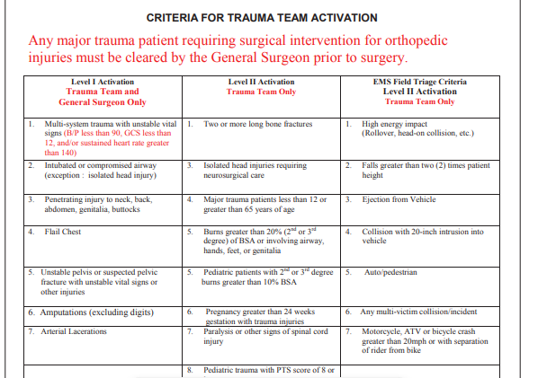
Supporting documentation
Requirements:
Trauma Team Activation criteria
Trauma Team Activation roles and responsibilities (including expected response times)

Slide 18
Ways to manage the problem
Evaluate over- and under-triage regularly
Adjust your activation criteria to reduce upgrades/downgrades
Always provide the appropriate level of care to the patient and support clinical decisions with documentation
When auditing, ask:
Did the patient meet criteria for activation on arrival?
Did the patient’s condition change after arrival?
Was the decision to upgrade/downgrade clearly documented?

Slide 19
TSN Webinars
Break
Would you like personal follow-up?

Slide 20
How will this affect
trauma center payments?

Slide 21
How the OIG audit could affect trauma center payments
“We will determine the amount of Medicare overpayments and Medicare charges that affect future hospital payments, and we will identify providers that are not trauma centers or that billed for medically unnecessary trauma team activations.”
It is unclear at this time what action may be taken by CMS once the OIG report
is available, but it could include fines and/or future payment adjustments

Slide 22
How to use UB 68x correctly

Slide 23
CMS rules for billing UB 68x
Must meet trauma team activation criteria
Each level of response must be clearly defined, including team members
Must show evidence of prehospital notification
Must be identified using FL 14, Type 5
Must use UB 68x revenue code
Must use G0390 combined with 30 minutes of critical care time (99291)*
* NOTE: Critical care time is not required to bill UB 68x. CMS states that when there is 30 mins of critical care, you must include G0390

Slide 24
UB 68x and prenotification
CMS:
Qualifying prehospital caregivers:
EMS
Police
Fire
Referring facility (ED, urgent care, doctor’s office, SNF, rehab, etc.)
Source: Uniform Billing Editor

Slide 25
UB 68x without prenotification
Cannot bill using revenue code UB 68x without pre-notification
The National Uniform Billing Committee specifically instructs a hospital to bill UB450 in addition to UB68X when pre-arrival notification is given.
The UB 450 level of service is the only alternative to recover costs when a patient arrives without pre-notification. Every patient must still meet the trauma team activation criteria. (TCAA Finance and Business Manual)
Charges should be related consistently to the cost of the services and uniformly applied to all patients whether inpatient or outpatient. (Provider Reimbursement Manual 1, Chapter 22, Section 2202.4)

Slide 26
Conclusion
Evaluate your trauma program’s use of upgrades and downgrades
Regularly evaluate your trauma team activation criteria
Ensure clinical documentation supports the use of revenue code UB 68x for trauma team activation, including critical care time
Review your center’s chargemaster to ensure the correct UB 68x code for your trauma center level and you are only using 450 if not designated/verified
If you are unsure, reach out to a trauma finance coding specialist for assistance

Slide 27
TSN Webinars
Your Questions
Click the Q&A icon

Slide 28
TSN Webinars
Thank You
Watch email tomorrow
Take exit survey

