Slide 1
TSN Webinars
Trauma Standards “Deep Dive” Workshop
A Closer Look at New ACS Requirements for
Documentation, Specialty Coverage,
Peds, Level III’s and More

Slide 2
TSN Webinars
Webinar slides and replay
Links will arrive by email tomorrow

Slide 3
TSN Webinars
Angie Chisolm
MBA/HCM, BSN, RN, CFRN, TCRN

Slide 4
Disclaimer
This webinar is not intended to replace information and official guidance from the American College of Surgeons (ACS)
Information provided in this webinar is not all-inclusive, but rather highlights key changes in the standards
Attendees are responsible for reading the ACS standards and confirming any interpretation through the ACS COT

Slide 5
Performance Improvement

Slide 6
How to document loop closure
2022 Standards
7.3 Documented Effectiveness of the PIPS Program – Type II All trauma centers must have documented evidence of event identification; effective use of audit filters; demonstrated loop closure; attempts at corrective action plans; and strategies for sustained improvement measured over time. Includes: Peer review minutes Loop closure documentation (ex. PDSA) Monitoring of event rates (dashboards) OPPE Benchmarking reports (TQIP)

Slide 7
How to document loop closure
What is loop closure? Evidence demonstrating that the identified problem has been resolved.
Example: 72y M s/p GLF. Per EMS, pt lethargic with vomit around face. Cold to touch. Arrives in the ED without a trauma team activation. Adm to ICU with SDH and multiple rib fractures. Develops respiratory failure requiring intubation. Trauma and Neurosurgery consulted after admission.
Problem(s) to solve (OFI):
Earlier surgical intervention
Earlier and more aggressive pulmonary hygiene
Action plan:
Revise trauma team activation criteria to include geriatric injuries with AMS from baseline
Review/revise/implement pulmonary hygiene order set
Loop closure:
“Since revision of TTA criteria go-live on Nov. 22, 2023, there have been 14 geriatric patients with AMS meeting trauma team activation criteria. 12 out of 14 patients received timely surgical evaluations (86% improvement)”
“Since go-live of pulmonary hygiene order set on Dec 10, 2023, the incidence of respiratory failure requiring intubation has decreased from 12 cases to 3 cases (75% improvement)”

Slide 8
How to document measures of compliance
4.15 IR for hemorrhage control
Start time captured in the registry if patient receives PRBC or whole blood within first 4 hours
Time interval between request (trauma flowsheet, trauma surgeon note, call service time stamp, EHR order time, paging system log, etc.) and arterial puncture (procedure note)
Dashboard: Total number of hemorrhage cases requiring IR [denominator] divided by the number of cases within 60 mins (time of request to needle time) [numerator]
Emergent response times (NS, Ortho, trauma)
5.17 A neurosurgery resident or APP may act as a consultant as long as there is documented communication with the neurosurgery attending, even at night
Time interval between request and evaluation (trauma flowsheet, surgeon note, call service time stamp, paging system log, badge readers, etc.)
Dashboard: Total number of “emergent criteria” [denominator] divided by number of times surgeon responded within expected timeframe [numerator]
3.1 OR response times
OR staffing policy demonstrating an available OR team to meet 15- or 30-minute requirement
Time interval between notification and response (must be staffed and available, aka open and ready for a patient)
This can be documented with a logbook, an electronic medical record, or a badge swipe. Some EHRs include “OR request time”
Dashboard: Total number of Class A emergent OR cases [denominator] divided by number of times OR is ready within expected timeframe [numerator]
“For the OR availability standard, does the patient need to be in the OR within 15 minutes?”

Slide 9
How to document measures of compliance
4.14 Radiology read times
Time interval between request (trauma flowsheet, trauma surgeon note, call service time stamp, EHR order time, paging system log, etc.) and interpretation (procedure note)
Radiology department leaders are a great asset for tracking this information. Every action in radiology is time-stamped and reported.
Not limited to TTAs, but should be focused on urgent/emergent requests
5.30 / 5.31 SBIRT compliance
New in 2022 standards: All trauma centers must screen all admitted patients greater than 12y/o
Blood alcohol levels and Alcohol Use Disorder are recorded in the trauma registry
Dashboard: Screening - Total number of admitted patients over 12y [denominator] divided by number with alcohol screening performed [numerator]
Dashboard: Intervention - Total number of positive alcohol screening results [denominator] divided by number with brief intervention performed [numerator]
“Does the SBIRT standard include admits less than 24 hours?”
ACS website: “All admitted patients greater than 12 years old, regardless of length of stay, must be screened.”
5.29 Mental Health screening compliance
Step 1 – develop a protocol to screen patients at high risk for mental health problems; include a referral process
Dashboard: Total number of patients meeting criteria for mental health screening [denominator] divided by number with screening performed [numerator]
https://www.facs.org/for-medical-professionals/news-publications/news-and-articles/acs-brief/january-10-2023-issue/acs-releases-screening-guideline-for-mental-health-substance-use-in-trauma-victims/

Slide 10
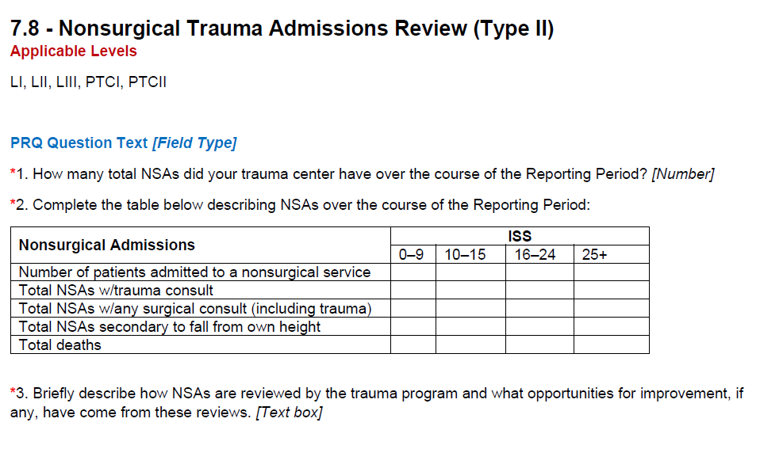
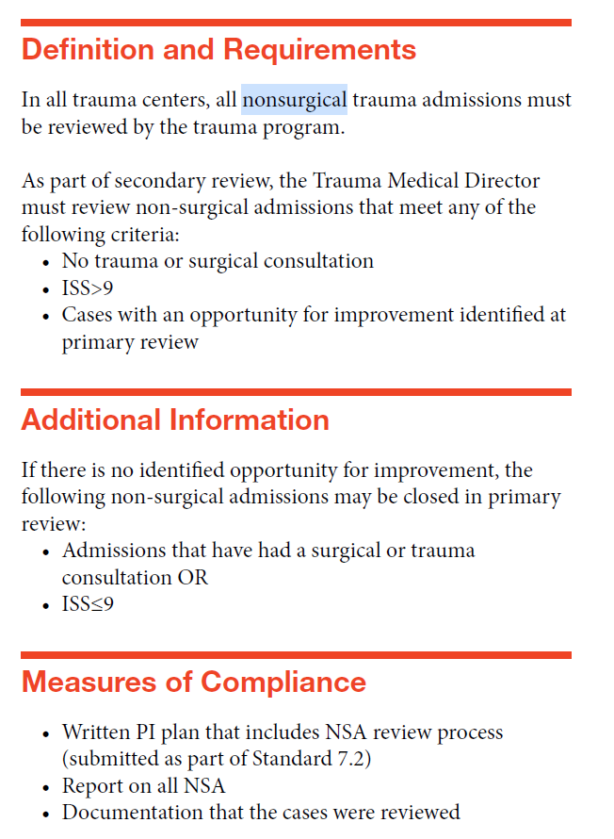
How to document measures of compliance

Slide 11
How to document measures of compliance

Slide 12
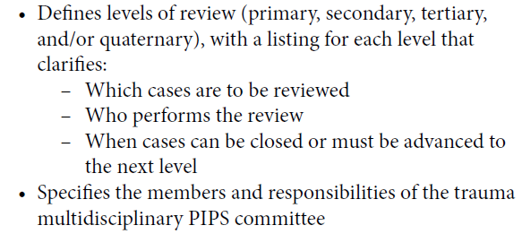
General PI
Systems/Operations meeting requirement?

Slide 13
Trauma Registry

Slide 14
Trauma Registry
Could you clarify trauma registrar education requirements for newly hired registrars? No time frame is mentioned.

Slide 15
Registry Staffing
2014 Standards | 2022 Standards
CD 15.9 In Level I, II, and III trauma centers, One full-time equivalent employee dedicated to the registry must be available to process the data capturing the NTDS data set for each 500–750 admitted patients annually – Type II | 4.31 Trauma Registry Staffing Requirements – Type II - All trauma centers must have 0.5 FTEs per 200 – 300 patient entries* (1 FTE : 400 – 600) - Combined adult and peds programs must have a pediatric lead registrar *Count of entries is defined as all patients who meet NTDS inclusion criteria, and those patients who meet inclusion criteria for hospital, local, regional and state purposes

Slide 16
Trauma Registry
Is a hospital-specific data dictionary mandated per the standards, or is it highly suggested we create one?
- The standards reference ACS NTDS Data Dictionary only
Is data validation by re-abstracting 5-10% of charts still a best practice, or can that number decrease? (Level 1 TQIP center)
- Yes, IRR 5 to 10 charts per registrar per month. One facility remarked that they review all deaths and ISS >16 for chart selection. They also completely re-abstract one chart per registrar per month.

Slide 17
Pediatric Trauma

Slide 18
Standards for pediatric care
2.6 Adult Centers Admitting Pediatrics – Type I
- Adult centers that admit more than 100 children under 15 years of age must have:
Pediatric emergency department area
Pediatric ICU
Appropriate resuscitation equipment outlined in the peds readiness toolkit
- Does not include transfers out
4.26 Medical Specialists – Type II
- Applies to Levels I, II, PI, PII
- Internal Medicine or Pediatrics continuously available
4.27 Child Abuse (NAT) Physician – Type II **NEW CD
- Level I and II peds must have board certified / eligible in child abuse or special interest in child abuse
5.10 Pediatric Readiness – Type II
- All trauma centers are required to perform a pediatric readiness assessment during the verification cycle
- All trauma centers are required to have a plan to address identified gaps
- There is no threshold for expected assessment results, however EMSC ‘research shows that high pediatric readiness (>87 points) results in lower mortality’ https://emscimprovement.center/domains/pediatric-readiness-project/
- Pediatric readiness applies to all hospitals, regardless of trauma center designation level
Pediatric readiness assessment: https://www.pedsready.org/
Other resources to address deficiencies: https://emscimprovement.center/domains/pediatric-readiness-project/readiness-toolkit/

Slide 19
Surgical & Medical Specialists

Slide 20
Coverage requirements
4.22 Ophthalmology – Type II
Levels I, II, PI, PII
Must have continuous coverage 24/7/365
Sporadic gaps in coverage due to vacation/conference attendance, etc. must be addressed with a contingency plan
Required to provide 12 months of call schedules at the time of the site visit
Contact ACS for guidance
4.21 Hand and Plastics – Type I
Levels I, II, PI, PII
Must have continuous coverage 24/7/365
“expertise” implies that there is a surgeon credentialled to provide acute trauma care for the services listed
Sporadic gaps in coverage due to vacation/conference attendance, etc. must be addressed with a contingency plan
Required to provide 12 months of call schedules at the time of the site visit

Slide 21
Coverage requirements
4.24 Craniofacial (OMFS) – Type I
Levels I, PI
Must be able to care for patients with acute facial fractures
Specialists include otolaryngology, oral maxillofacial, or plastic surgery
Options for coverage include a single specialty covering all injuries, a rotating schedule, or involvement of specific expertise depending on the nature of the injury
Locums
Not addressed in the standards
2018 ACS position statement summary: must meet all requirements to be on the trauma call panel

Slide 22
Neurosurgery
Is there a requirement for back-up call?
- Level I and II centers must have BC/BE neurosurgeons continuously available for the care of neurotrauma patients.
- Level III-N centers must have BC/BE neurosurgeons
- Level IP centers must have at least one BC/BE neurosurgeon who has completed a pediatric neurosurgery fellowship
- Continuously available is defined as 24/7/365 with no gaps in coverage.
ACS website: “A neurosurgery published backup call schedule is not required to meet this standard.”
How to capture response times?
- Time interval between request and evaluation (trauma flowsheet, surgeon note, call service time stamp, paging system log, badge readers, etc.)
- ACS website: “Evaluation within 30 minutes is required for the injuries specified in the standard and can be done remotely.”

Slide 23
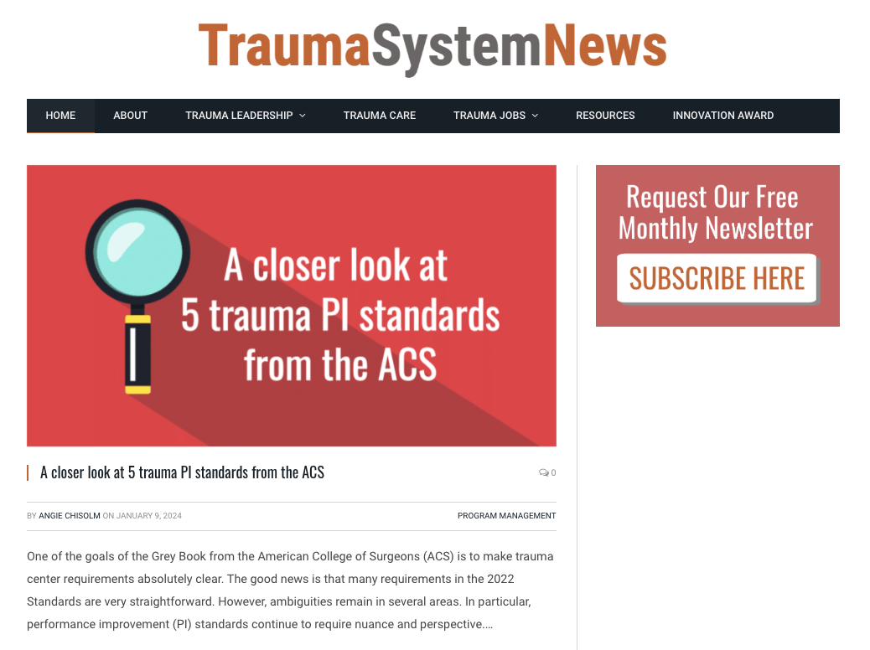
TSN Webinars
Subscribe to our newsletter
> Visit www.trauma-news.com
> Click the “Subscribe Here” box

Slide 24
Level III Trauma Centers

Slide 25
Level III trauma centers
Can a Level III center have NSGY availability without requiring 24/7/365 coverage?
- Level III-N centers are those that provide neurotrauma care for patients with moderate to severe TBI, defined as GCS of 12 or less at the time of emergency department arrival.
- 5.19 Level III-N centers must have a neurotrauma contingency plan that includes the potential diversion and must implement the plan when neurosurgery capabilities are encumbered, overwhelmed, or unavailable
- ACS website: “If a trauma center admits any patients with moderate to severe TBI, they must apply as Level III-N, and will be required by standard 4.10 to have board-certified or board-eligible neurosurgeons.”
How do Level III centers demonstrate “access to the OR” for nonemergent ortho trauma?
- OR scheduling policy that details how cases are posted
- OR schedule showing orthopedic cases scheduled, not as “add-on” in the evenings
Surgical coverage requirements for Level IIIs
- Trauma Surgery 24/7/365 with back up schedule or back up plan
- Orthopedic surgery 24/7/365
- Neurosurgery (LIII-N)
Geriatric liaison requirements for Level IIIs
- 4.5 Applies only to Levels I and II

Slide 26
Level III trauma centers
3.5 Medical Imaging – Type I
- Does the patient need to be in CT within 30 minutes or does CT need to be available within 30 minutes?
- In Level III centers, the services must be available 24 hours per day and be accessible for patient care within the time interval specified
CT – 30 mins
- CT needs to be available within 30 minutes to accept the patient. If the patient’s condition warrants a CT within 30 mins, then compliance is measured from time of request to time patient in CT
5.29 Mental Health Screening – Type II
- Level III centers must have a process for referral to a mental health provider when required
5.30 / 5.31 SBIRT – Type II
- All trauma centers must screen all admitted trauma patients greater than 12 years old; compliance at least 80%
- All trauma centers must provide a brief intervention for patients who screened positive; compliance at least 80%
- Level III centers must have a mechanism for referral if brief intervention is not available as an inpatient
Dashboard: Screening - Total number of admitted patients over 12y [denominator] divided by number with alcohol screening performed [numerator]
Dashboard: Intervention - Total number of positive alcohol screening results [denominator] divided by number with brief intervention performed [numerator]

Slide 27
Level III trauma centers
4.35 PI Staffing Requirements – Type II
- All trauma centers must have at least 0.5 FTE dedicated to performance improvement (PI) when the annual volume of registry patient entries exceeds 500 patients. When the annual volume exceeds 1,000 registry patient entries, the trauma center must have at least 1 FTE PI personnel.
5.21 Orthopedic Surgeon Response – Type I
- All trauma centers must have an orthopedic surgeon (ortho resident or APP) respond to the bedside within 30 minutes of request for the following:
Hemodynamically unstable, secondary to pelvic fracture
Suspected extremity compartment syndrome
Fractures/dislocations with risk of avascular necrosis (e.g. femoral head or talus)
Vascular compromise related to a fracture or dislocation
Trauma surgeon discretion
**if Ortho resident or APP respond instead of the surgeon, there must be documented communication with the surgeon
Can the ED provider document conversations with specialist or does there need to be a note by the surgeon?
- This is not addressed in the ACS standards, except for 5.4 (TS response), 5.21 (Ortho response). Review your hospital’s bylaws for expectations of consultation response and documentation of consultations.

Slide 28
Level IV Trauma Centers

Slide 29
Guidance for Level IV trauma centers
How does the Grey Book New ACS Requirements for Documentation affect Level IV Trauma Centers and our survey requirements?
- ACS website: “The COT is giving this careful consideration and will determine how best to address the concerns. In the meantime, the 2014 Resources for Optimal Care of the Injured Patient (aka, the Orange Book) contains Level IV criteria that are still relevant, current, and can continue to be used.”
We are a state designated Level V. How does this impact us?
- The ACS 2014 Level IV criteria is still relevant, current and can continue to be used; however, at a minimum, state standards should be followed
Does the CAISS requirement apply to Level IV facilities?
- CAISS was not required in the 2014 standards
- no current information currently available to indicate if CAISS will be required in the revised standards
How does the Grey Book New ACS Requirements for Documentation affect Level IV Trauma Centers and our survey requirements?
- Currently, the new ACS requirements do not affect Level IV survey requirements

Slide 30
Survey Readiness

Slide 31
Pre-Review Questionnaire (PRQ)
4.14 Radiologist Access – Type I
Does the radiologist access standard apply only to trauma activations or to all trauma patients in the registry?
- the standard is not limited to trauma activations
When asking for job descriptions, are they really looking for a CV and a display of their expertise instead?
- the only request for job descriptions in the PRQ is for Injury Prevention staff
- Several “roles and responsibilities” for various staff and physicians are required, not the CVs
What are paperwork specifics for Injury Prevention? What must be submitted for programs and events, etc.?

Slide 32
Pre-Review Questionnaire (PRQ)
Can you clarify the required documents for 2.10 and 2.11? R&R [responsibilities and reporting] vs role profile of TPM?
- The requirement is to upload the roles and responsibilities document for the TPM position, showing the allocation of the FTE’s responsibilities (PI, Injury Prevention, etc.) – is the TPM also covering these roles?
- The role profile could be the same document and may be the job description
In a Level III, if the co-director of the ICU is the TMD, would I upload the TMD roles & resp. in the PRQ?
- Yes
PRQ reminders:
12 months of call schedules for all surgical specialties
ATLS certificate numbers are required
Board certification ID’s
One (1) completed OPPE required

Slide 33
Preselected Chart Review (PCR)
PCR – questions about adult vs peds. Specifically, do they need two separate chart lists?
Select the number of charts based on the information below:
Standard visits: 25 charts
Combined programs (Adult Level I or II with Pediatric Level II): 25 charts for adults and 15 charts for peds
Concurrent programs (Level I adult and Level I peds): 25 charts for adults and 25 charts for peds
Focused visits: 25 charts
For chart selection, what is meant by "subcategories“?
- If a patient is included in the “Death” list, but also meets criteria for inclusion in “NSA” – the NSA is the subcategory. You cannot duplicate charts in more than one category
How to request information for medical records from HIM
- Refer to Appendix 2 – Medical Record Review for details on how to organize the medical record

Slide 34
Standards: General Questions

Slide 35
Nursing education
8.2 Nursing Trauma Orientation and Education – Type II
All trauma centers must provide trauma orientation to new nursing staff caring for trauma patients. Examples of nursing orientation may include: Center-developed educational program that integrates PIPS-identified issues Education specific to patient population served Nursing orientation may include simulation sessions, online learning, conferences, and annual training events. | Nurses must participate in trauma CE corresponding to their scope of practice and patient population served. Examples of nursing education may include: ATCN — Advanced Trauma Care for Nurses TNCC — Trauma Nursing Core Course PCAR — Pediatric Care After Resuscitation TCAR — Trauma Care After Resuscitation TNATC — Transport Nurse Advanced Trauma Course

Slide 36
Disaster management
2.3 Clarify surgical response to disaster in hospital disaster plan
- The surgical response must outline the following:
Critical personnel
Means of contact
Initial surgical triage (including subspecialty triage when appropriate)
Coordination of secondary procedures
4.35 Disaster Management and Emergency Preparedness Course – Type II **NEW CD
- Level I adult/peds the trauma surgeon liaison to the disaster committee must complete the DMEP course at least once
Do both the trauma surgeon and orthopedic liaison need to take the EM courses?
- Level I Adult and Pediatric centers must include an orthopedic surgeon from the trauma call panel as a member of the hospital’s disaster committee.
- In Level I Adult and Pediatric centers, the trauma surgeon liaison to the disaster committee must complete the DMEP course

Slide 37
Other standards
5.4 Trauma Surgeon Response to Highest Level of Activation – Type I
Why patient arrival versus activation time? This is not a new standard and has always been based on patient arrival
In the Orange Book, we provided feedback on patients transferred in/out. Is this still required?
What are the requirements of trauma centers to proactively share patient follow-up information with EMS agencies?
7.10 Prehospital Care Feedback – Type II
- All trauma centers must have a process of reviewing and providing feedback to:
EMS agencies, related to accuracy of triage and provision of care
Referring providers, related to the care and outcomes of their patients and any potential opportunities for improvement in initial care

Slide 38
TSN Webinars
Your Questions
Click the Q&A icon

Slide 39
TSN Webinars
Thank You
Watch email tomorrow
Take exit survey

