Slide 1
TSN Webinars
Pediatric Readiness:
Streamlined Implementation Strategies for
Trauma Center and Emergency Department Leaders

Slide 2
TSN Webinars
Webinar slides and replay
Links will arrive by email tomorrow

Slide 3
TSN Webinars
Karen Webb
DNP, RN, NEA-BC, NHDP-BC
Senior Consultant
Peregrine Health Services

Slide 4
Disclaimer
This webinar is not intended to replace information and official guidance from the American College of Surgeons (ACS)
Information provided in this webinar is not all-inclusive, but rather highlights key aspects of the standards
Attendees are responsible for reading the ACS standards and confirming any interpretation through the ACS Committee on Trauma

Slide 5
Objectives
How to spot “wishful thinking” in your organization’s National Pediatric Readiness Project self-assessment
How to create manageable systems for monitoring and improving pediatric care quality
How to secure pediatric equipment, supplies and medications without significant extra costs
How to create a focused pediatric readiness gap report and a realistic action plan
How to establish pediatric emergency care coordinators (PECCs) with no new budget

Slide 6
Emergency Medical Services for Children
EMSC
Congressional authorization
Reassessment
Hospital Reassessment
Trauma Centers
Standards for Pediatric Care
IOM
Joint Policy
NPR Assessment
The Future of Emergency Care in the United States
Growing Pains
Guidelines for Care of
Nationwide survey
Children in the ED
1984
2009
2021
2006
2013
2023

Slide 8
Trauma Center-Based Pediatric Emergency Care
Pediatric death from injury
Opportunity: reduce mortality 30%
Childress Institute for Pediatric Trauma, 2008 Report
Pediatric Trauma System Assessment Score (PTSAS)

Slide 9
Pediatric Trauma System Assessment Score
Disaster
Legislation / Funding
IP/ Recognition
Access to Care
QI / Registry
Pediatric Readiness

Slide 10
ASC 2022 Trauma Center Standards

Slide 11
Standards for Pediatric Care
2.6 Adult Centers Admitting Pediatrics – Type I
- Adult centers that admit more than 100 children under 15 years of age must have:
Pediatric emergency department area
Pediatric intensive care unit (PICU)
Appropriate resuscitation equipment outlined in the pediatric readiness toolkit
2.14 Child Life - Type II
- Applies to pediatric trauma centers
4.26 Medical Specialists – Type II
- Applies to all centers
- Internal Medicine or Pediatrics continuously available
4.27 Child Abuse (NAT) Physician – Type II **NEW CD
- Level I and II peds must have board certified / eligible in child abuse or special interest in child abuse
5.7 Assessment of Children for Nonaccidental Trauma – Type II
- Process to assess for nonaccidental trauma
- Process that integrates child advocacy and child protective services

Slide 12
Trauma Program Oversight
2.8 Trauma Medical Director Requirements — TYPE II
Measure of Compliance
For Pediatric TMD not board certified in pediatric surgery
Written affiliation agreement
Evidence of PALS certification
PIPS committee meeting attendance
2.10 Trauma Program Manager Requirements — TYPE II
Measure of Compliance
CE certificates or transcripts
Proof of membership in trauma organizations
2.12 Injury Prevention — TYPE II
Definition and Requirements
Develop and maintain an organized, interdisciplinary, public health approach to injury prevention
Data driven

Slide 13
Standard 5.10: Pediatric Readiness
Definition & Requirements: “In all trauma centers, each emergency department must perform a pediatric readiness assessment during the verification cycle and have a plan to address identified gaps.”
Measures of Compliance: “Pediatric Readiness Assessment Gap Report” and “Plan to address gaps identified through the pediatric readiness assessment”
Applicable to all trauma centers — LI, LII, LIII, PTCI and PTCII
Pediatric readiness has 7 specific domains that must be addressed to demonstrate preparedness to care for an injured child
There is no threshold for expected assessment results, however EMSC research shows that high pediatric readiness (>87 points) results in lower mortality

Slide 14
EMSC Pediatric Readiness Assessment
Determines pediatric readiness
Identifies gap
Quality improvement
Collaboratives
Best practice

Slide 15
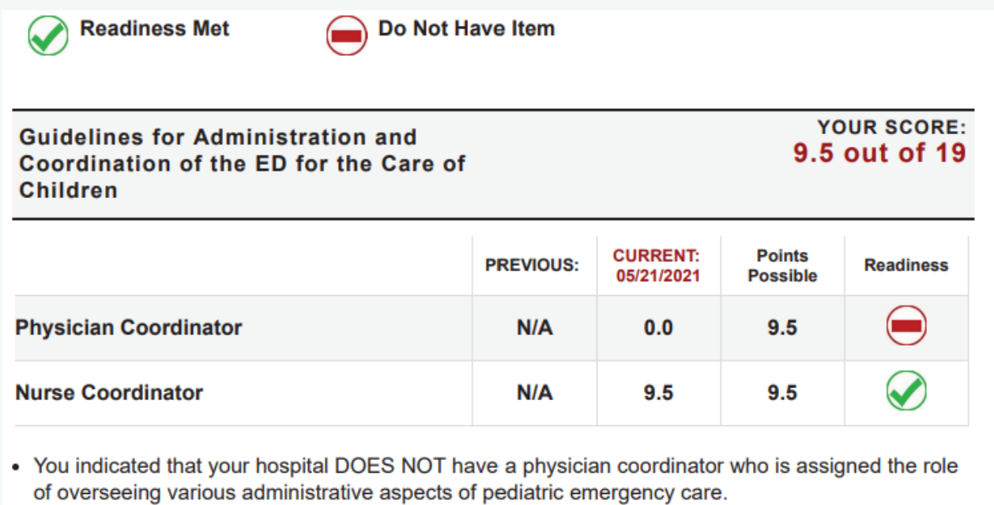
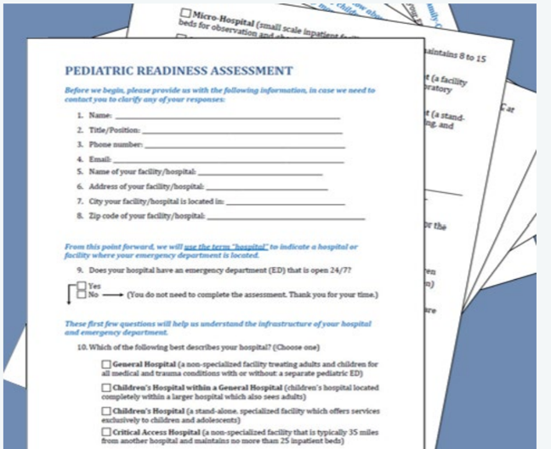
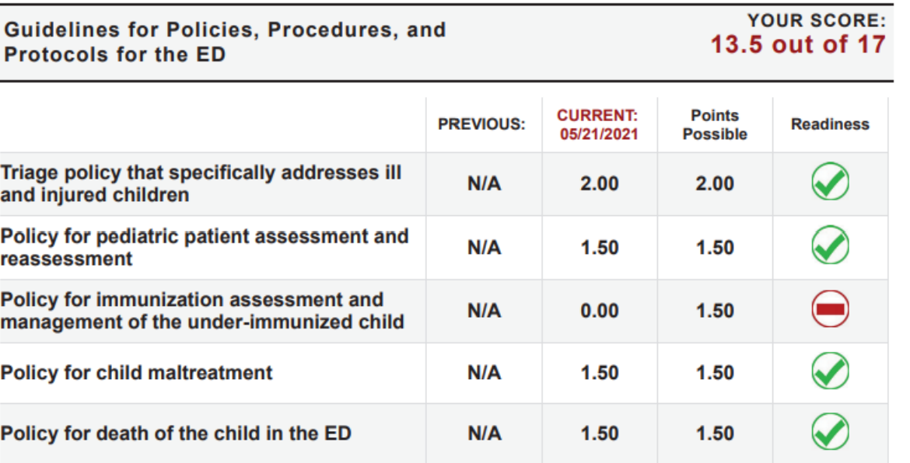
EMSC Pediatric Readiness Assessment

Slide 16
Pediatric Readiness Assessment
Administration
Coordination
Equipment Supplies
Care Team Competencies
Quality / Process
Improvement
Policy
Protocol
Support Services
Medication

Slide 17
Conducting an Internal Assessment
Interviews
Policy
Equipment
Data

Slide 18
Sample Gap Analysis
2022 Results | Scoring | Next Steps
Administration and Coordination of Care
Missing PECC – both physician and nurse | Zero points | Evaluate and implement PECC
Care Team Competencies
Competencies Missing – provider and nursing | Zero points | Competencies for pediatric population-specific triage, injuries and illness Age-specific competencies Peds Vitals, Pathophysiology
Quality and Process Improvement
Noted that there are no QI or PI initiatives that pertain to pediatrics | Partial scoring – some elements can be found | Steering Committee Identify data needs Create reports – track, trend, report
Guidelines for Policies, Procedures, and Protocols
Missing P&P for: Assessment and Reassessment of Pediatrics, Immunization assessment and management, and Death of the child in the ED | Partial scoring – some elements can be found | Search literature Collaborate with experts Create practice

Slide 19
Sample Gap Analysis
2022 Results | Scoring | Next Steps
Guidelines for Improving Pediatric Patient Safety
Weight is not recorded in kilograms only No procedure in place to notify physician(s) when abnormal pediatric vital signs are found | No points given | Opportunities around weight collection and documentation
Equipment, Supplies, and Medications for the Care of Patients in the ED
Missing airway management equipment and supplies. The following supplies are noted to be present now: Magill forceps 2.5 uncuffed ETT Non-Rebreather masks LMA 1.5-3 Tracheostomy tubes 3.0 and 3.5 Laryngoscope blades 00 and umbilical catheters | Partial scoring – some elements can be found | PECC Convene working teams to evaluate supply and equipment deficits

Slide 20
TSN Webinars
Break
Would you like personal follow-up?

Slide 21
“What comments/suggestions have the
ACS reviewers provided to centers they have
visited regarding Pediatric Readiness?”
Informal survey to learn about current experience
About 25 responses from trauma program leaders

Slide 22
How are reviewers assessing compliance?
Pediatric readiness discussed in more than half of site reviews
Reviewers are going by the book: “They just asked us if it was completed and what gaps we identified. I provided the information as well as the work we are doing to close the gaps.”
Remember, you do not need to close every gap: “Peds Readiness Survey identified OFIs, some were loop closed where others were not likely, i.e. MD/APP Medical Director for peds.”
At this point, there is some variation in approach: At one trauma center, the assessment was not completed, but reviewers noted it as an OFI and recommendation
Theme: If ED does assessment without input from trauma, may not be aware that many elements are in place

Slide 23
Roadmap for Compliance
All areas
Big Gains in Care
Small task
EMSC

Slide 24
Priority 1 – Administration & Coordination
Time
Qualifications
Responsibilities
Identify SME
Define job roles
Clinical growth
Quality
Continual assessment
Community partnership

Slide 25
Priority 2 – Care Team Competencies
Equipment Competency
Physical Assessment
Orientation & Knowledge
Build competencies
Triage education
Baseline certification
Simulation

Slide 26
Priority 3 – Quality & Process Improvement
Periodic Preparedness Checks
Gap Analysis
Benchmark
Quality Metrics

Slide 27
Diagnosis Related Codes
Top ED Presentations
Upper Respiratory Infections
Fever
Lacerations
Orthopedic– Fractures
Ear – Otitis
Vomiting
Flu
Behavioral
Substance Abuse
Bumps, Bruises, & Contusions
At Risk Visit Types
Acute Kidney Failure
Angioedema
Cardiac Arrest (1 year)
Hyperglycemia
Spontaneous Pneumothorax
Respiratory Failure
Tachypnea
Type 2 DM ketoacidosis
Tracheostomy Complication
Anaphylactic Shock

Slide 28
Priority 4 – Pediatric Policy
AI Algorithms
Reference Cards
Validated Tools
PEWS
Policy

Slide 29
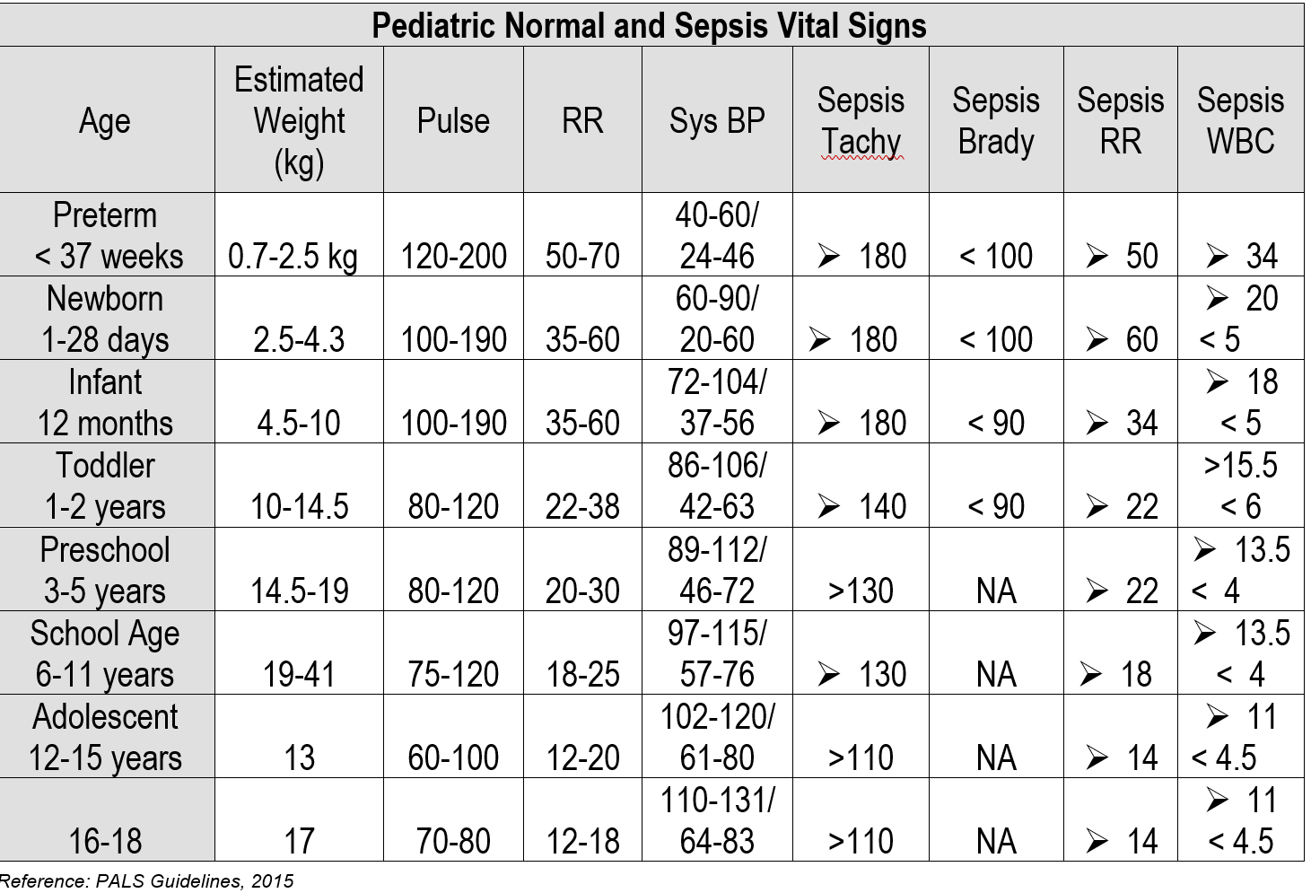
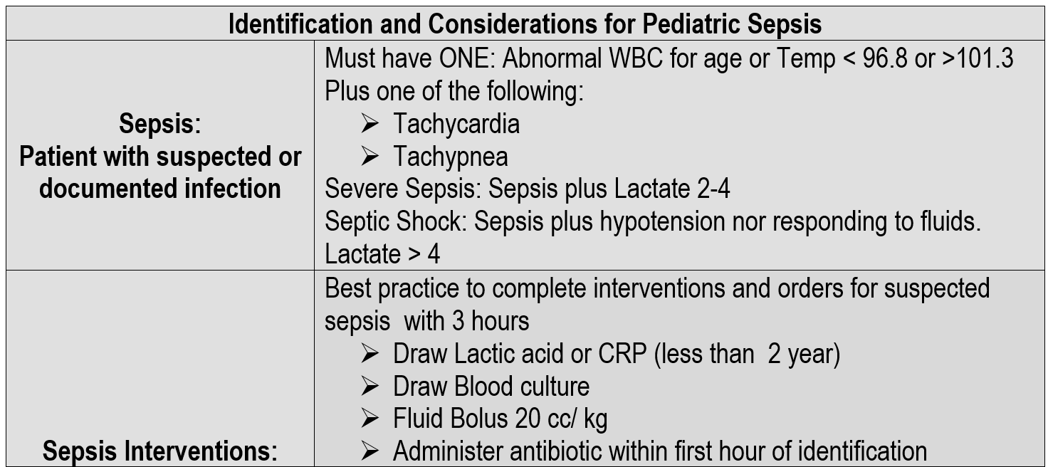
Vital Sign Reference
Vital Sign Reference: Connecticut Children’s Medical Center, Emergency Department

Slide 30
Priority 5 – Support Services
Radiologic Dosing
Pediatric Play
Ancillary Depts

Slide 31
Priority 6 – Medication Management
Electronic Health Records
Equipment
Weight Based Dosing

Slide 32
Priority 7 – Equipment & Supplies
Specialty Supplies
Trauma Center
Equipment

Slide 33
Getting Buy-In
Share results
Create teams
Resources
Reach out to experts

Slide 34
TSN Webinars
Your Questions
Click the Q&A icon

Slide 35
TSN Webinars
Thank You
Watch email tomorrow
Take exit survey

Slide 36
Resources
EMSC Innovation and Improvement Center WEBSITE
EMSC Innovation and Improvement Center National Pediatric Readiness Project WEBSITE
National Pediatric Readiness Project (NPRP) Assessment WEBSITE
Status of Pediatric Trauma System Development in the United States REPORT
A Novel Approach to Assessment of US Pediatric Trauma System Development PAPER
Other Resources for Addressing Deficiencies: The NPRP Checklist & Toolkit WEBSITE
National Pediatric Readiness Quality Initiative WEBSITE (comprehensive quality program for pediatric emergency care)
Pediatric Trauma Society WEBSITE (several resources, including a pediatric-specific MTP)
For information on EMSC Colorado, contact Nicolena Mitchell (also, visit Colorado Pediatric Preparedness for the ER (COPPER))
For information on EMSC North Dakota, contact Chettie Greer

