Slide 1
TSN Webinars
How Trauma Program Leaders Can
Work Effectively With Value Analysis to
Secure Approval for New Products

Slide 2
TSN Webinars
Webinar slides and replay
Links will arrive by email tomorrow

Slide 3
TSN Webinars
Melinda Case
Trauma Program Director
Palomar Health
Mark Copeland
Vice President of Sales
3T Medical Systems
Blake Havers
Key Account Manager
Aspen Medical Products

Slide 4
Defining Value: The TPM Perspective

Slide 5
Beyond Price: Aspects of Clinical Value
Length of stay
Patient safety
Patient compliance
Patient outcomes
Readmissions
Mortality
Staff safety
Staff ease-of-use

Slide 6
Trauma Program Manager Perspective
TPMs are clinical experts for vendors and should have a presence on — or access to — the hospital Values Analysis Committee
TPMs oversee a service line — broader scope for trauma patient population needs
Daily rounding on trauma patients helps to mitigate complications (for example, skin breakdown, HAPIs)
Knowing how well a product works for your patient population can help with soft costs: length of stay, patient comfort and compliance, staff knowledge in use and rationale
TPMs are responsible for monitoring PI and outcome measures — we have a vested interest in equipment and supplies purchased / examples:
Cervical collars/braces
REBOA
Clot formation dressings/MTP products

Slide 7
Making Your Case to Value Analysis

Slide 8
Brief History of Value Analysis
15 years ago (approximately)
Health systems began merging
Average size $3B annual purchasing ($8.2M per DAY)
Goals:
Centralize purchasing
Standardize product usage to maximize buying power
Apply best clinical practices across the system
Kaiser Permanente Model

Slide 9
Value Analysis Demystified
Value Analysis
Clinical Leadership
Economic Leadership
Quality
Risk Management
Stated Goal:
The best product for your patients at the best possible price

Slide 10
How to Perform a CBA
Never underestimate clinical benefit! (The patient is still #1)
Parallels to draw from:
Buying versus renting a house
Total cost of ownership of different cars
“If we buy it, what do we get out of it?”

Slide 11
How to Perform a CBA
Time IS money, but convert your time saved to $:
OR time: $50 per min / if product saves 10 minutes = $500
FTE: Full-time employee costs ________
Length of stay cost per day __________
What will you spend time doing that you couldn’t before? (opportunity cost)
If we spend $______ on _____, we will save $______ over ___ months/years.

Slide 12
How to Calculate ROI
Take your Cost Benefit statement
Example: If we spend $100,000 on this _______, but it shortens LOS by 1 day and we see 300 patients every year…
LOS = $1,500/day
300 x $1,500 = $450,000 annual reduction in episode of care costs
ROI at 1 year = 4.5x
Pays for itself at 67 patients, or about 2.6 months (ROI)

Slide 13
Value Analysis Case Study: VRTX

Slide 14
Value Analysis Priorities and Headwinds
Supply chain disruptions and backorders:
Importance of vetting vendors’ inventory status
Distributor vs. Manufacturer
Standardization vs. supplier diversity
Commodities vs. breakthrough technology
Waste/sustainability:
Packaging, transportation, etc.

Slide 15
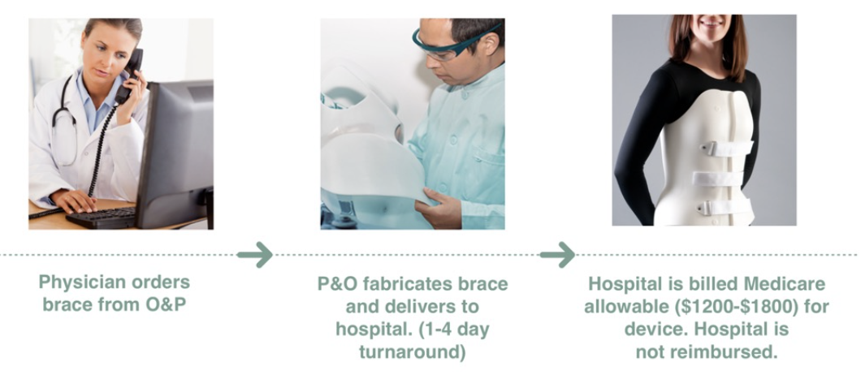
Case Study: The VRTX System
Standard practice/process for sourcing and application of lower spine orthoses

Slide 16
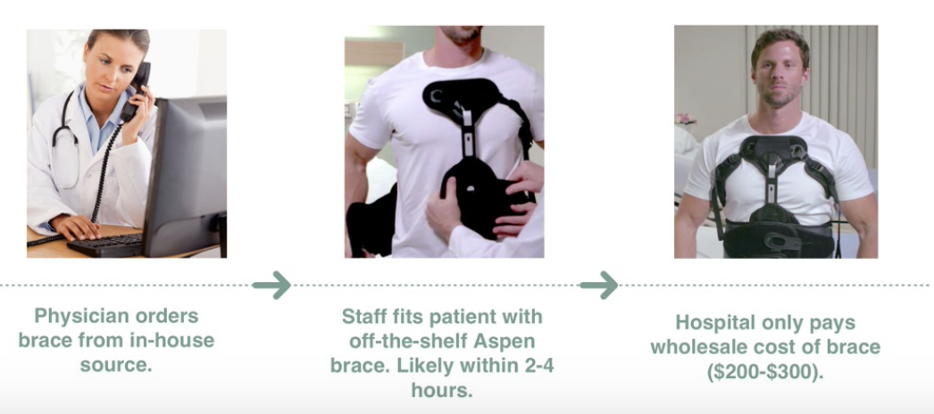
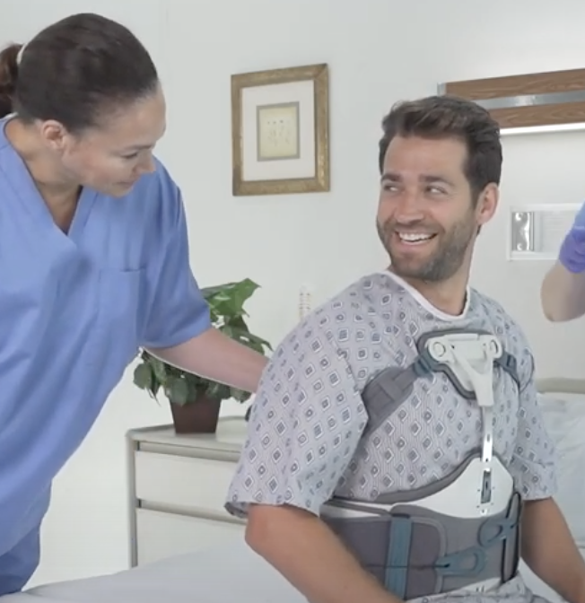
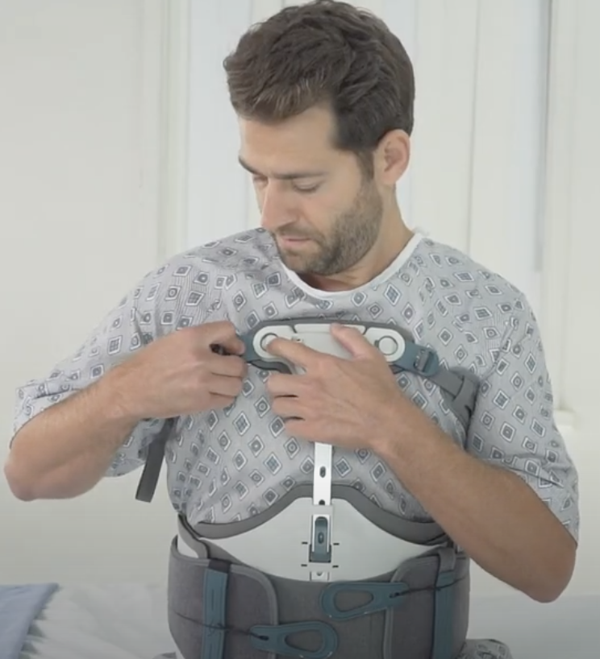
Case Study: The VRTX System
Opportunities for improvement when in-house staff manages process

Slide 17
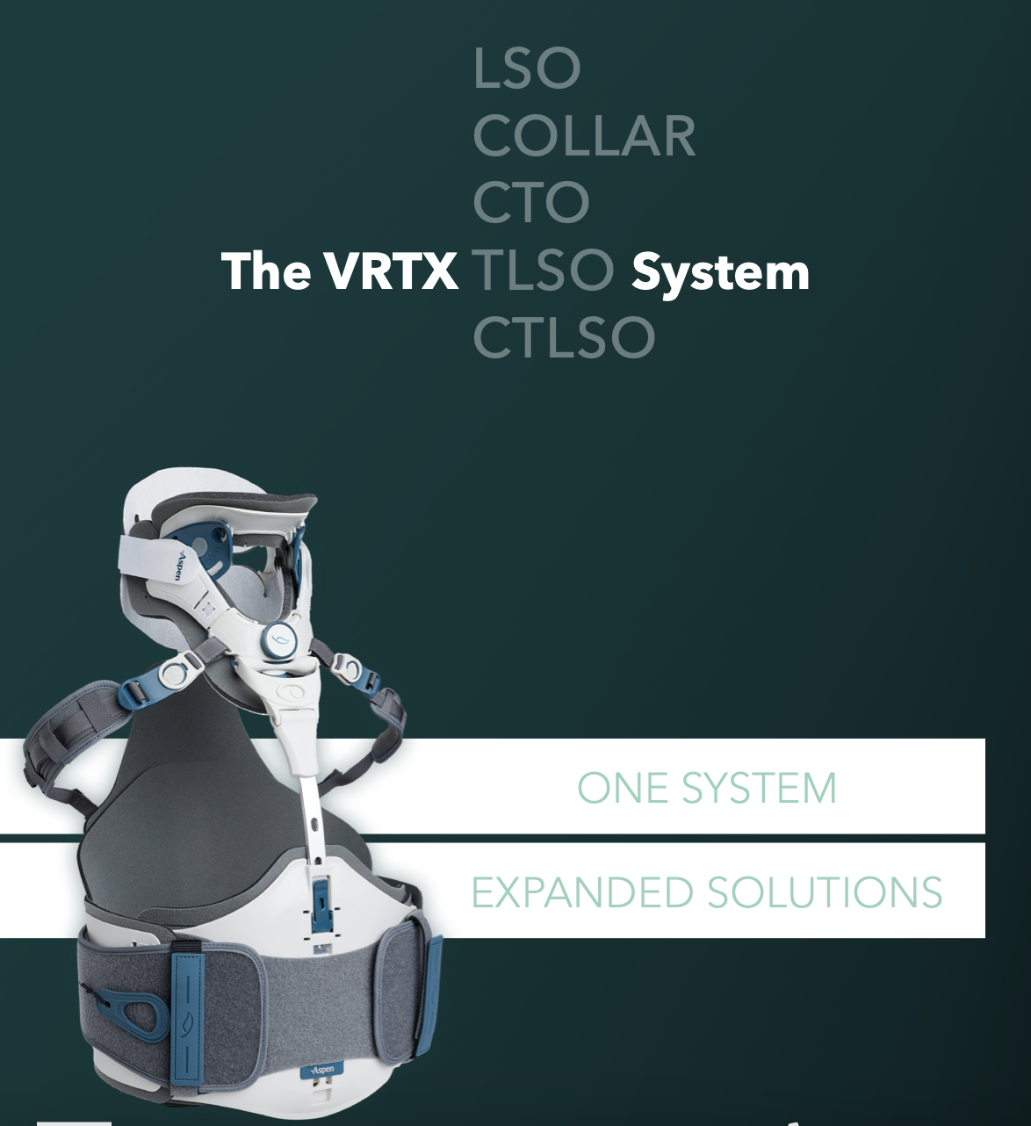
Case Study: The VRTX System
Clinical evidence:
S. Willey study
Quality improvements:
LOS and time to mobilize
Impact on staff:
Improved efficiency
Cost savings:
$200K-$500K for TC, $1M+ for entire IDN
Supply chain impact:
Current vendor, standardized pricing

Slide 18
TSN Webinars
Break
Would you like personal follow-up?

Slide 19
Pulling It All Together: The EBS

Slide 20
How to Create an EBS
Catch the Value Analysis Committee’s attention with
an Executive Business Summary (4 parts, 5-6 sentences)
Clinical situation
Economics (cost and financial improvements)
Additional Value Analysis KPIs affected (LOS, mortality, quality, etc.)
CBA/ROI

Slide 21
Sample EBS
Currently, average LOS for a defined trauma patient cohort is 4 days. (Clinical SITUATION)
A $100,000 investment in _________ allows our trauma team to maintain our high clinical standards while shortening LOS by 1 day, saving our health system $450,000 annually (ECONOMICS)
Our LOS is estimated to decrease from 4 to 3 days. (KPIs)
Morbidity and mortality will decrease by _____ (Value Analysis KPI)
Sepsis documentation will increase by _____% (Quality/Risk Management KPI)
We estimate a 4.5x return on the investment at 1 year and payoff of the investment at 2.6 months (CBA/ROI)

Slide 22
TSN Webinars
Your Questions
Click the Q&A icon

Slide 23
TSN Webinars
Thank You
Watch email tomorrow
Take exit survey

Slide 24
Resources
Association of Healthcare Value Analysis Professionals Website
VRTX: The First All-in-One Solution for Cervical to Sacrum Treatment Website
[VIDEO] How the VRTX System Differs from Custom CTLSOs Watch
[VIDEO] The VRTX System Application and Care Instruction Watch
Mark Copeland, Value Analysis Expert Website / Email

