Slide 1
Peregrine Award for Trauma Innovation
Profiles in Trauma Innovation:
Improving Trauma Data Quality and
Trauma System Collaboration

Slide 2
Peregrine Award for Trauma Innovation
Jessica Cofran
Trauma Service Line Director
CommonSpirit Health Mountain Region
2023 Peregrine Award for Trauma Innovation
Level I & II Trauma Centers Category
To learn more about last year’s winning PIPS Dictionary innovation, contact Jes at jessicacofran@centura.org

Slide 3
Peregrine Award for Trauma Innovation
Greg Bishop
President and Founder
Bishop + Associates
Sarah Spilman
Chief Operating Officer and Consultant
Bishop + Associates

Slide 4
2024 Peregrine Award for Trauma Innovation Level I & II Trauma Centers Category
Texas Health Presbyterian Hospital Dallas

Slide 5
Software to Identify Logical Inconsistencies in Trauma Registry Data
Jake Roden-Foreman

Slide 6
The problem
Our center uses all recommended data quality tools
Inter-rater reliability routinely >95%
Deep-dive before a verification visit revealed notable and widespread issues

Slide 7
Our innovation
Export registry data
Open program, select file(s)
Program applies logic checks
Program makes reports for each staff member
Staff review reports
Data corrected or issues overridden
A new, fully customizable software program to automatically detect potential data quality issues in registry data

Slide 8
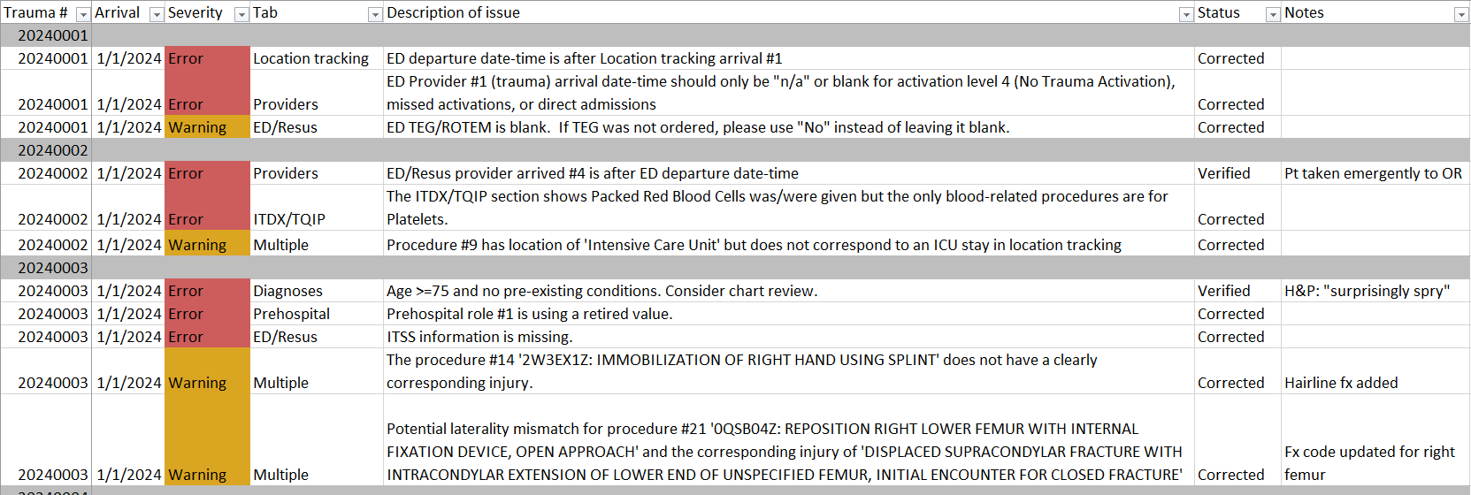
Sample data quality report

Slide 9
Individualized feedback
This type of issue is responsible for 15.7% of all issues for this person
Issue group | Frequency | Percent of issues | O:E ratio
Procedure start #X is before ED departure, but procedure location is not 'Emergency Department' | 19 | 15.70% | 2.5
Initial ED temp unknown. | 8 | 6.61% | 0.8
Admit service is "Trauma" but admitting physician is not one of the trauma docs. | 4 | 3.31% | 1
Procedure start #X is after ED departure, but procedure location is 'Emergency Department' | 3 | 2.48% | 0.26
There is an orthopedic consult urgency listed but no orthopedic surgeon listed as a provider, or vice versa. | 3 | 2.48% | 0.6
Multiple ICD10 unspecified codes | 2 | 1.65% | 0.48
This person has this type of issue about 40% less than other staff

Slide 10
Our program vs. existing registry checks
Both systems processed 63 cases submitted for ACS chart review (e.g., 10 neurosurgical injuries, 5 adverse events, etc.)
Our program found 47% more issues than the registry (225 vs. 153)
Among top 10 issues:
No overlap between systems
None of the registry’s issues were true issues

Slide 11
To access the paper, visit: https://journals.lww.com/journaloftraumanursing/abstract/2024/01000/pilot_study_of_a_software_application_to_identify.5.aspx

Slide 12
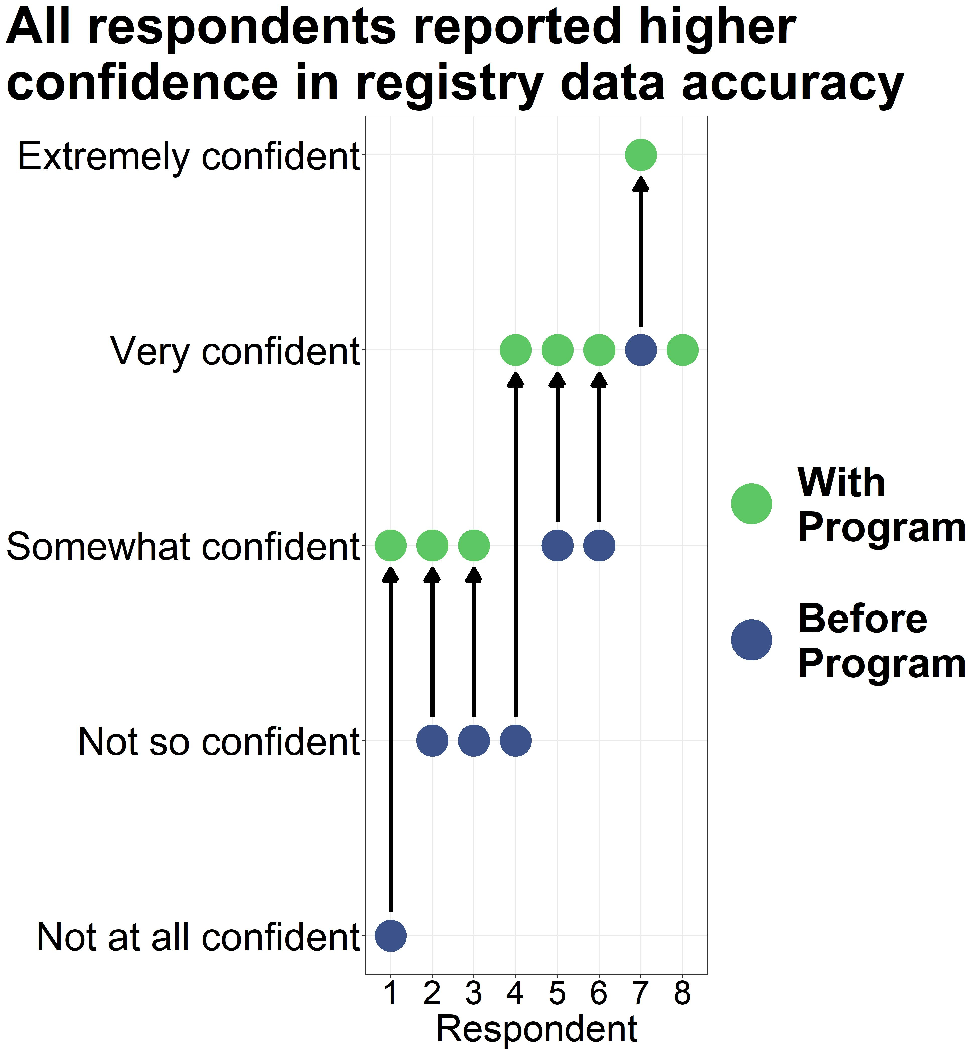
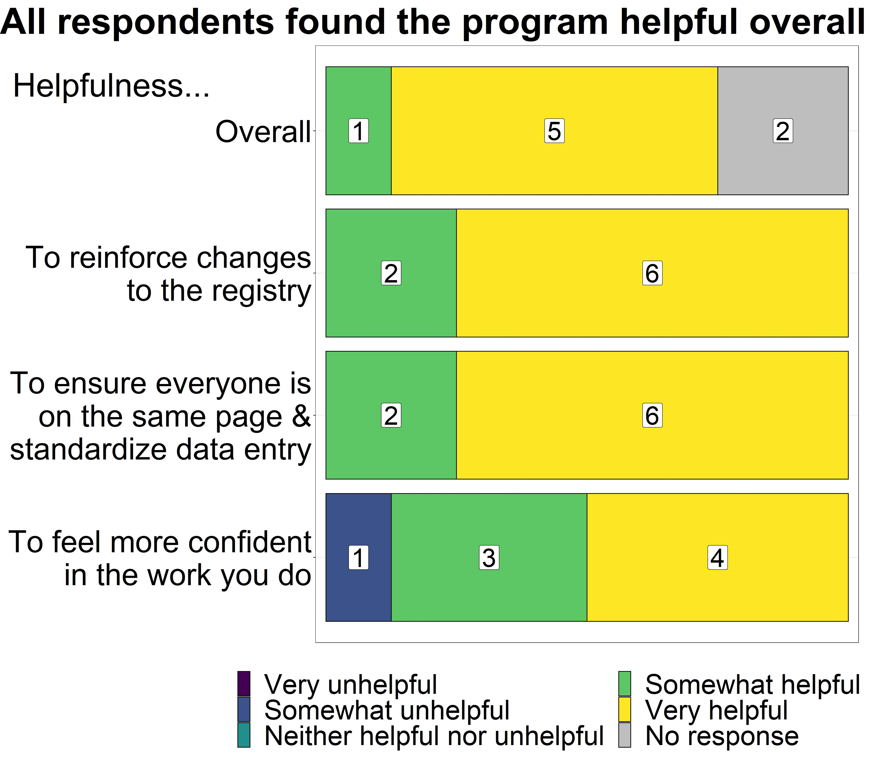
Staff satisfaction survey (8 of 10 responded)

Slide 13
Thank you
JacobRoden-Foreman@TexasHealth.org

Slide 14
2024 Peregrine Award for Trauma Innovation Level III, IV & V Trauma Centers Category
Montana State Trauma Care Committee

Slide 15
Montana Interfacility Blood network (MT IBN)
Alyssa B. Johnson MSN, RN, CEN, TCRN
State of Montana Trauma System Manager

Slide 16
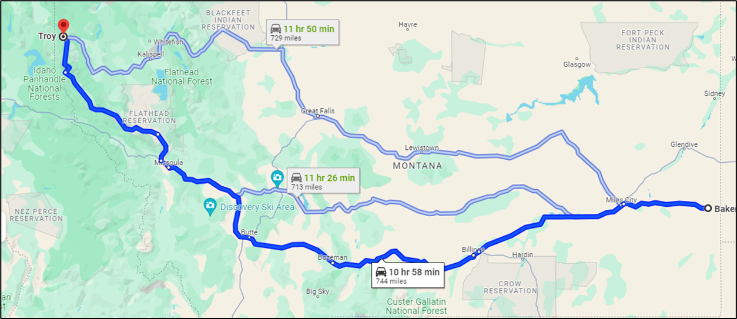
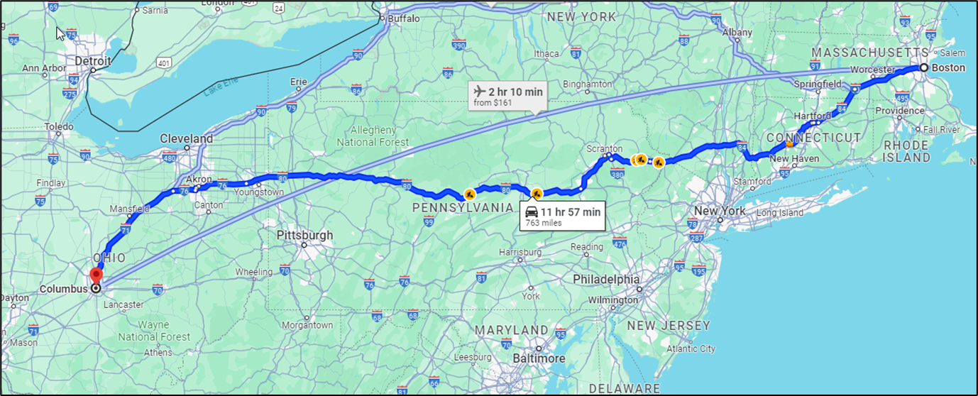
Troy, MT to Baker, MT
744 miles
Columbus, OH to Boston, MA
763 miles

Slide 17
Montana
147,040 square miles (Montana is slightly larger than Japan)
4th largest state and is the largest landlocked state.
Population: 1,104,271 (2020 Census).
The population density is 7.4 persons / square mile (avg. US 94/sq. mi) ranking the state as the 48th in population density in the United States, followed only by Wyoming and Alaska.
One city has a population over 100,000: Billings.
Three cities with populations over 50,000: Missoula, Great falls and Bozeman.
More than 80% of Montana's communities have populations less than 3,000 people.

Slide 18
At the time of this project: 41 state-designated trauma facilities (4 Regional Trauma Centers/ACS-verified level II, 3 Area Trauma Hospitals/ACS-verified level III, 11 Community Trauma Hospitals, and 23 Trauma Receiving Facilities).

Slide 19
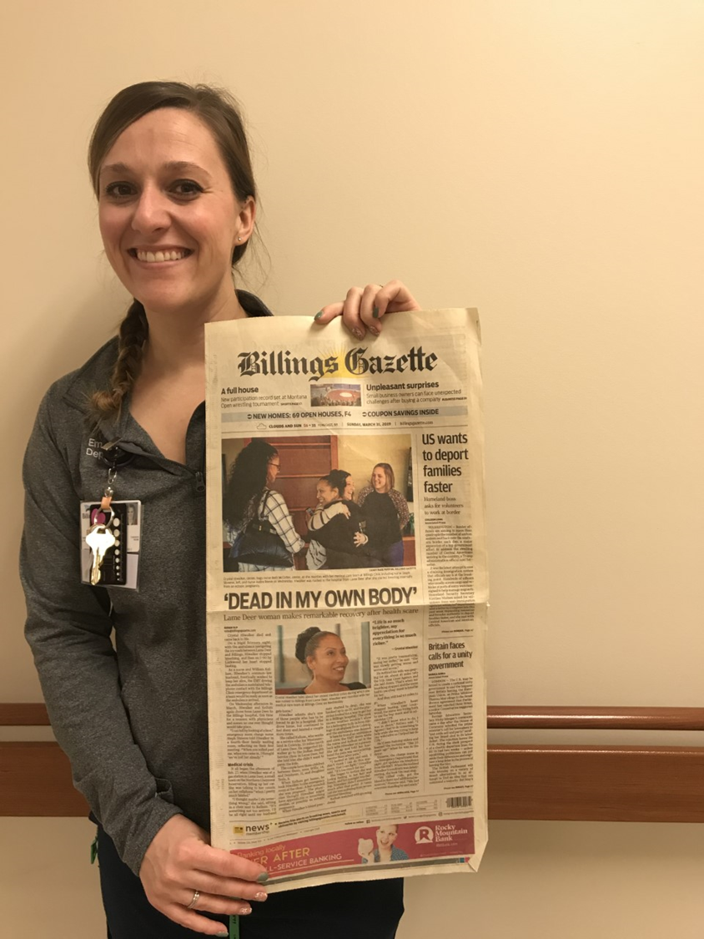
Initiation from an index case:

Slide 20
•

Slide 21
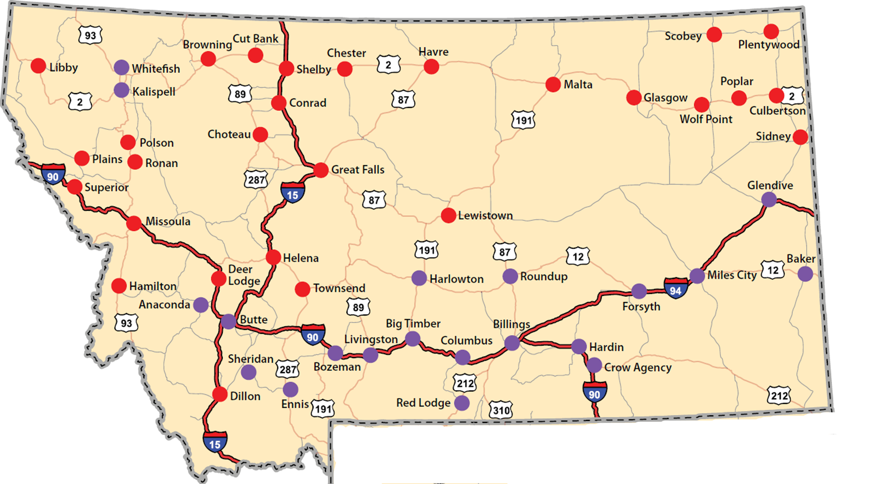
•

Slide 22
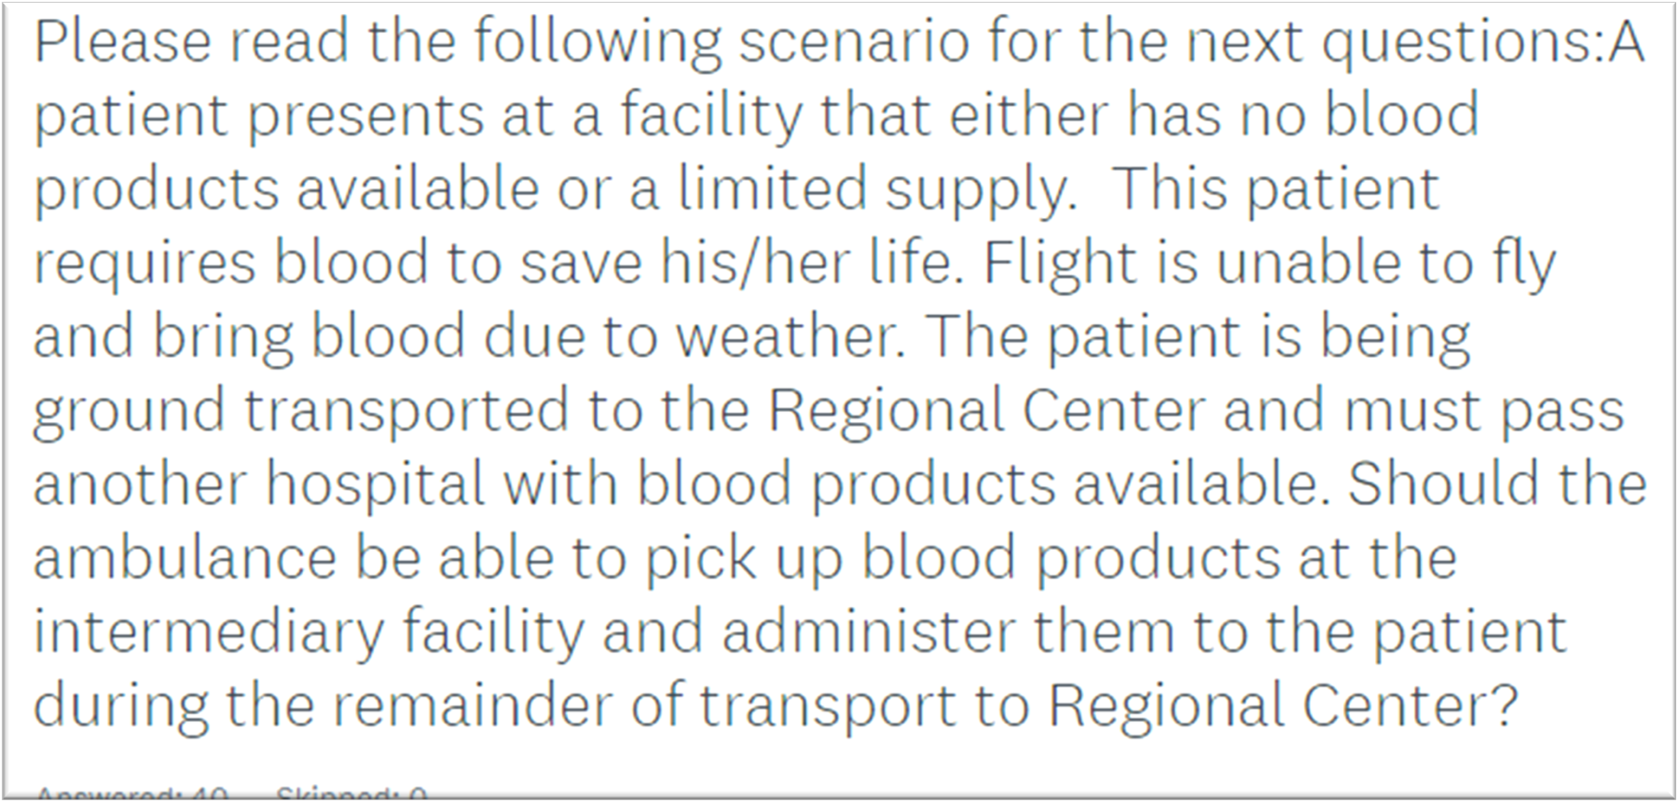
STCC Survey: January 2020

Slide 23
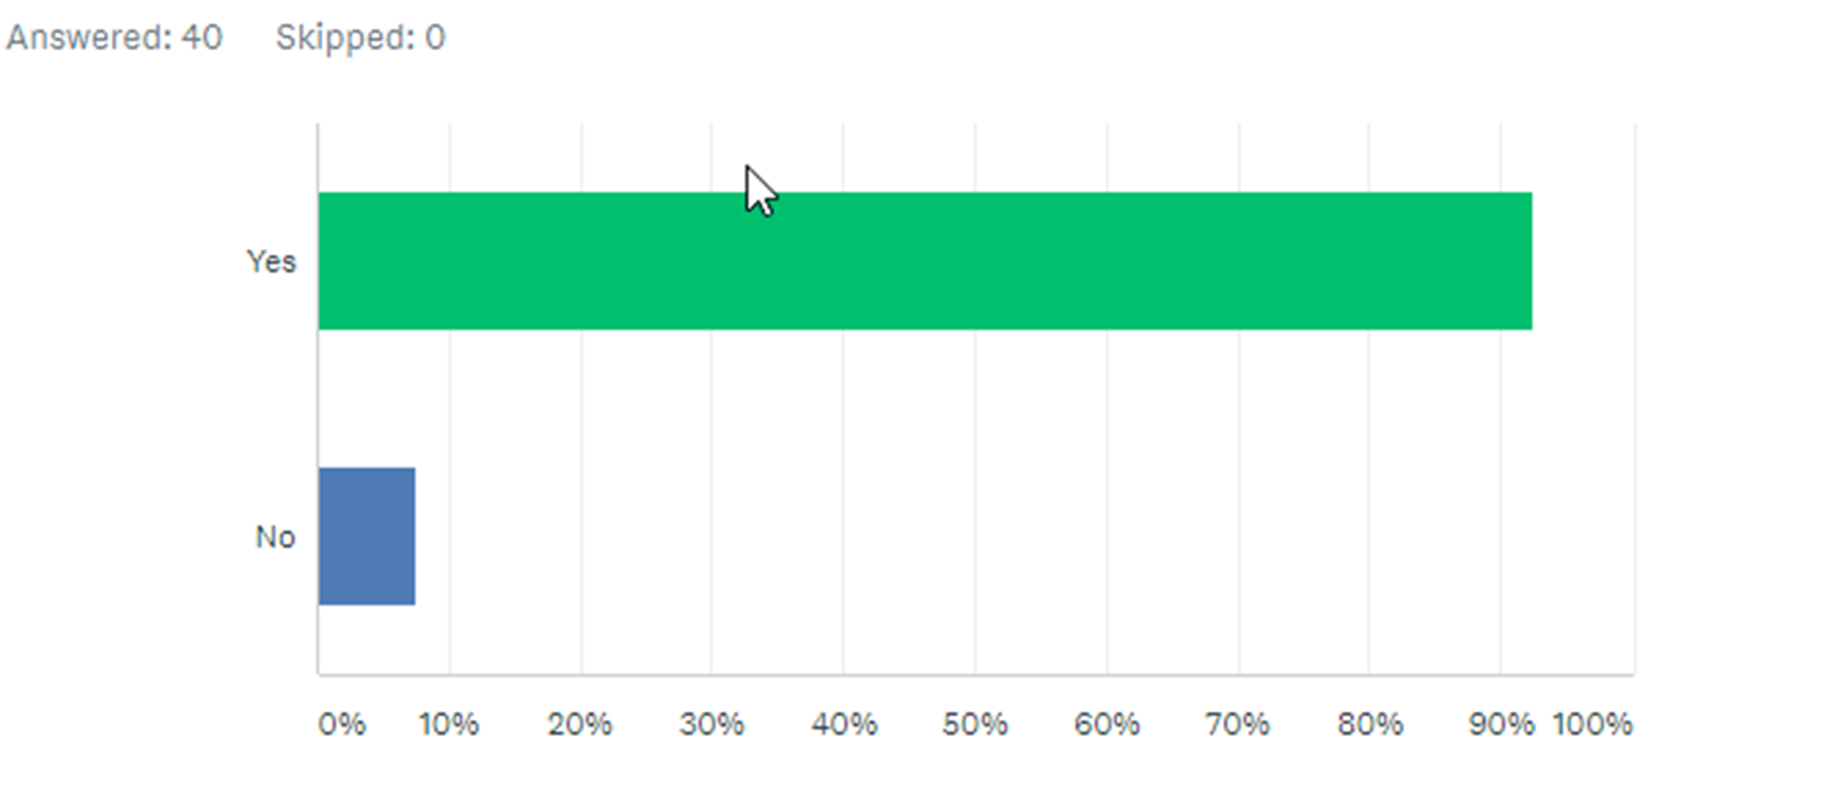
•

Slide 24
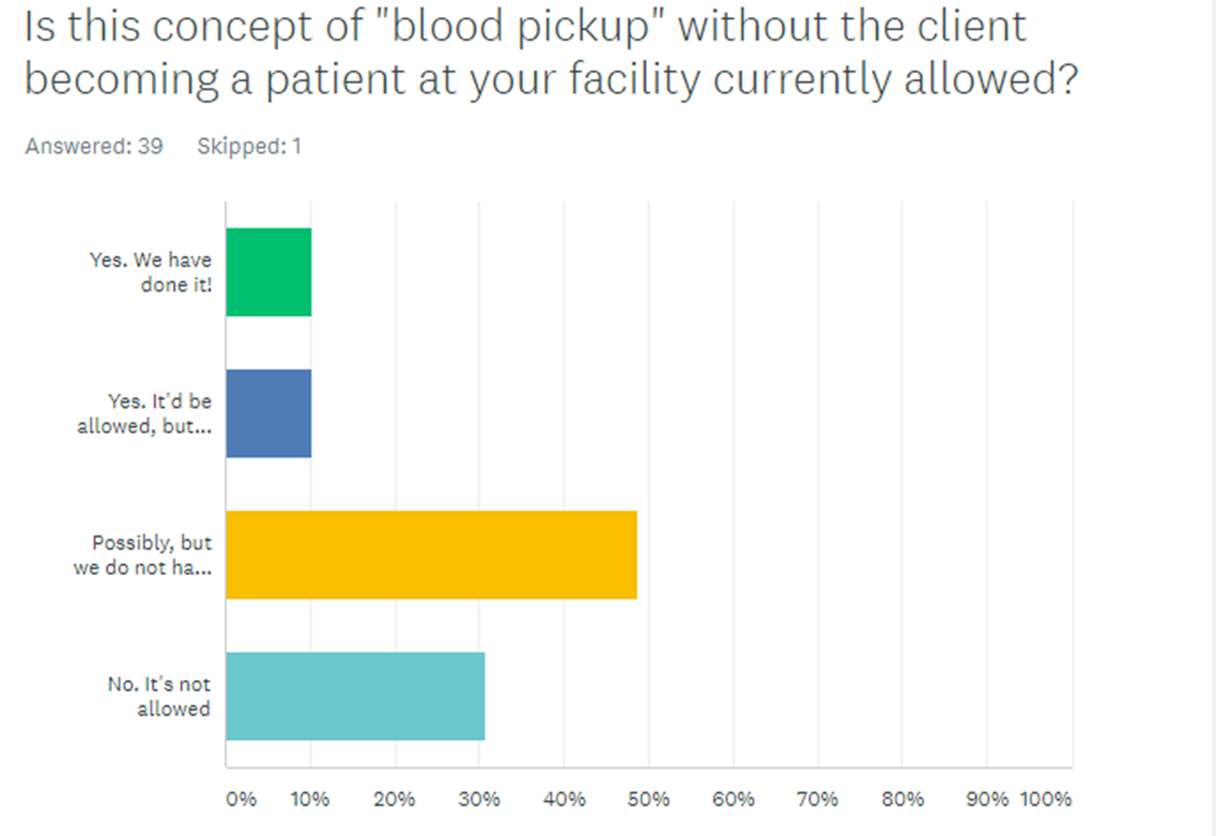
•

Slide 25
Guideline Development
Reason to share resource identified
Resource must be available
Proper packaging
Paperwork for transfer
Resupply and billing

Slide 26
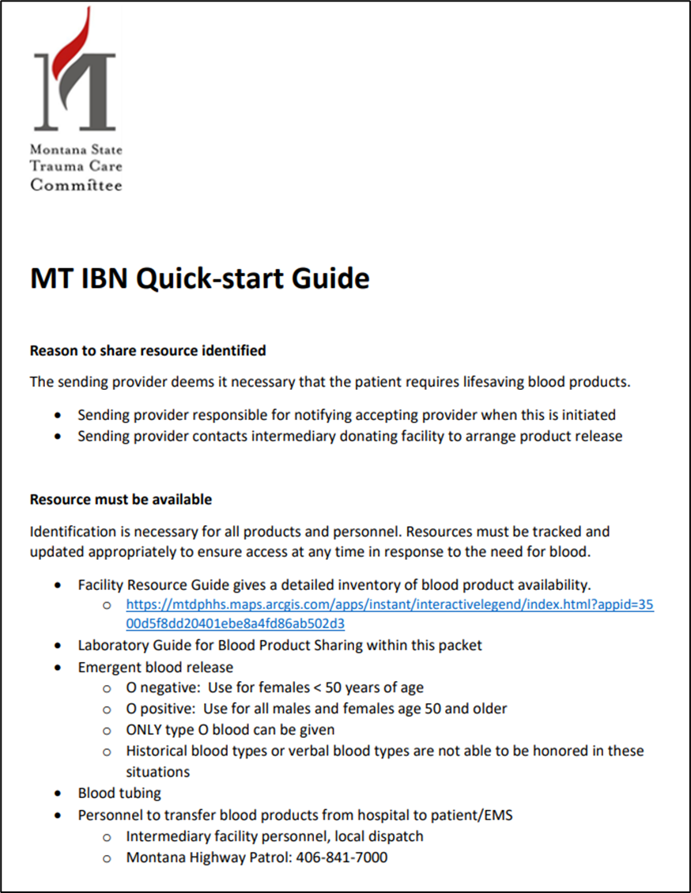
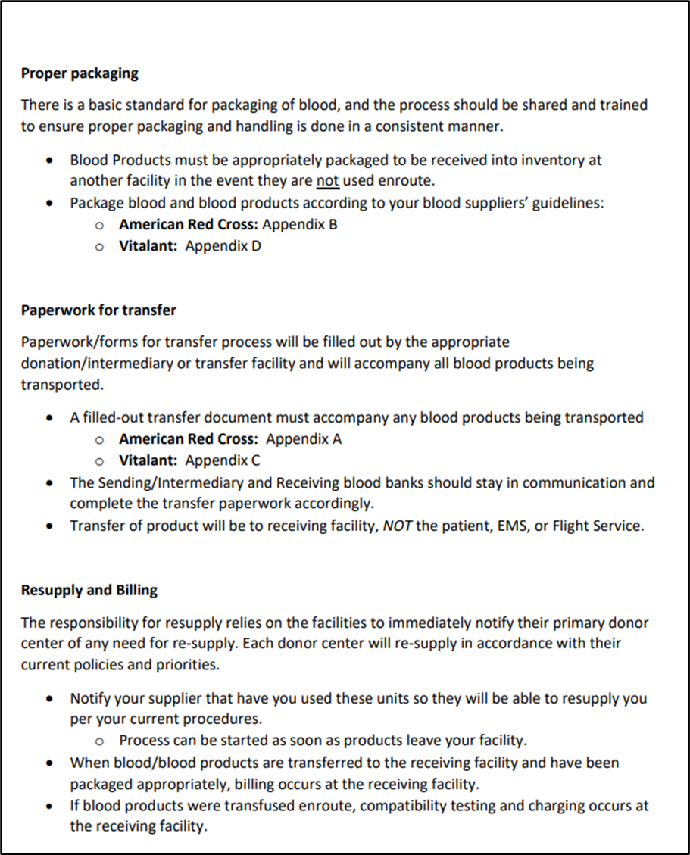
•

Slide 27
Emergent Release Blood
ONLY Type O blood can be given
Historical blood types or verbal blood types are not able to be honored in these situations

Slide 28
Emergent Release Blood
O negative
Use on females < 50 years of age
O positive
Use on all males
Use on females ≥ 50 years of age

Slide 29
Reason to Share Resource Identified
Sending provider determines necessity for “life-saving” blood products
Sending provider notifies accepting provider when initiated
Sending provider contacts intermediary facility to arrange product release

Slide 30
Resources Must Be Available
Standard supply and resources
Blood tubing
NS to flush
Qualified individuals to continue/initiate blood administration during transport
Paramedic, critical care paramedic, RN, medical provider

Slide 31
•
EMTALA?
No. Stopping for resource, not evaluation
Montana Highway Patrol, sheriff/local law enforcement available to handoff, if needed

Slide 32
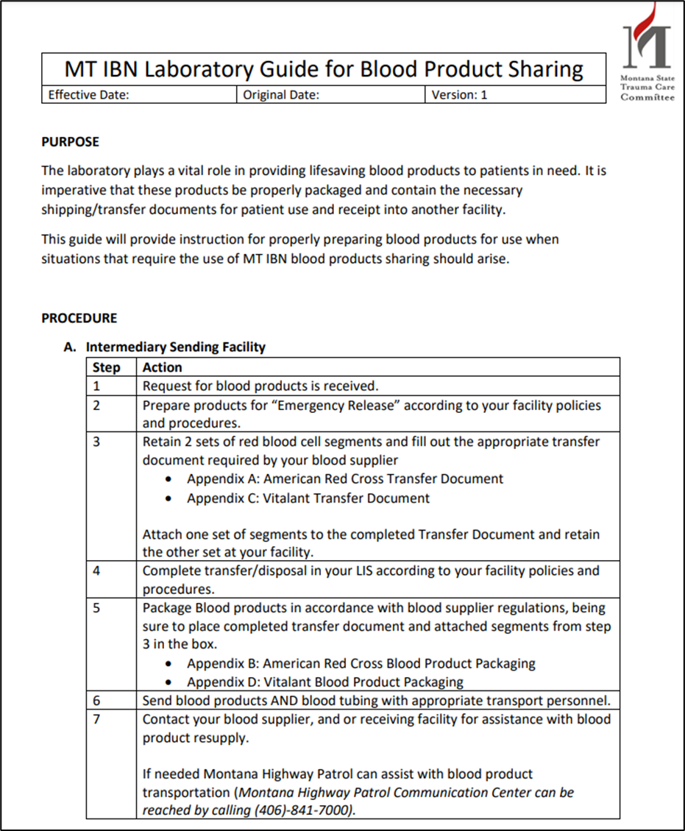
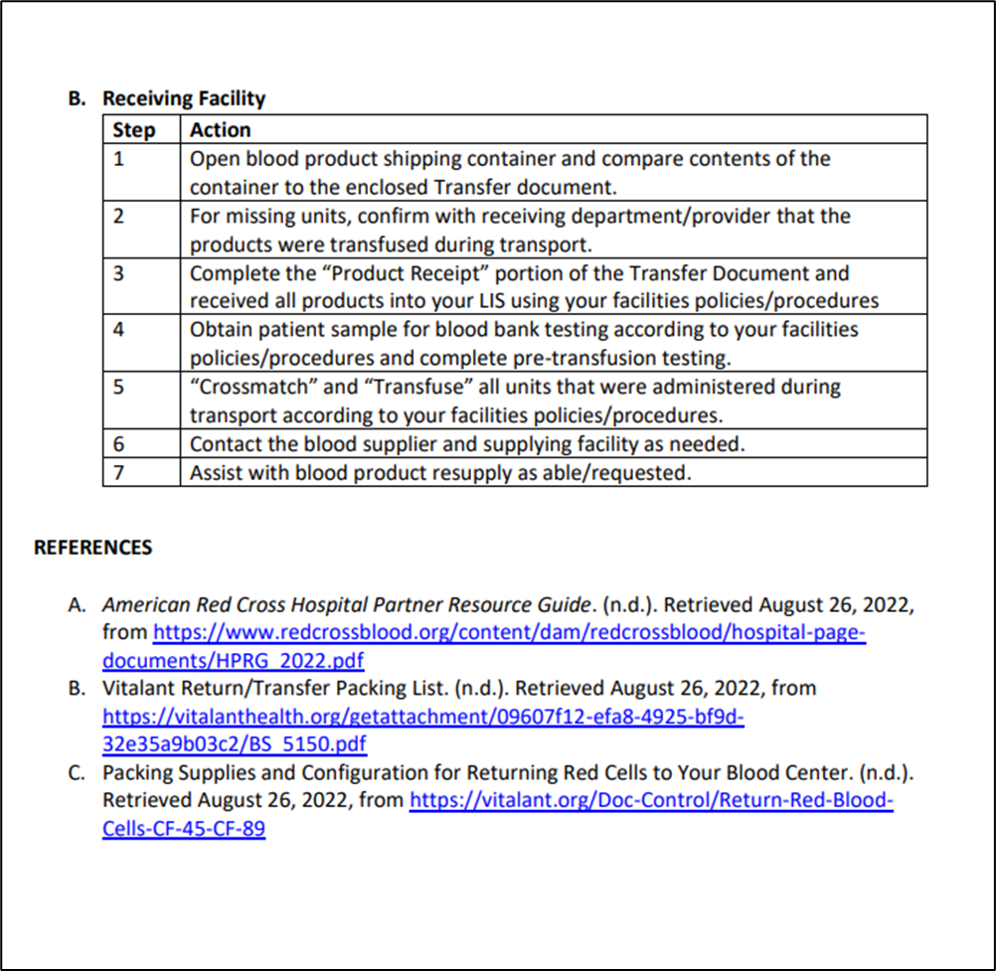
•

Slide 33
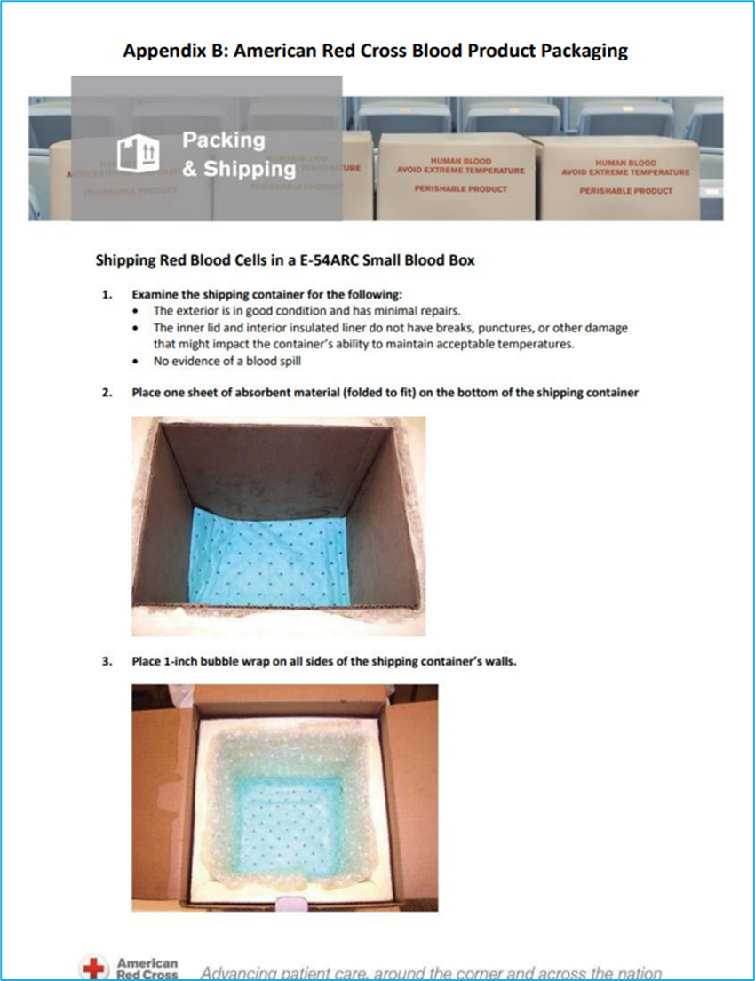
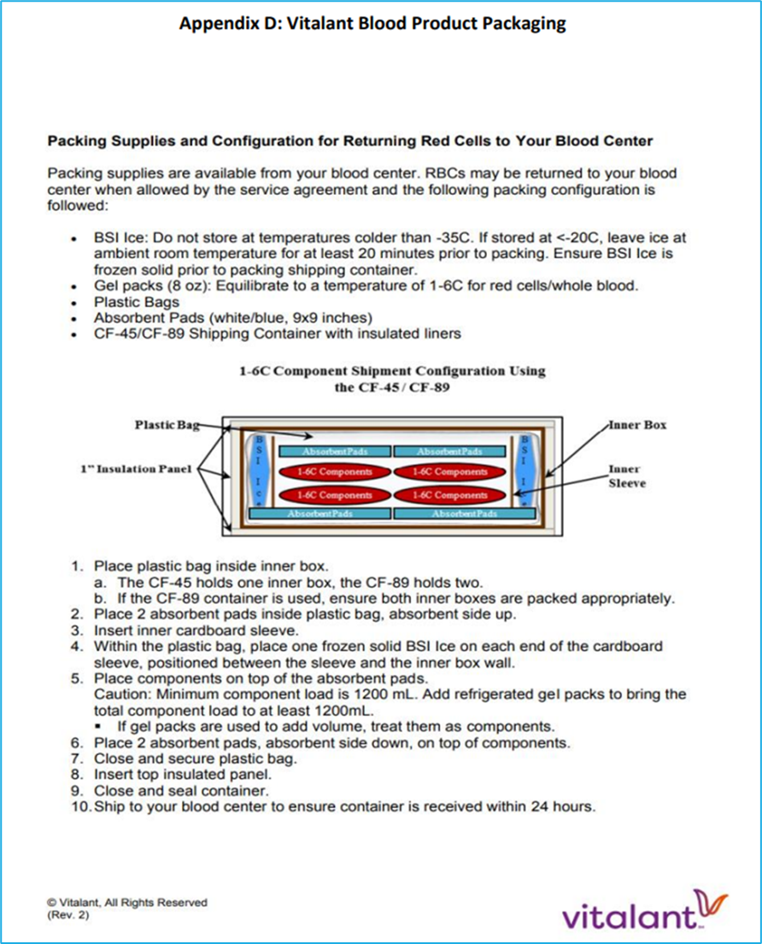
Proper Packaging of Blood Products
Basic standards of packing according to blood supplier’s guidelines:
American Red Cross
Must be appropriately packaged to be received into inventory at another facility if not used en route
Vitalant

Slide 34
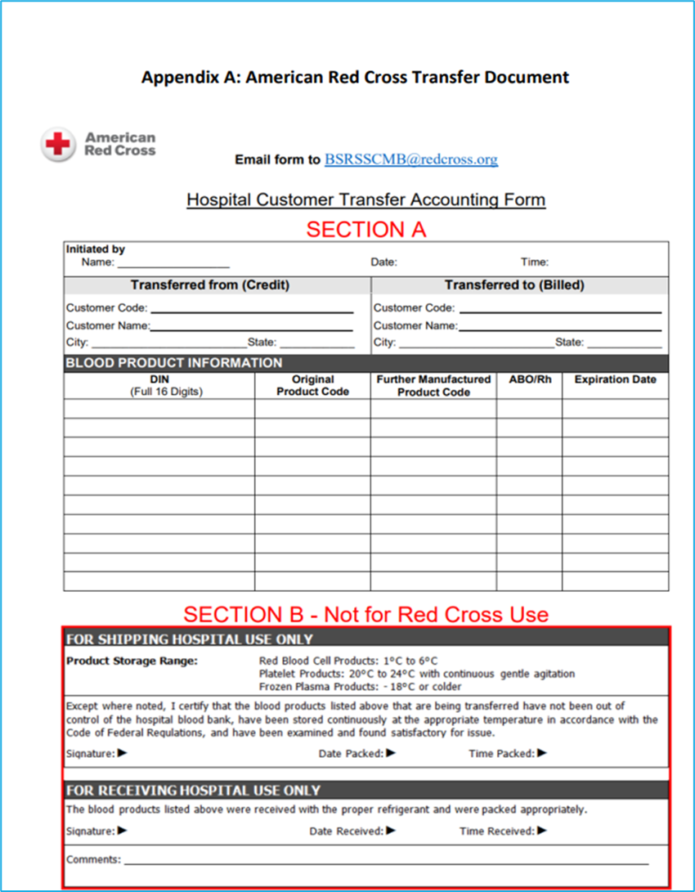
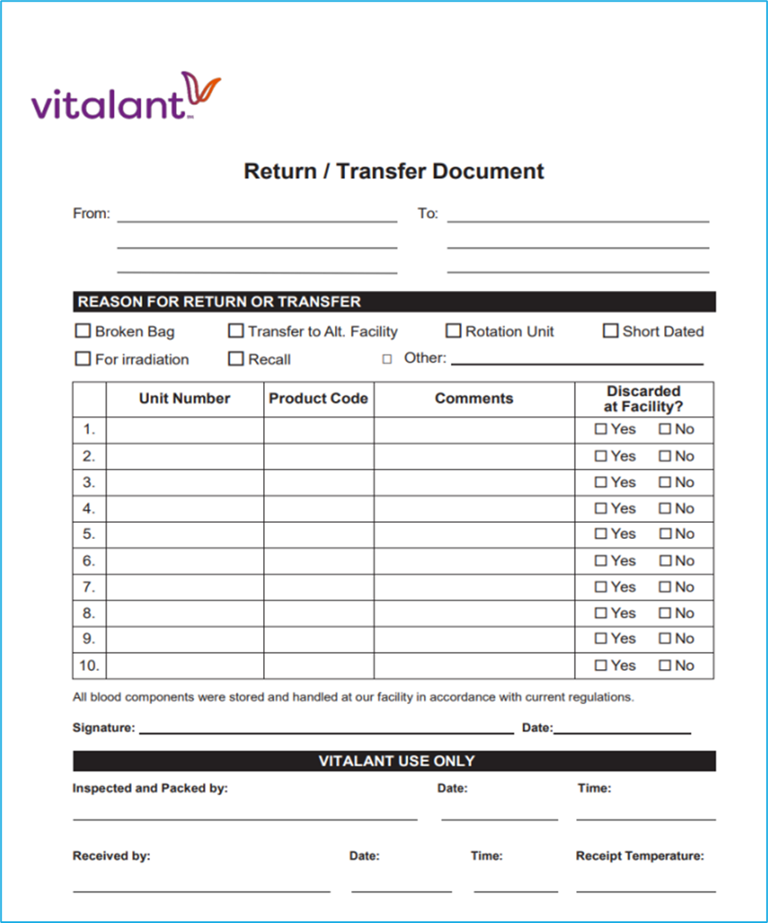
Paperwork Available for Transfer
Transfer document must accompany blood products (American Red Cross, Vitalant)
Imperative that Sending/Intermediary and Receiving blood banks stay in communication and complete transfer paperwork
Transfer will be to receiving facility, ie final patient location
Not patient, EMS, flight service, etc

Slide 35
Resupply & Billing
Responsibility for resupply relies on facilities to immediately notify their primary donor center.
Process can be started as soon as products leave facility.
When blood/blood products are transferred to the receiving facility and have been packaged appropriately, billing occurs at the receiving facility.
If blood products were transfused enroute, compatibility testing and charging occurs at the receiving facility.

Slide 36
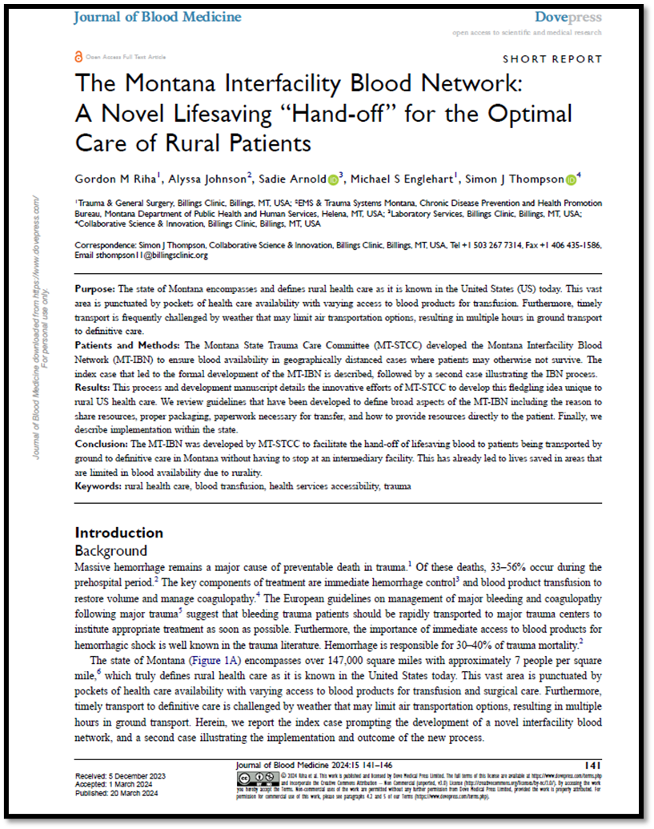
Implementation & Education
To access the paper, visit: https://www.dovepress.com/the-montana-interfacility-blood-network-a-novel-lifesaving-hand-off-fo-peer-reviewed-fulltext-article-JBM

Slide 37
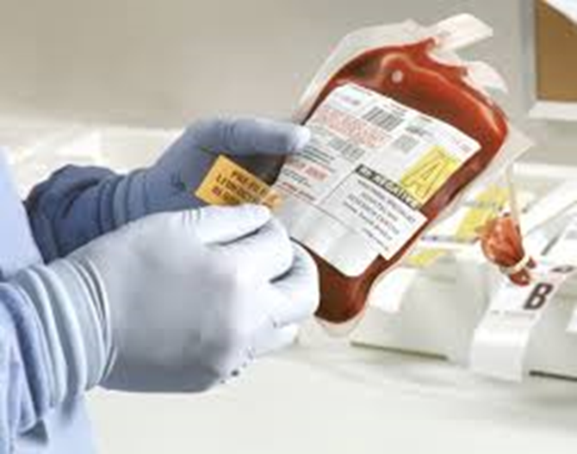
The MT IBN is an innovative concept that will ultimately save lives in a state dominated by vast distances between health care facilities.

Slide 38
Alyssa Johnson MSN, RN, CEN, TCRN alyssa.johnson@mt.gov 406-444-0752 https://dphhs.mt.gov/publichealth/emsts/trauma/educationresources
Thank you

Slide 39
Thank You to the Judges of the 2024 Peregrine Award for Trauma Innovation
Chris Cribari, MD, FACS
Medical Director Acute Care Surgery, UCHealth
Peter Fischer, MD, MS, NRP, FACS
Trauma Medical Director, Regional One Health
Elizabeth Freeman, BSN, MHA, RN, TCRN
Trauma Program Director, Atrium Health
Tim Murphy, MSN, RN, ACNP-BC, CEN, TCRN, FAEN
Trauma PI Coordinator, Robert Wood Johnson University Hospital
Melissa Sorensen, BS, MSN, RN, CEN, CSTR, CPHQ
Corporate Trauma Registry Manager, Mountain Division, CommonSpirit Health

Slide 40
2024 Trauma Innovation Special Report
June 2024 issue of TSN
Award winners
All semifinalists
In your email on June 10
Subscribe at trauma-news.com

