Slide 1
TSN Webinars
How to Build a High-Performance Trauma Registry Team

Slide 2
TSN Webinars
Pre-Broadcast Poll
How many FTEs are dedicated to your trauma registry?
1 | 18%
2 or 3 | 32%
4 or 5 | 22%
6 or more | 30%
Is your trauma registry team on-site, remote or hybrid?
Almost completely on-site | 29%
Hybrid mix of on-site and remote | 33%
Almost completely remote | 38%
What is your registry's average days to chart completion?
20 days or less | 26%
21 to 40 days | 24%
41 to 60 days | 41%
> 60 days | 9%
200 responses
192 responses
(Totals exceed 100% due to rounding)
196 responses

Slide 3
TSN Webinars
Jodi Greenwood RN, BSN, TCRN, CSTR, CAISS
Trauma Performance Improvement Coordinator
Intermountain Health St. Mary’s Regional Hospital
Norrie Bradley RN, BSN
Trauma Program Manager, Trauma Providers
CoxHealth

Slide 4
3 Day to Completion
August 21, 2024
Jodi Greenwood, BSN, RN, TCRN, CSTR, CAISS.
Trauma PI Coordinator

Slide 5
St. Mary’s Regional Hospital
Grand Junction, CO

Slide 6
Level II
ACS verified since 1992
State of Colorado designated since 1999

Slide 7
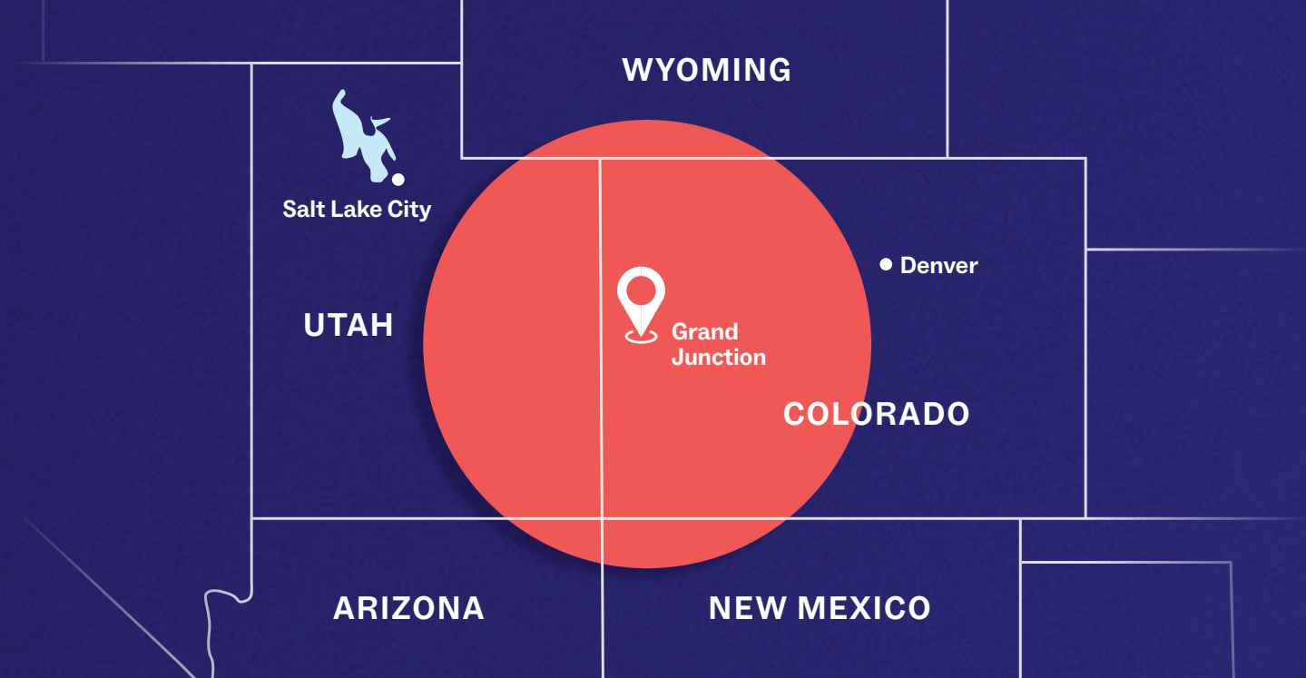

Slide 8
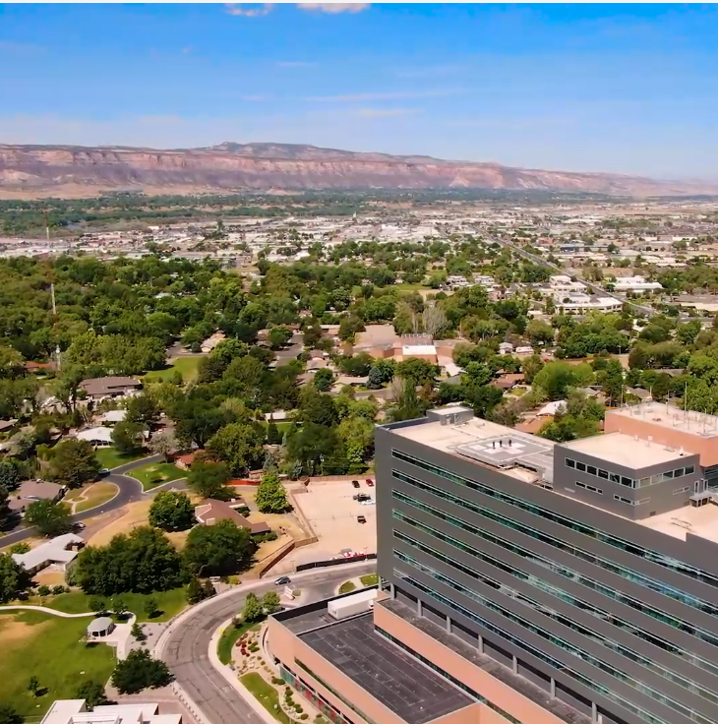
Our hospital
346 Licensed Beds, 33 in ED
42K ED Visits
1,615 Registry Events
1,446 Trauma Admissions
383 with ISS >15

Slide 9
2019
Greater than
60 days to completion
100% turnover during the year
Dec – 2 FTE RN Registrars (one new, one adapted)
New Registry Sept 2019 – ImageTrend State Platform
NTDS events: 1,303

Slide 10
Facility Inclusion Criteria

Slide 11
2020
40 days
100% Remote starting March 17 – COVID
How do we support each other?
What tools do we need?
NTDS inclusion: 1,351

Slide 12
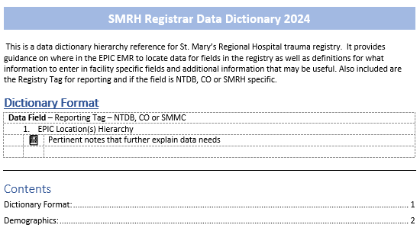
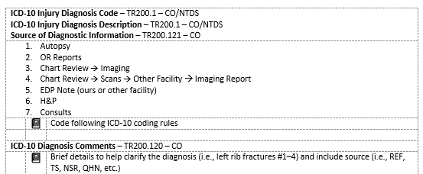
Facility Data Dictionary

Slide 13
2021
60 days
Rumors of change to ACS registrar FTE ratio
AND
The ratio would apply to all registry entries, not just NTDS
NTDS inclusion: 1,272

Slide 14
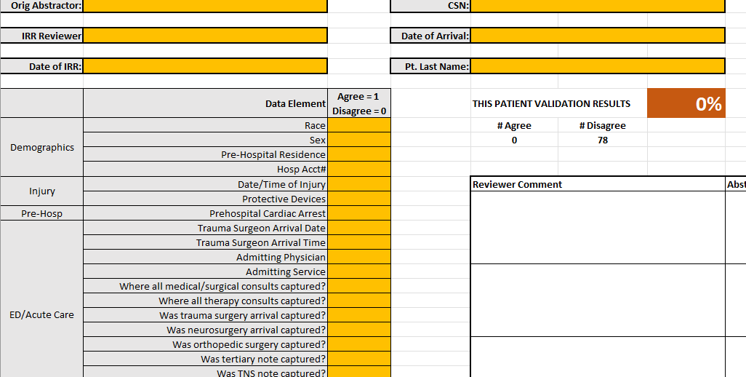
Update to IRR

Slide 15
2022
33 days
March 2022 – Grey Book, 4.31 at least 0.5 FTE per 200-300 annual patient entries. Entries defined as all patients who meet NTDS inclusion, and hospital, local, regional and state.
Noticed from TQIP benchmarking reviews that we had opportunity to improve in pre-existing conditions capture and hospital event validation.
Total registry: 1,511 / NTDS inclusion: 1,353

Slide 16
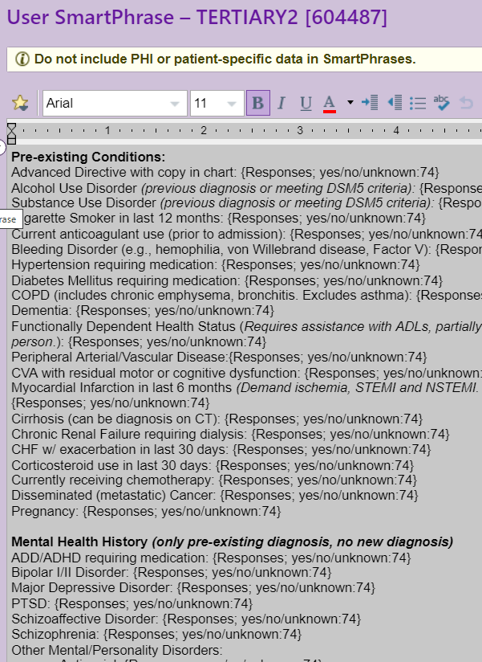
Pre- Existing Conditions

Slide 17
2023
29 days
Priority abstraction – initial data points for reporting and PI cases
EPIC chats for real-time question clarification with team
Weekly huddle for questions, IRR feedback review
Total registry: 1,616 / NTDS inclusion: 1,488

Slide 18
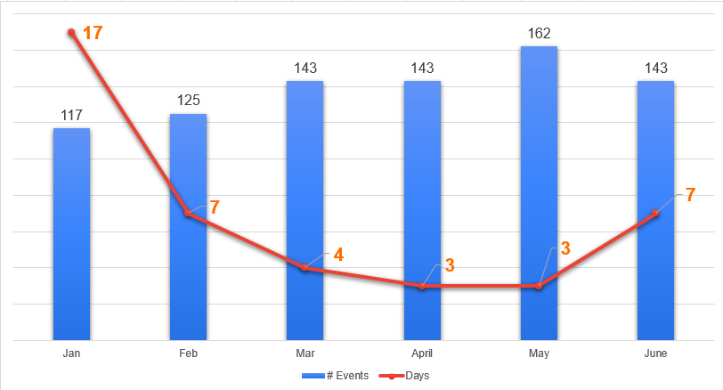
2024 Average Days to Completion
3!

Slide 19
2024 (Jan – June)
7 days
Stated a weekly goal for # of charts completed in Jan
Formally challenged registrars to 15-day completion goal in Feb
Transitioned to 1 person reviewing census, event creation and initial priority field entry
Coding through diagnosis / procedures prior to discharge
Total registry: 833 / NTDS inclusion: 777

Slide 20
2024 Average Days to Completion
3!

Slide 21
Key factors in how we got here:
Getting/keeping FTEs, leadership support
Facility data dictionary with EMR hierarchy
Registrar on-boarding process, retention
PI cases priority abstraction, increased turnaround
Focus on last month, shared work list
Weekly huddle for questions, IRR feedback review
Pre-existing conditions template added to tertiary note
Flexible 40 remote registrars, retention/satisfaction
1 registrar reviewing census, incident creation and initial priority field entry

Slide 22
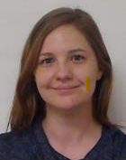
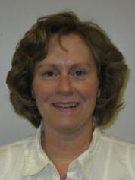
The Team:
Nona
Laura
Sarah

Slide 23
Thank you! Jodi.Greenwood@imail.org 970-298-2022

Slide 24
TSN Webinars
Break

Slide 25
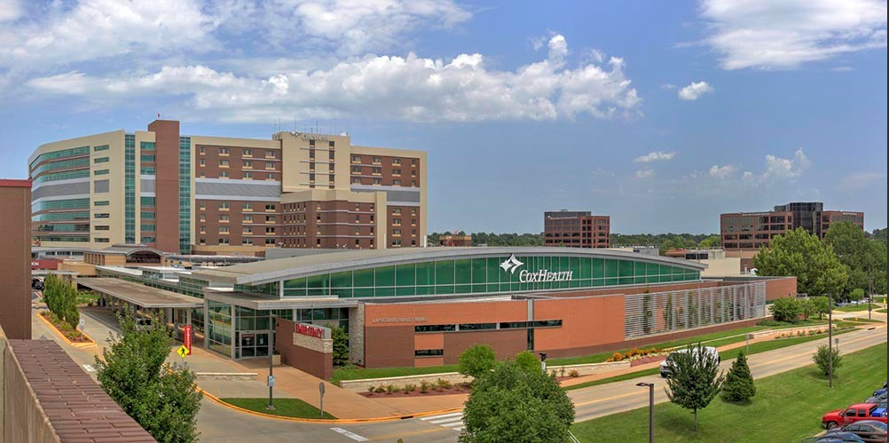
CoxHealth
Level 1 Trauma Center
Springfield, MO
Norrie Bradley, RN, BSN
Trauma Program Manager

Slide 26
Introduction
Every trauma registry has to develop a system of data entry that meets regulatory standards

Slide 27
Trauma Registry
5 FT
2 PT
2 PRN
> 100 audit filters
CY 2023: 4,458 patients placed in registry
Lori H.
Christi K.
Deidre B.
Karen C.
Laken D.
Vicky R.
Nita B.
Jen B.
Ashley G.

Slide 28
Trauma Program
Program Manager
Registry
Process Improvement
Educator
Outreach
Injury Prevention
Nurse Clinicians
Research

Slide 29
Importance of
Trauma Registries
Process Improvement
Submission/Regulation
Research Projects
Billing
Education
Injury Prevention

Slide 30
Old way:
Rotational chart assignment as each patient was activated
“Chasing a carrot on the treadmill that was not slowing down”
“Every-man-for-himself”
Stressful when approaching vacation

Slide 31
The idea:
Step 1
Split registry staff into Team 1 and Team 2
Assign specific tasks
Step 2
Assign Team Coordinator
Direct and support the rest of the assigned Team

Slide 32
Registry Teams
Team 1
Team 2
Goal: Always have 3 people on this team
Rotate weekly
Friday-Thursday
Create Entry
Chart Completion
Assign Trauma #
Create entry with initial data and billing
Request data from outside agencies
Chart closure
Picks up where initial data ends
Ensure compliance
Anyone on vacation part
of the week?
Goes to Team 2

Slide 33
Goals:
Initial data completed within 7 days (needed for a research project)
Improve work-life balance
Accommodate vacations easily
Rotate so not one person is stuck doing initial data the rest of their life

Slide 34
Trauma Teams Timeline
March 2023
Trauma Services initial data entry Teams proposal.
July 2023
Registrars meet with TPM to discuss and establish roles, Team 1 and Team 2.
August 2023
The registrars met to review and modify team duties based on recent cases and chart closure needs.

Slide 35
Outcomes

Slide 37
Outcomes
September 2023
TQIP and State submissions. Charts closed ahead of schedule, no charts closed more than 60 days.
During data collection, chart-closure productivity improved by an average of 5 days from Q1 2023 to Q3 2023.
Additionally, the rate of charts closed after 60 days fell from 7.4% to 0.51% despite an increase of 94 charts in Q3 over Q1.

Slide 38
Outcomes
Pros
Cons
Teamwork
Clear communication
Improved reported work-life balance
Chart closure productivity improved
Initial data within 7 day
Multiple people in charts
Difficulty tracking individual chart accuracy
Staffing changes
New hires, PRN

Slide 39
Future Goals
IRR
Implementing IRR process with modifications
Modify
Modifying current team structure based on census and staffing
Continue
To strive for work-life balance for all registry professionals

Slide 40
Resources Needed:
Enthusiasm
Flexibility
Time
Staffing
Willingness for Change
Investment

Slide 41
Thank you.
Norrie Bradley, RN, BSN
Trauma Program Manager, CoxHealth Level 1 Trauma Center
Norrie.Bradley@CoxHealth.com

Slide 42
TSN Webinars
Thank You

